Slide 1

Geoscientific Data Warehouse (GDW)
Overview and demonstration

Slide 2
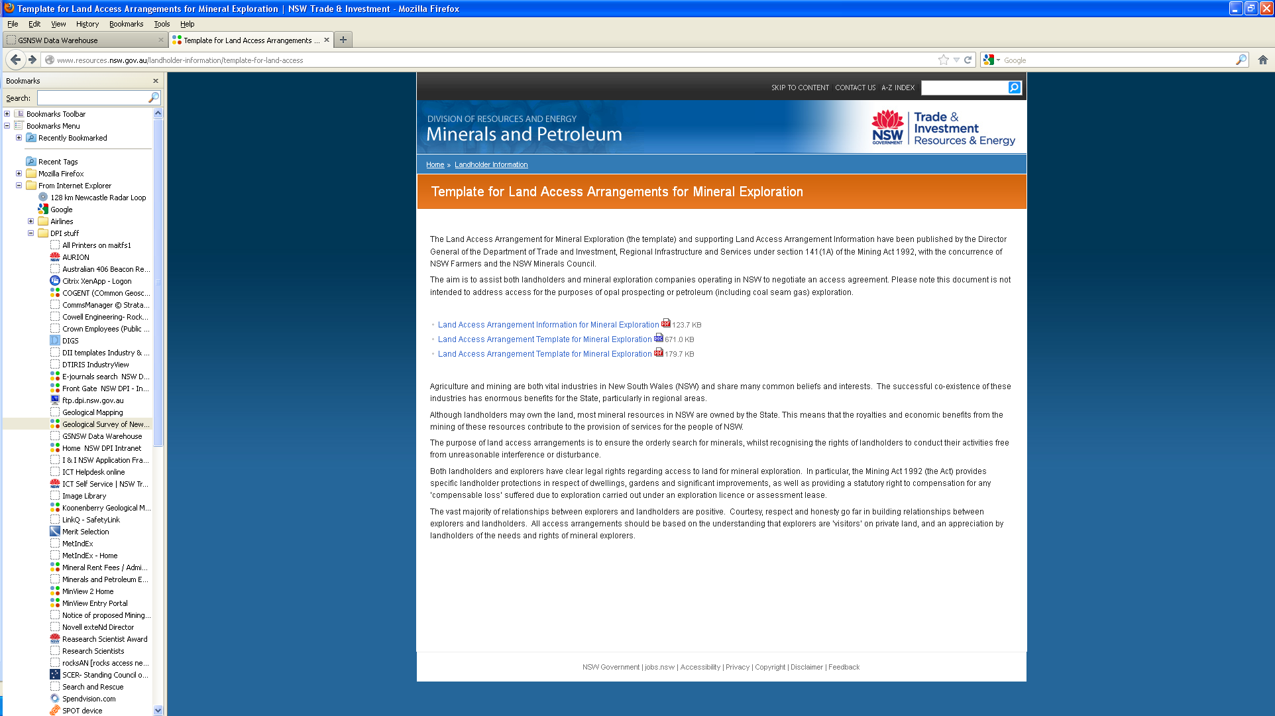

Slide 3
Contents
What is the GDW?
Why do we need it?
How does it work?
How was it done?
Where do you access?
When?
Demo
Coming soon
Feedback

Slide 4

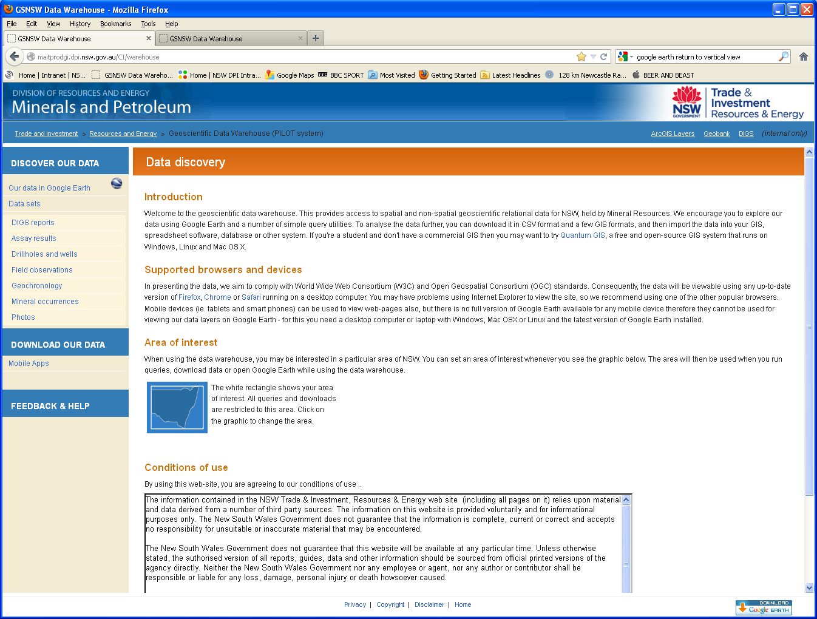
What is the GDW?
A tool to simplify the discovery and accessibility of geoscientific information in NSW
The end product of the COGENT II project
Nightly replication of data from the geoscience data management system – relational, secure, highest integrity
Displayed in Google Earth
Spatial and attribute searches
Download to ESRI (ArcGIS) shapefiles, MapInfo TAB files or text files (.csv)

Slide 5
Why do we need it?
Data is the currency of geoscience, and we are custodians of geoscience data in NSW
A major role of Resources & Energy Division is to provide ‘geoscientific information to attract investment for mineral and petroleum exploration and development and helping inform land use decision making’
Put simply …
The best advice to Govt. based on the best data
Responsible management of explorers data
Improve on our competitive advantage: attracting exploration

Slide 6
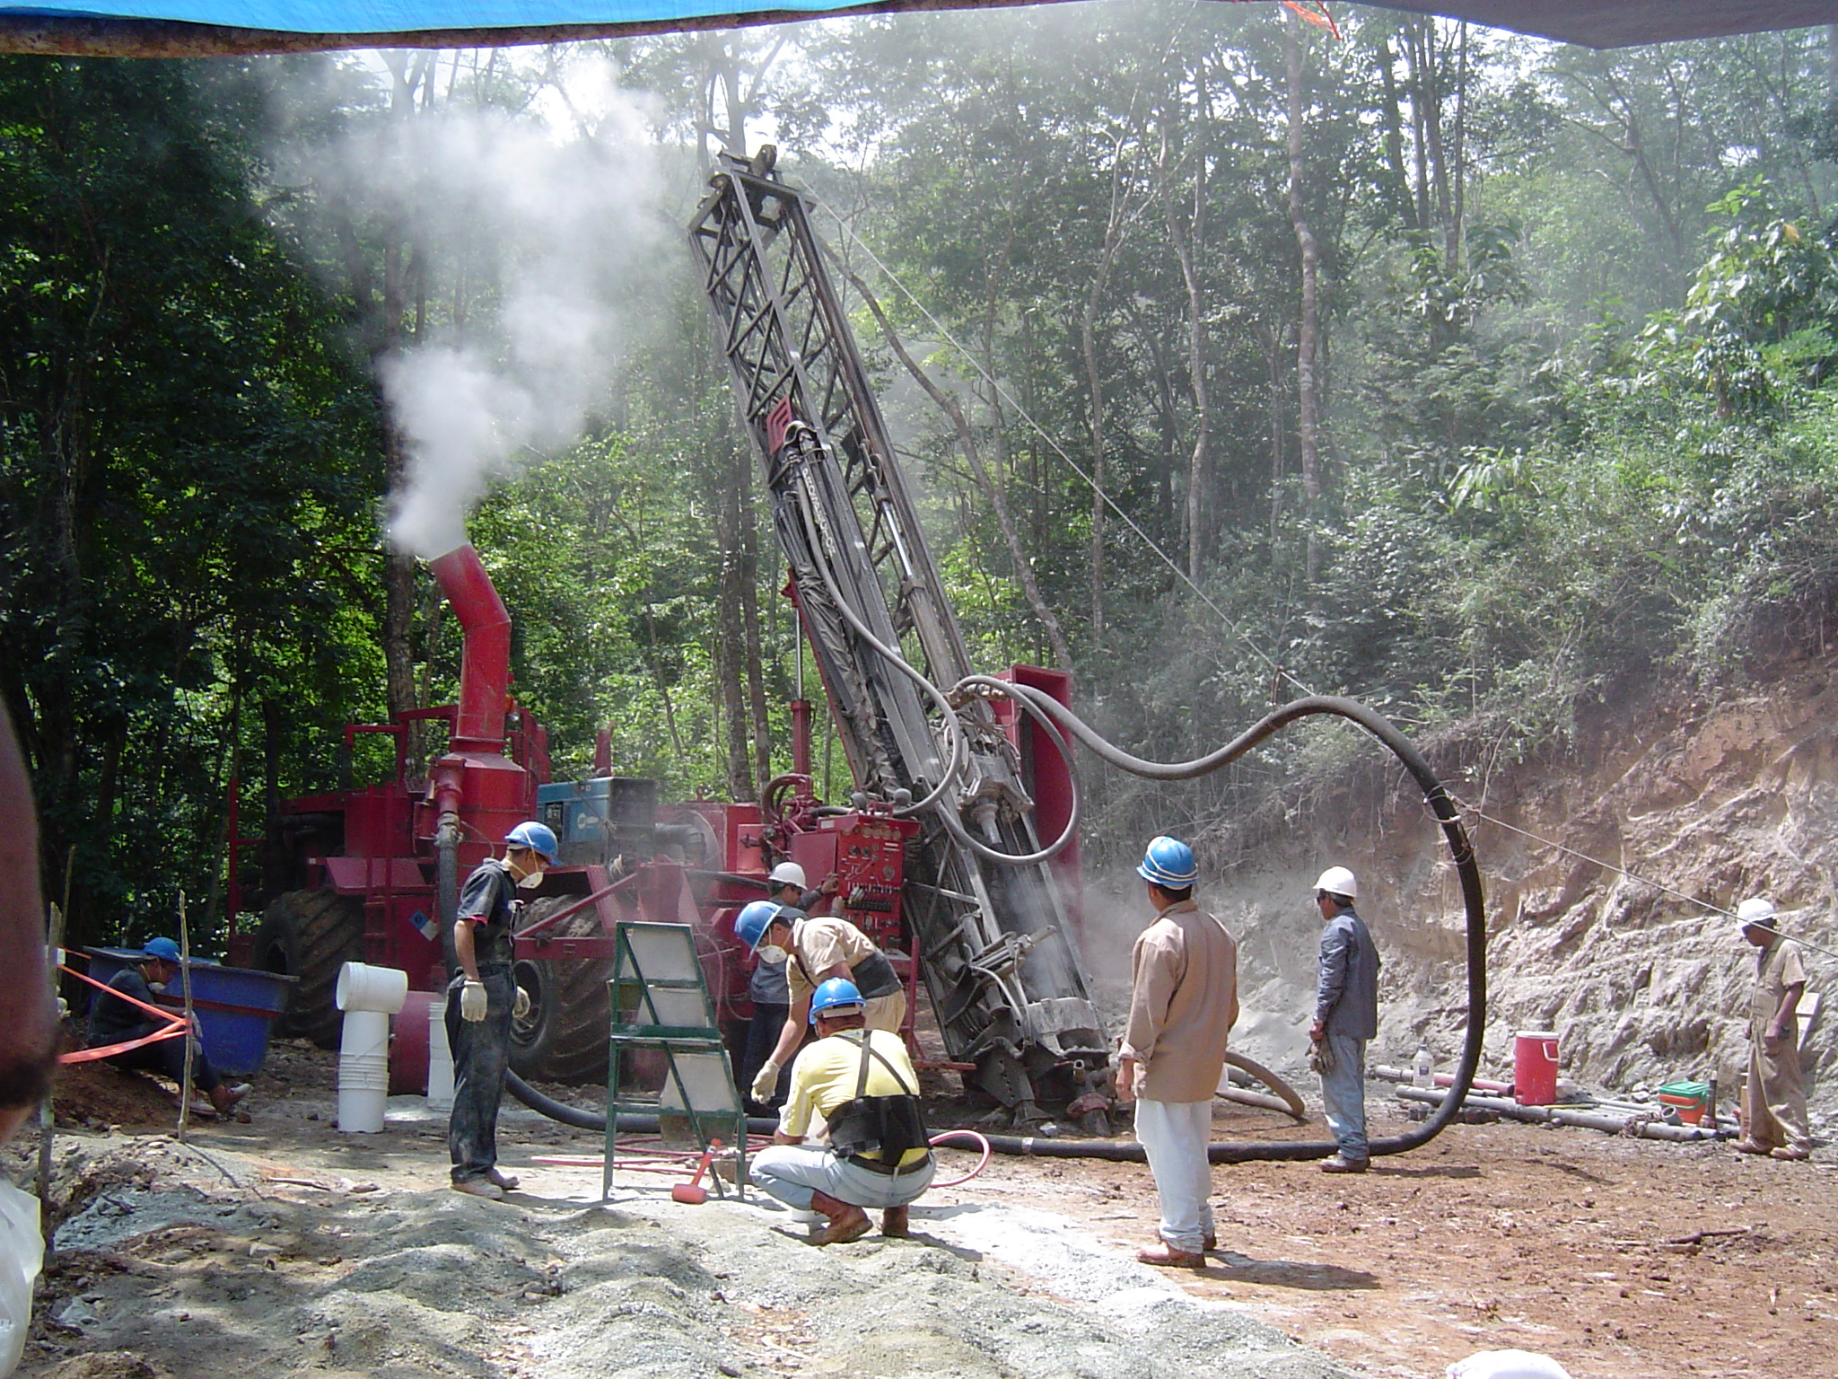
RC drilling- Venezuela

Slide 7
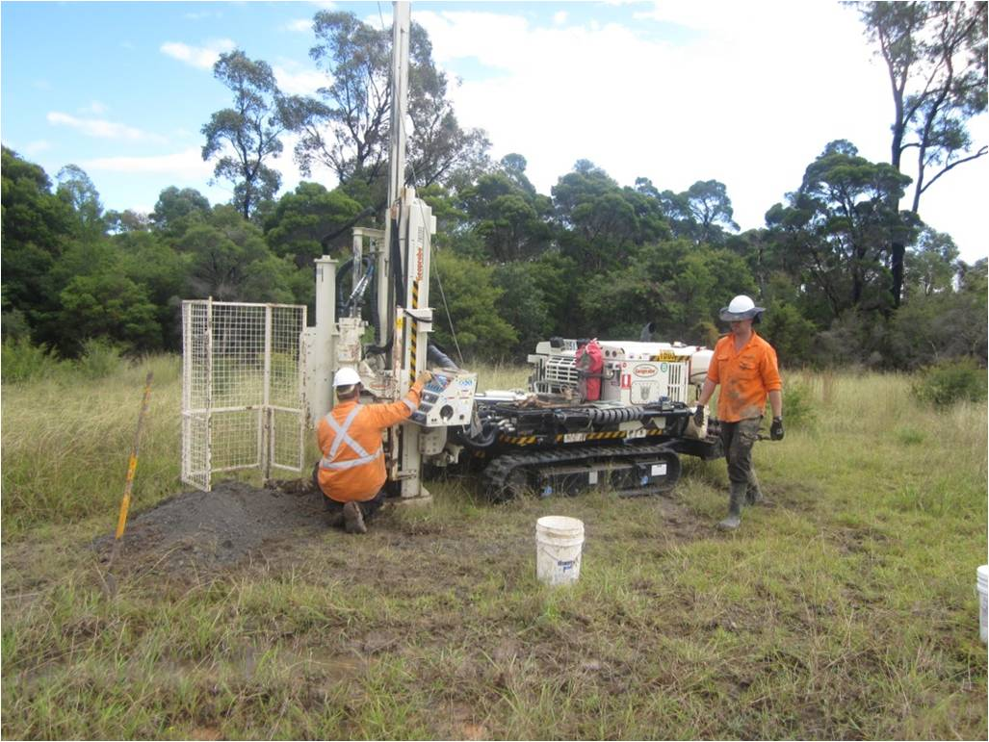
TM drilling- Cessnock

Slide 8
Fraser Institute Survey of Mining Companies
2010-2011
Mild deterrent to investment
Strong deterrent to investment
Would not pursue investment due to this factor
Encourages investment
Not a deterrent to investment
Notes:
If the mapping is an expensive drawn out process, Why does the NSW Govt spend money on it?
This slide shows how our geological maps and associated data gives us a competitive advantage against other companies seeking to attract exploration investment

Slide 9

How does it work?
GDW is the output from the COGENT II project
The Vision
On demand access to all validated (non-confidential) corporate geological data stored by Minerals from a single spatial-based interface
The Goal
A comprehensive geoscientific data management system where digital data of the highest integrity is owned and maintained by the NSW Government, secured in perpetuity
Notes:
The vision is all data … this will always be ongoing
But we have reached the goal – the system has been developed

Slide 10
How does it work?
COGENT II commenced in late-2008
Four stages in COGENT II project:
Stage One: Project scope
Completed 2009
Stage Two: Data consolidation
Several datasets implemented from May 2011
Stage Three: Corporate database development
System Tools complete, several datasets implemented – May 2011
Stage Four: Web delivery
Complete for publishing September 2012

Slide 11
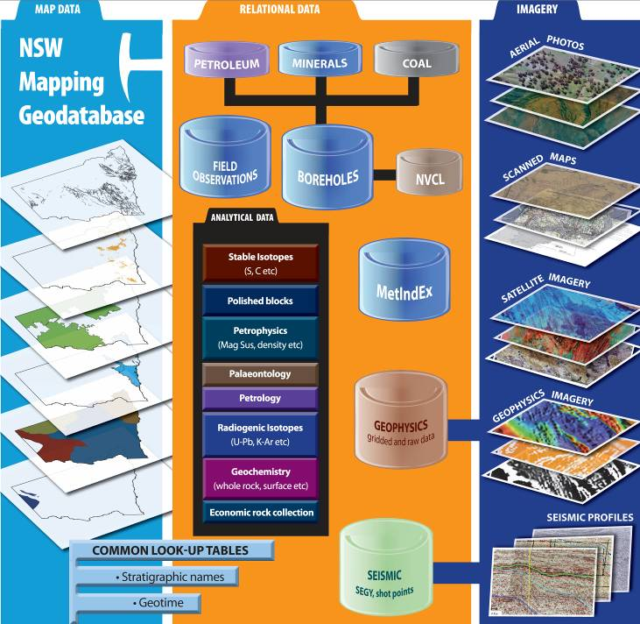
Data
Vector
Imagery
Grids
Systems
Lookups

Slide 12
Key systems
MetIndex (in progress)
30 000 mineral occurrences in NSW
Integrate existing Oracle database into corporate system
Field Observations (complete)
Observations and measurements from GSNSW
Developed for field work – synch to corporate system
Statewide Geodatabase (complete)
ESRI geodatabase system for geological linework
Consistent look up tables across system

Slide 13
Key datasets
* Complete = data QA, data modelled, infrastructure developed, data migrated
Priority | Data | Status | Records
1 High | Radiogenic isotopes | Complete Q1/2012 (except for Pb-Pb) | ~ 4 000
1 Medium | Petrological collection | Complete Q1/2012 | ~ 95 000
1 Medium | Drill holes - coal | Complete Q2/2012 | ~ 55 000
1 Medium | Drill holes - minerals | Complete Q2/2012 | ~ 30 000
1 Medium | Drill holes - petroleum | Complete Q2/2012 | ~ 700
1 Medium | Seismic | Awaiting petroleum resourcing | ~ 45 000 line km
Notes:
i.e. system developed.
Backfill of data under way / needs completion

Slide 14
Priority | Data | Status | Records
1 Low | Exploration geochemistry | Down hole assay complete Q1/2012. Surface samples (stream sediments, soils, rock chips, NITON) in progress. | ~ 1.25m to date ? ~2m +
1 Low | Photographs | Complete Q1/2012. Field photos only at this point. | ~ 2 500
1 Low | 3D Geology | Awaiting resourcing
1 Low | Petrophysics | Awaiting resourcing (2013) | ? ~ 5 000

Slide 15
Priority | Data | Status | Records
2 | Whole rock geochemistry | Awaiting resourcing (2013) | ~ 25 000
2 | Palaeontology | In progress (2012 / 2013) | ~ 65 000
3 | Stable isotopes | Awaiting resourcing (2013) | ~ 3 500
3 | Polished blocks | Awaiting resourcing | ~ 1 775
3 | Economic rocks | Awaiting resourcing | ~ 30 000

Slide 16
How does it work?
System developed
SQL database (Micromine’s GeoBank)
Data tables
Relationships
Common look up tables
Methodology implemented
To build tables
To migrate data
To create metadata (ANZLIC compliant)
All documented
So more data can be added with time ‘backfill’
Other Dept. business units can add their data

Slide 17
Look up tables
Standardised across the system
e.g. stratigraphic names
~ 3800 current names in NSW
Spatial distribution – statewide geodatabase
Attribution – in progress
e.g. age range, depositional environment, chemistry
Master unit description table for every unit
Plus search for data by stratigraphic unit

Slide 18
What about retrieving data?
The GDW !
Data discovery in Google Earth
Data query – spatial or textural
Data download – .shp .tab .csv

Slide 19
Confidential data
Two versions of the GDW
External
Non-confidential data only
e.g. unpublished isotope analyses
e.g. EL data still under tenure
Internal
All data

Slide 20

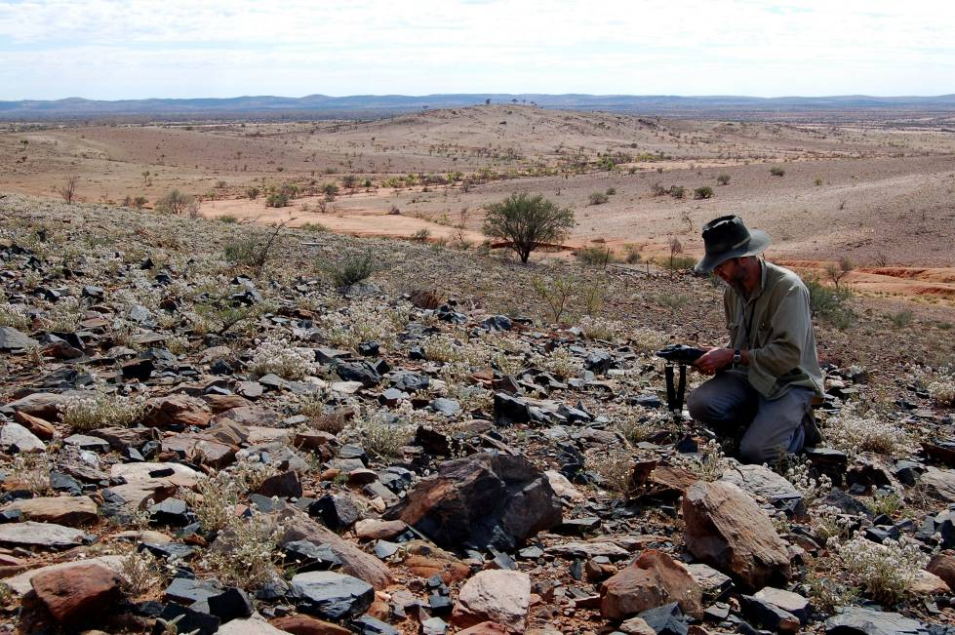
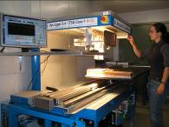
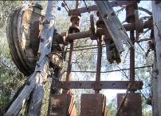
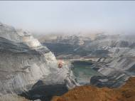

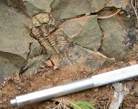
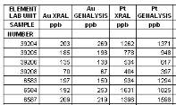
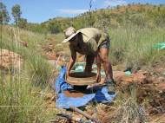

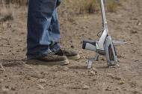


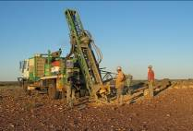
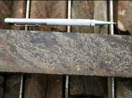
New
data
GEOBANK
Corporate
Database
(SQL server)
Legacy
data
Nightly
replication
Discover
Download
Source: niton.com, Quantum Res. Ltd, pfncapital.com

Slide 21
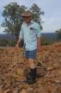



How was it done?
Minimal costs …
Key people in key positions
David Collins (System Architect), Trevor Barlin (Project Manager)
Excellent team effort
Geological Survey (Reg Map, Geoscience Info, MinLU), Coal, Petroleum, ICT
Purchase of software
Micromine’s GeoBank (nee GBIS), FME Server
Some use of contractors
Data compilation and QA (e.g. TerraSearch)
Coding (e.g. ArcSites)

Slide 22
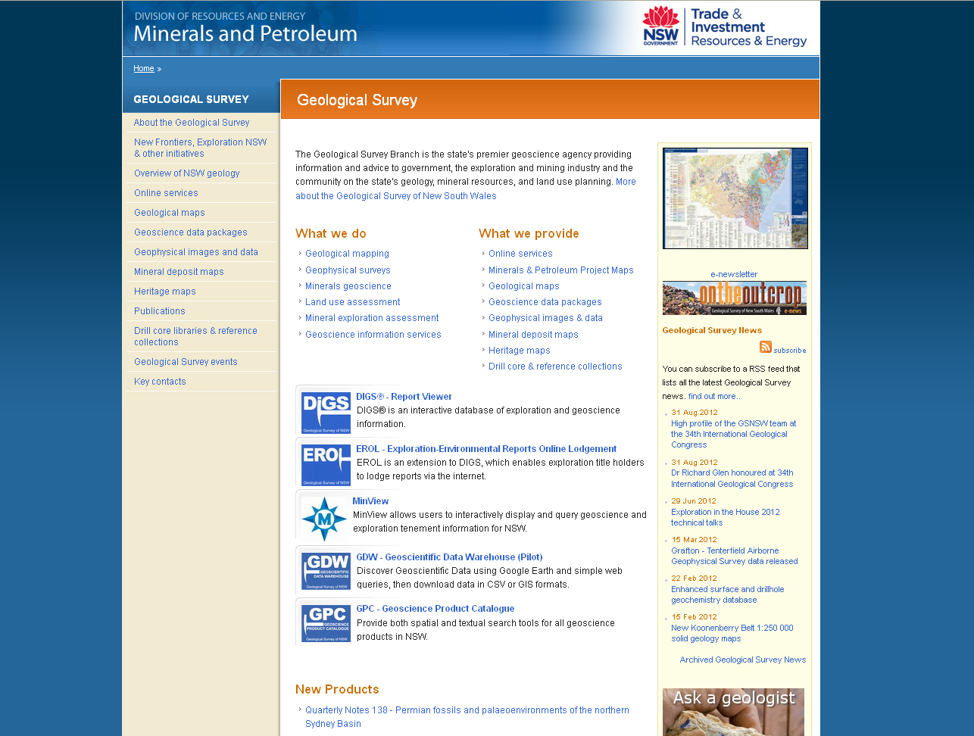
Where do you access?
Go to the GDW in your internet browser
http://dwh.minerals.nsw.gov.au/CI/warehouse (external)
Or navigate via website:

Slide 23
Where do you access?
Will work on Windows, Mac OS X and Linux PCs
Only partially accessible from mobile devices as requires full version of Google Earth
Requires Google Earth v6.2 or newer version
Requires recent version of Firefox, Chrome or Safari as internet browser
Internet Explorer not sufficiently standards-compliant yet

Slide 24
When?
Now !!!
External
Live since 20th September 2012
Internal
Live since 2011
But remember GDW is dynamic …
You are accessing a nightly replication
More data being added constantly

Slide 25
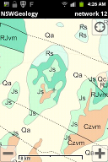
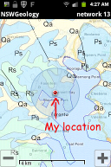
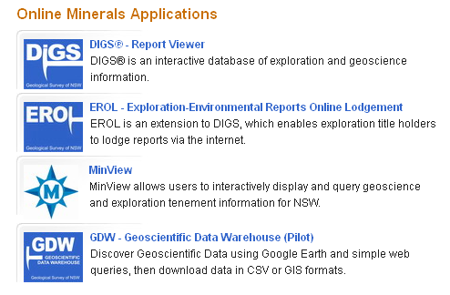
Coming soon
Mobile app!
Updated data added daily !
e.g. exploration data – drilling, assay, surface geochemistry
New datasets coming soon
Palaeontology (2012/13)
Stable isotopes (2013)
Whole rock geochemistry (2013)
NITON (2013)
Mobile platform data
e.g. NSW geology maps for iPhone and Android
Increased interaction with DIGS
Integration into Geoscience Information Gateway (GIG)
In early planning stages
Scheduled for completion in June 2014
Plus user suggestions for improvements … feedback page
GIG

Slide 26
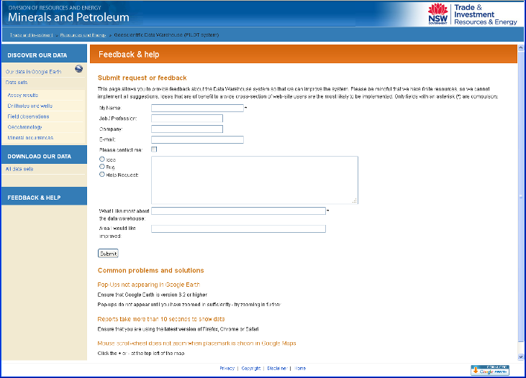
Feedback
We welcome suggestions so we can improve the system
Both for useability and for data

Slide 27
Demo
Live ... the true test of a system!

Slide 28
Thanks !

Slide 29
EXTERNAL DEMO

Slide 30
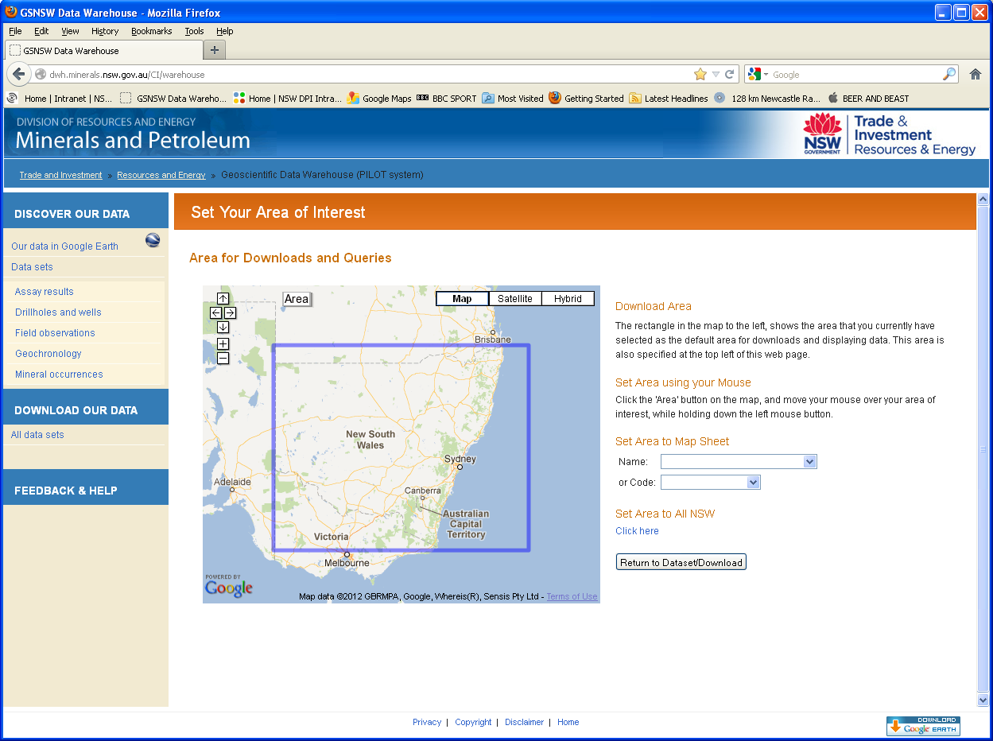
GDW home page

Slide 31
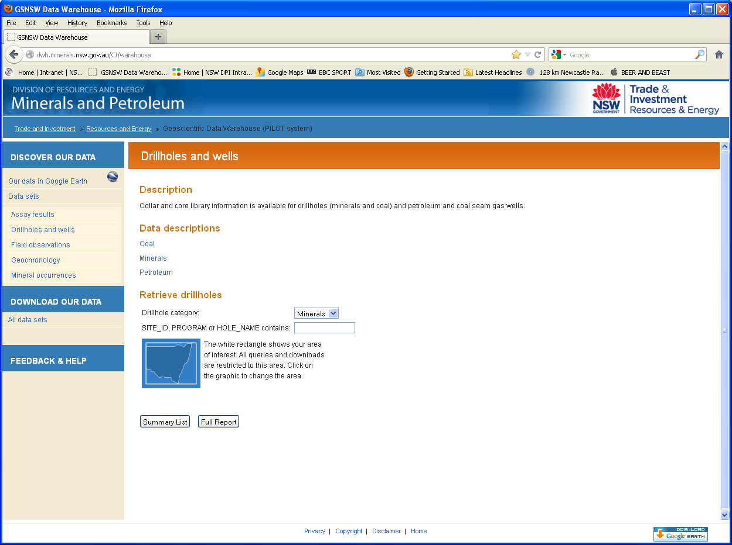
By data set

Slide 32
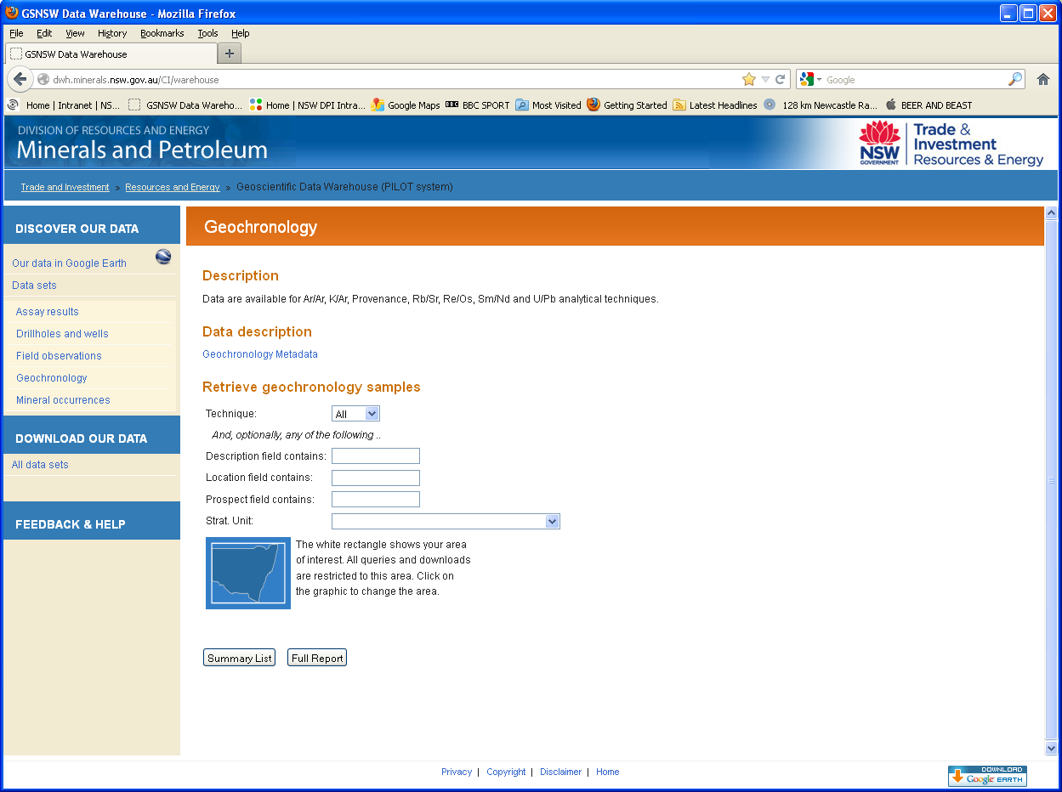
Metadata

Slide 33
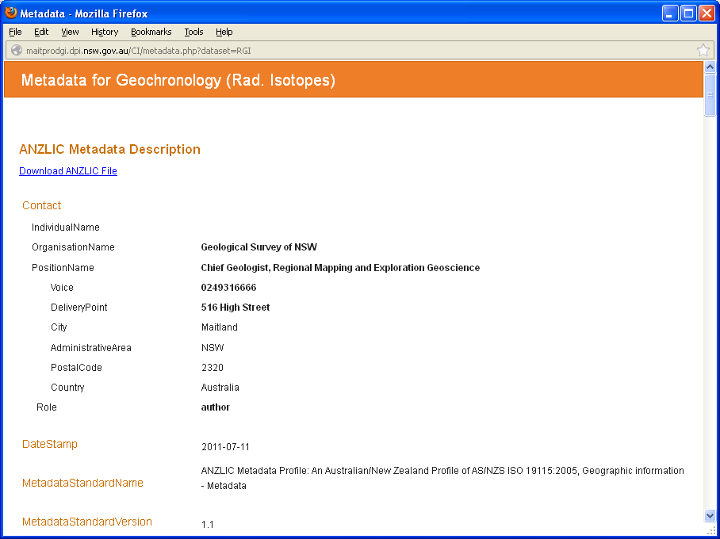
Metadata

Slide 34
Spatial search

Slide 35
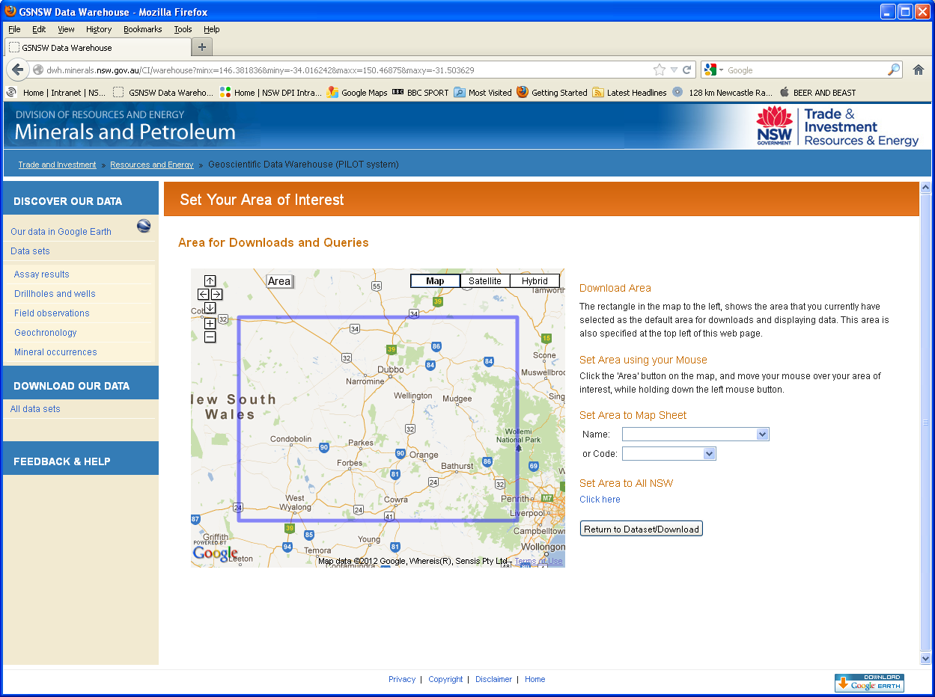
Spatial search

Slide 36

Summary list

Slide 37
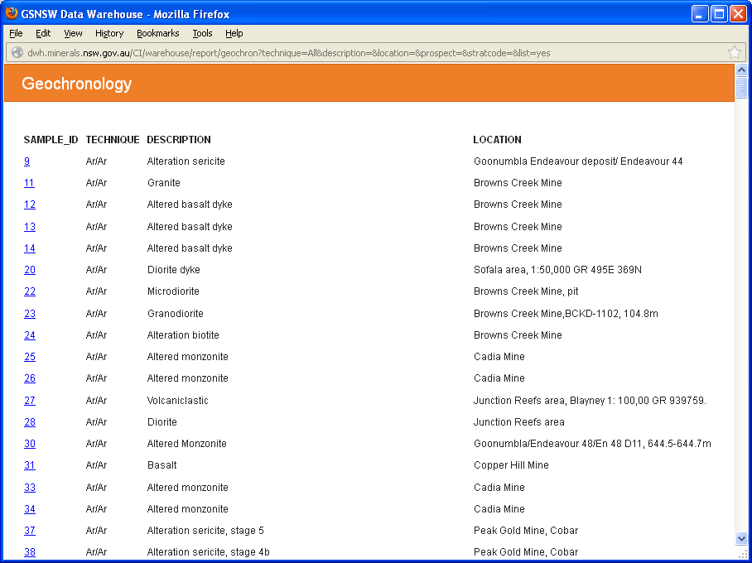
Summary list

Slide 38

Full report

Slide 39
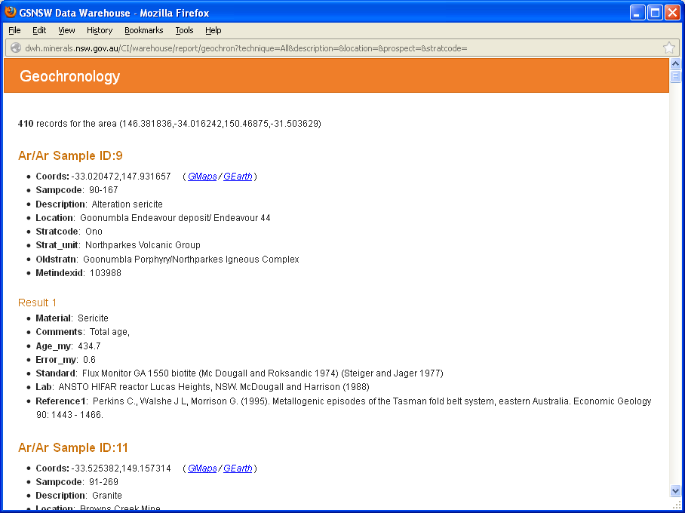
Full report

Slide 40
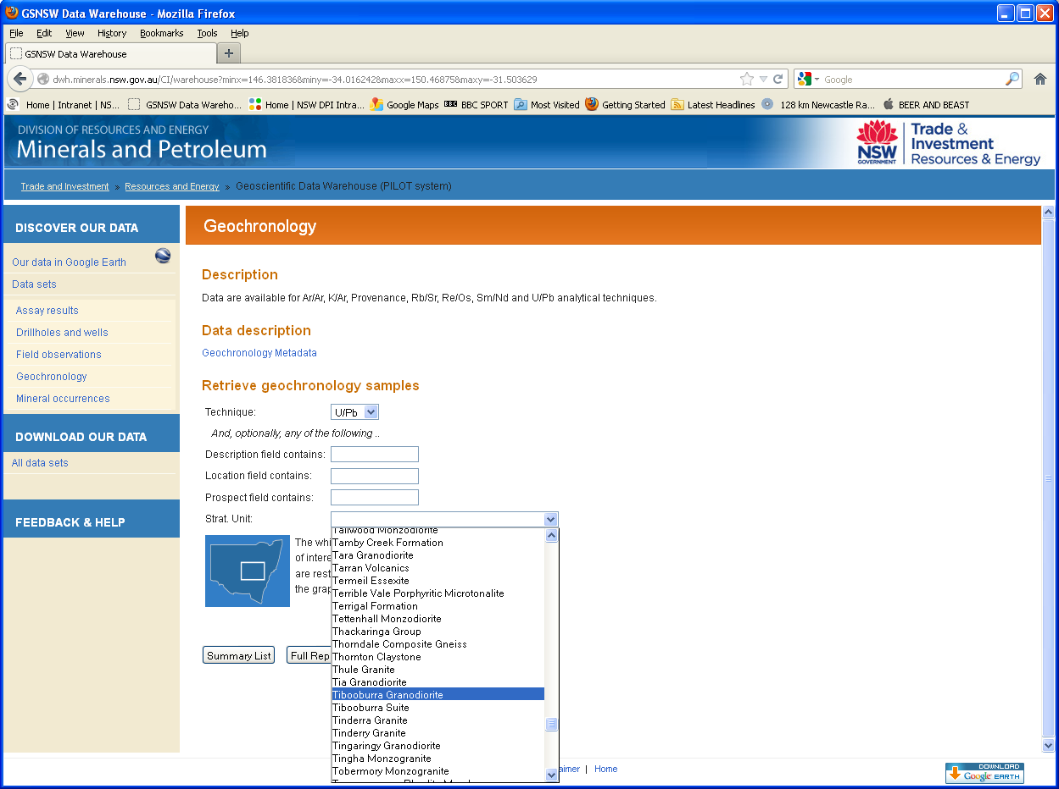
Attribute search

Slide 41
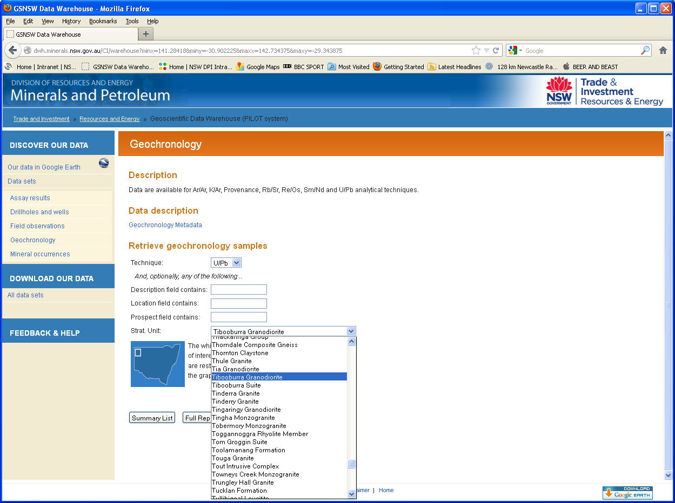
Combined – spatial and attribute

Slide 42
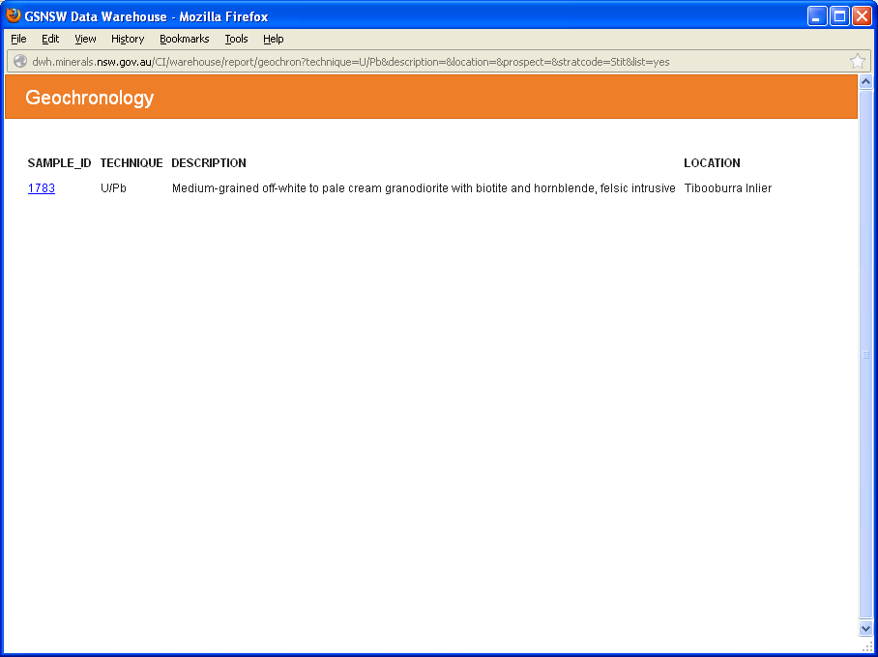
Combined – spatial and attribute

Slide 43
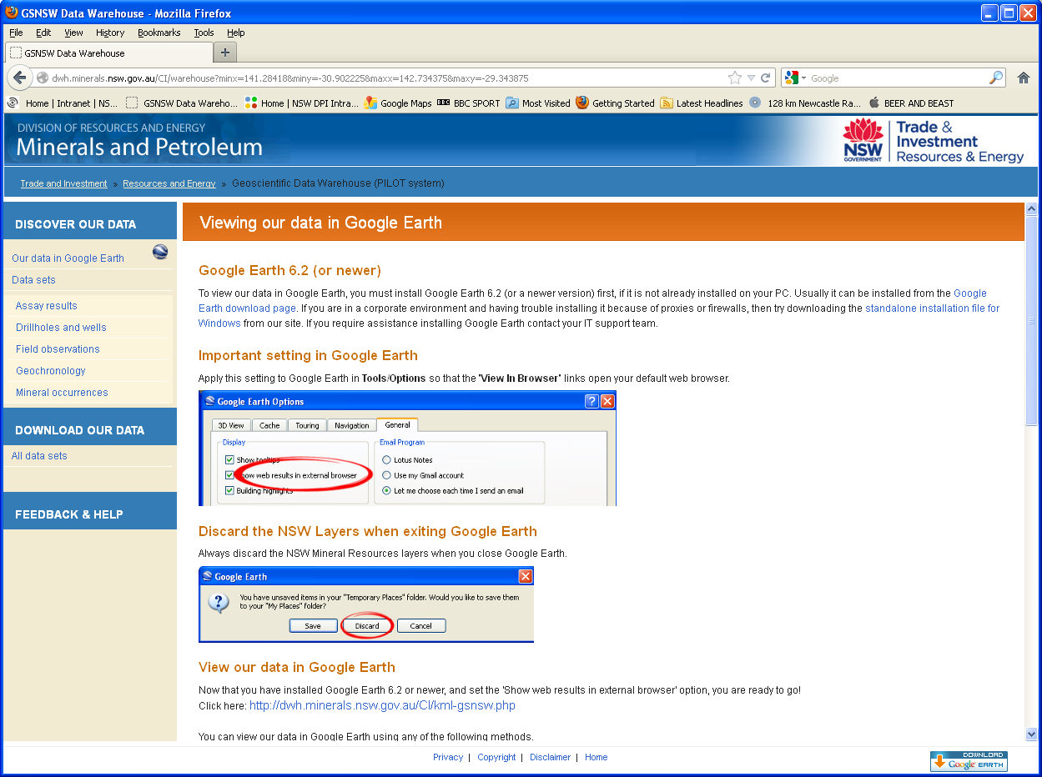
View all data

Slide 44
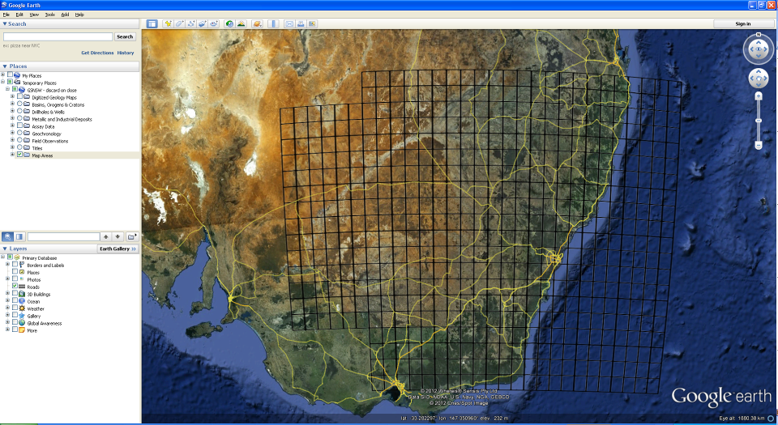
Google Earth opens to NSW

Slide 45
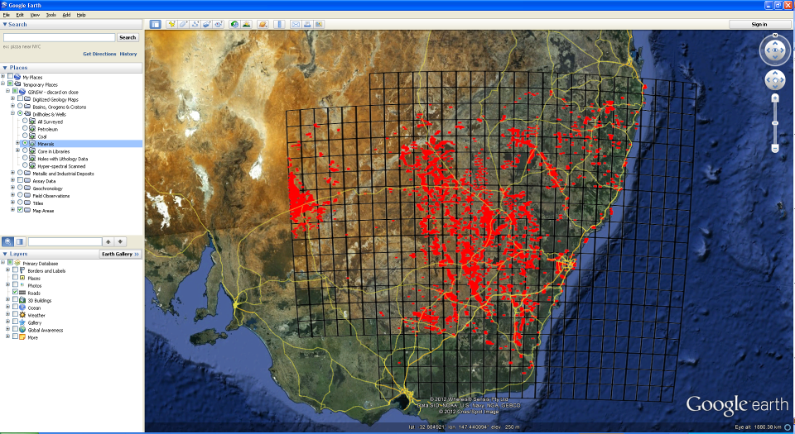
Minerals drillholes

Slide 46
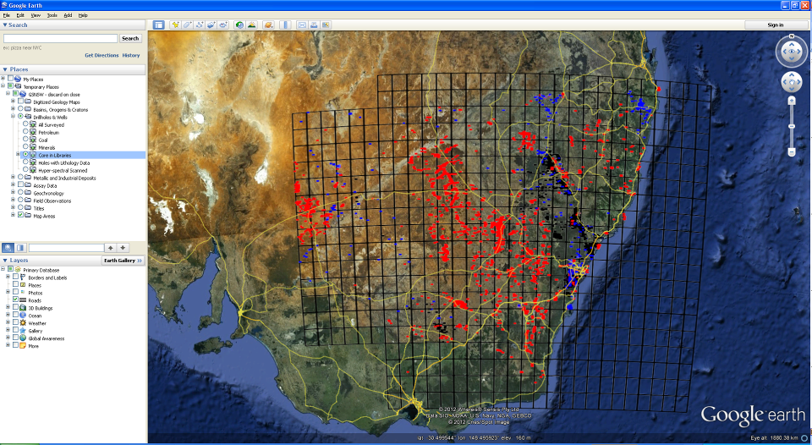
Drill core in department library
Londonderry, Broken Hill

Slide 47
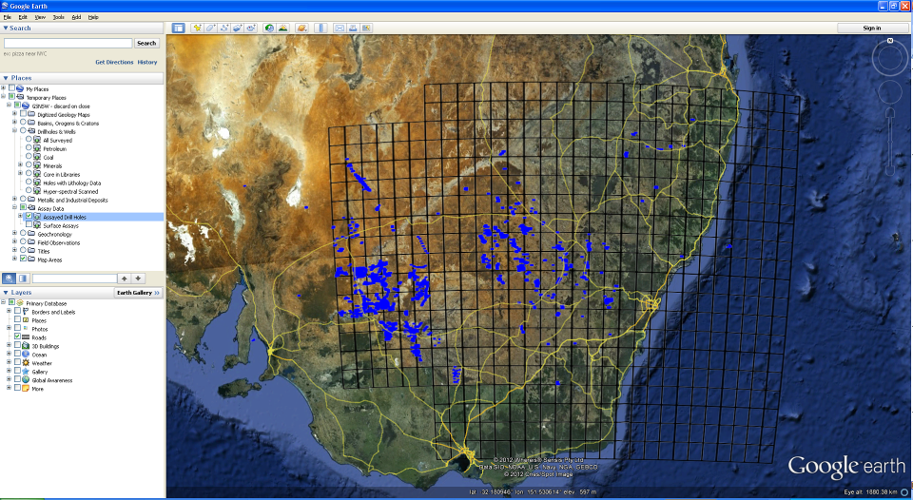
Assayed drill holes

Slide 48

Surface exploration geochemistry

Slide 49
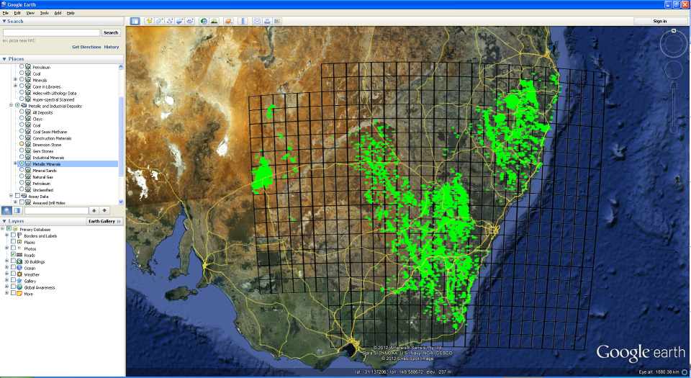
Metallic minerals
Displays at raster when >1000 records in view

Slide 50
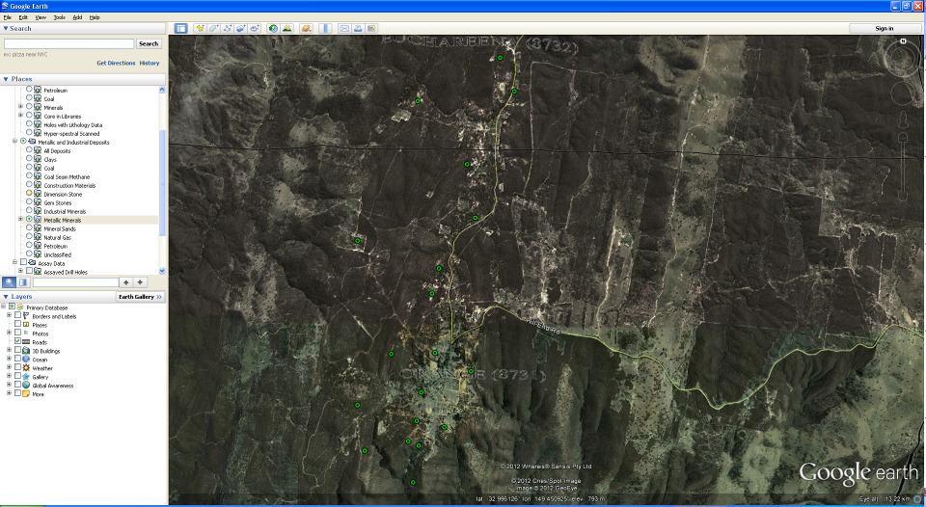
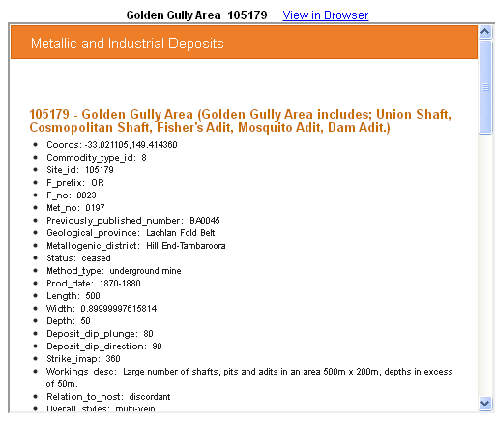
Metallic minerals
Change to vector points when <1000 records in view
Click on points to see info

Slide 51
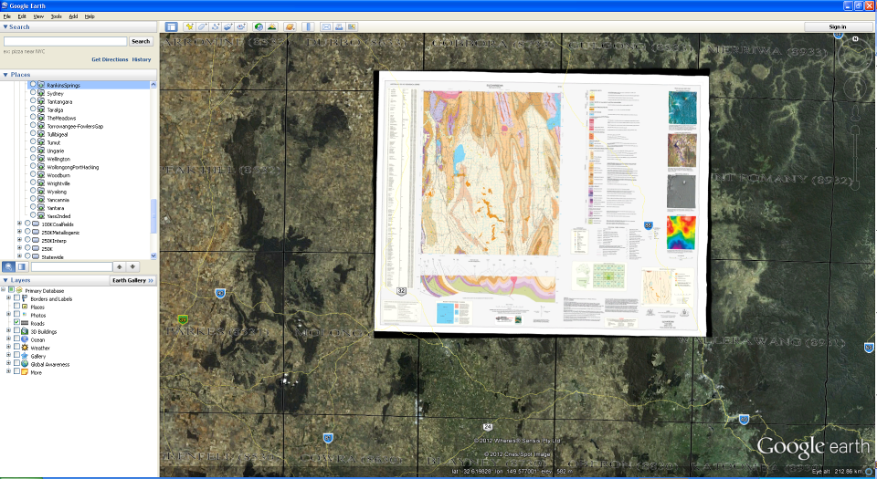
GSNSW maps
Georeferenced

Slide 52
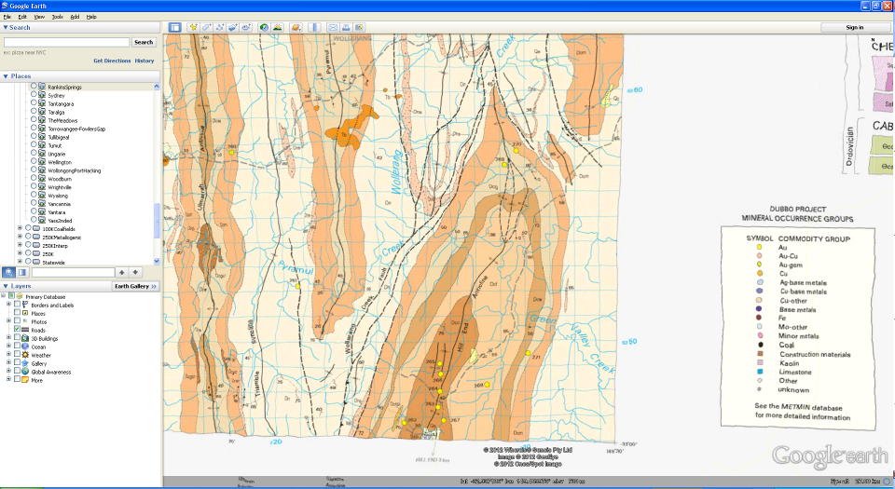
GSNSW maps
Yep, useful to see geology …

Slide 53
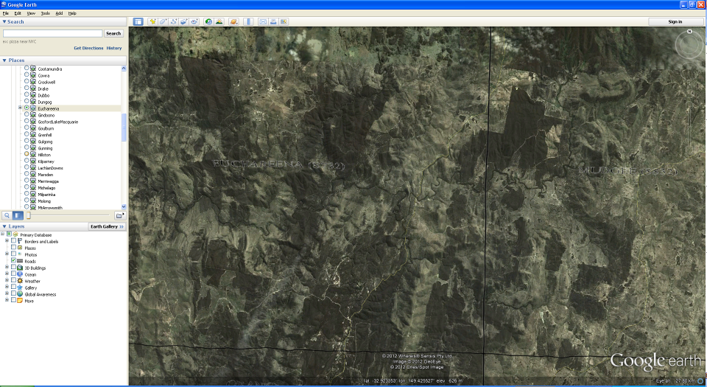
GSNSW maps
And useful to see imagery …

Slide 54
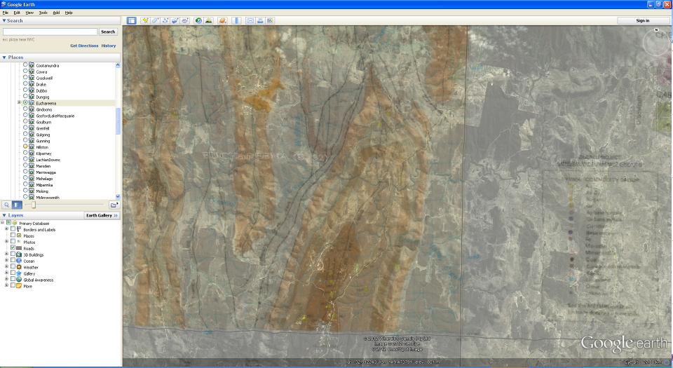
GSNSW maps
Even better when transparency applied to maps …

Slide 55
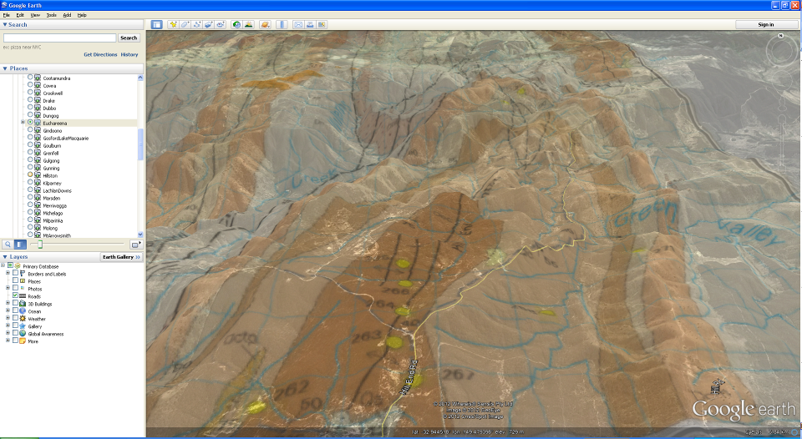
GSNSW maps
And Google Earth tilting and zoom used

Slide 56
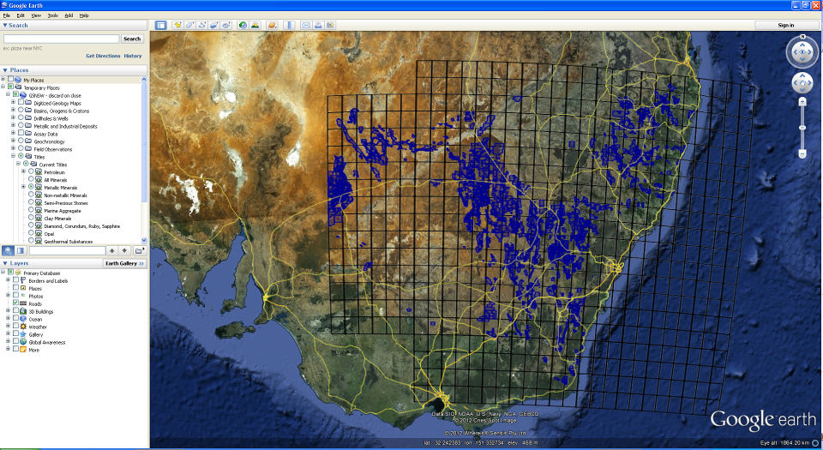
Titles
By licence type

Slide 57
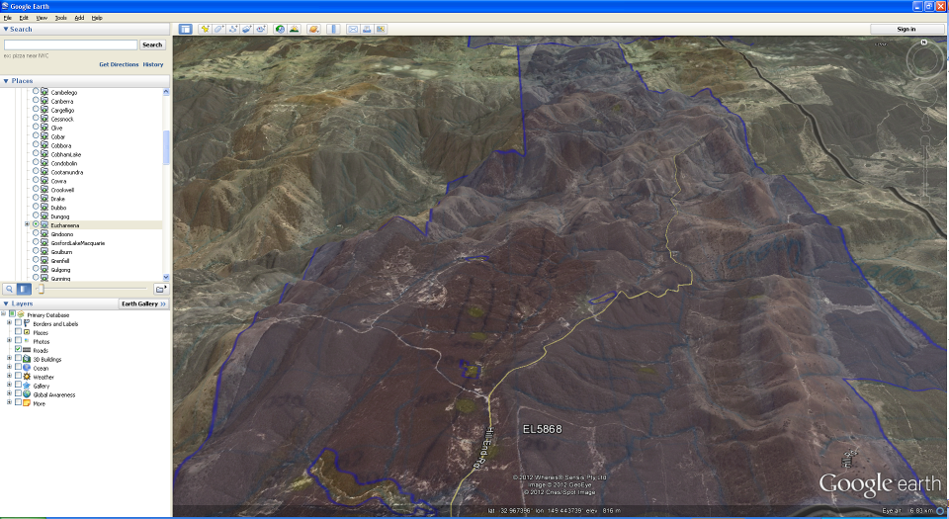
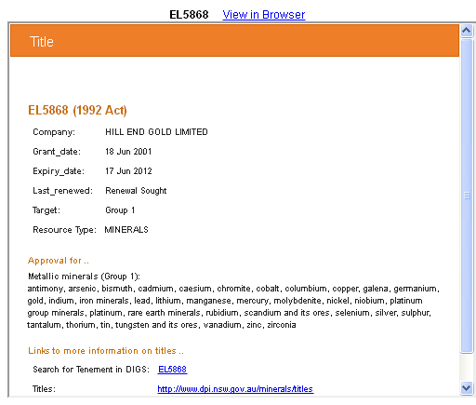
Titles
Draped over topography with semi-transparent map
Click for info

Slide 58
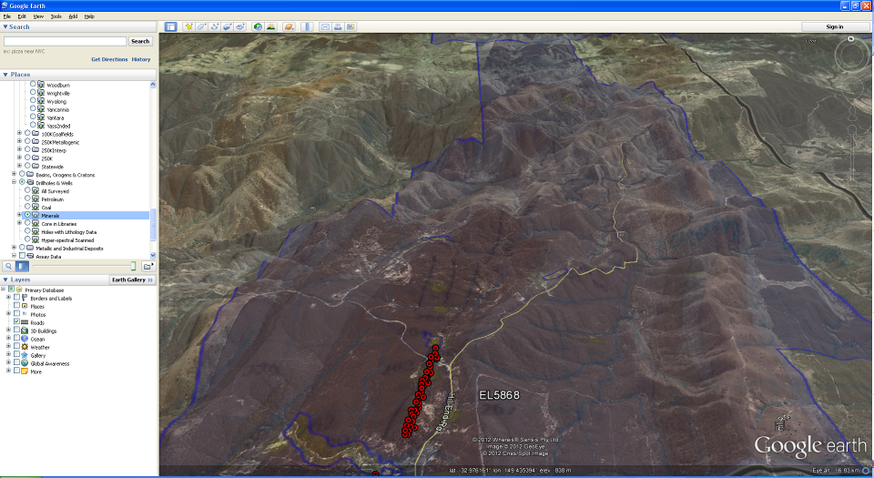
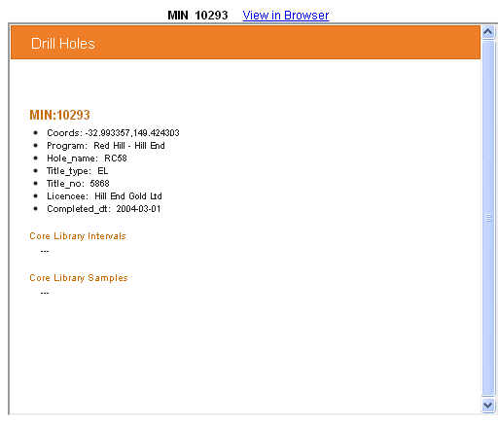
Drill holes (open file only)
And mineral drill holes added
Click for info

Slide 59
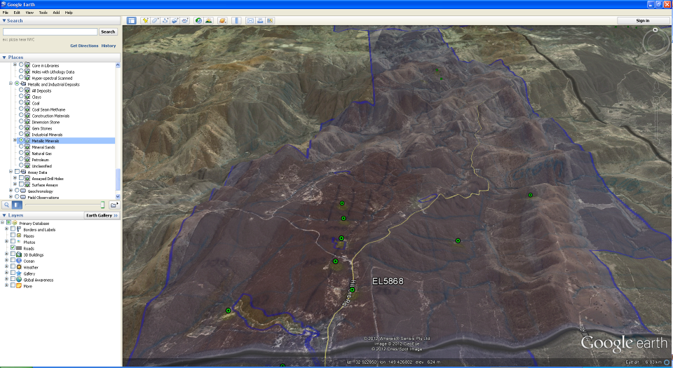
Surface exploration geochemistry (open file)
Rock chips

Slide 60

Downloads

Slide 61

Downloads – statewide, map or spatial search

Slide 62

For search area – choose download format

Slide 63

Enter email address

Slide 64

FME server processes your request – emails it

Slide 65


Email received with .zip file of data

Slide 66


Metadata – good idea to read!

Slide 67

This example is for (surface, drill hole) assay data

Slide 68

Drillholes – NVCL (hylogger) core

Slide 69
Thanks !

Slide 70

Field Observations
Collection of geoscience observation and measurements
Field and office use
Synchronise MS Access version in / out of GeoBank

Slide 71




Field Observations

Slide 72

Field Observations

Slide 73

Field observations

Slide 74

Field observations

Slide 75

Field observations

Slide 76

Field observations

Slide 77

Field observations

Slide 78

Field observations

Slide 79

Field observations and GSNSW maps

Slide 80

Field observations and GSNSW maps

Slide 81

Mobile Apps - geology

