Slide 1



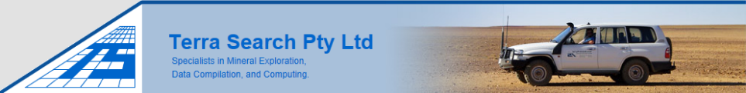
EGRU and James Cook: a 40 year voyage of scientific endeavour to explore and discover
Dr Simon Beams,
Managing Director/ /Principal Geologist
Terra Search Pty Ltd
SERVING THE EGRU INDUSTRY ADVISORY BOARD FOR OVER 30 YEARS
BACK IN 1982 , PROJECT GEOLOGIST ESSO AUSTRALIA LTD FOUNDATION MEMBER OF EGRU,
EGRU ENGAGEMENT DAY 3/11/2022

Slide 2
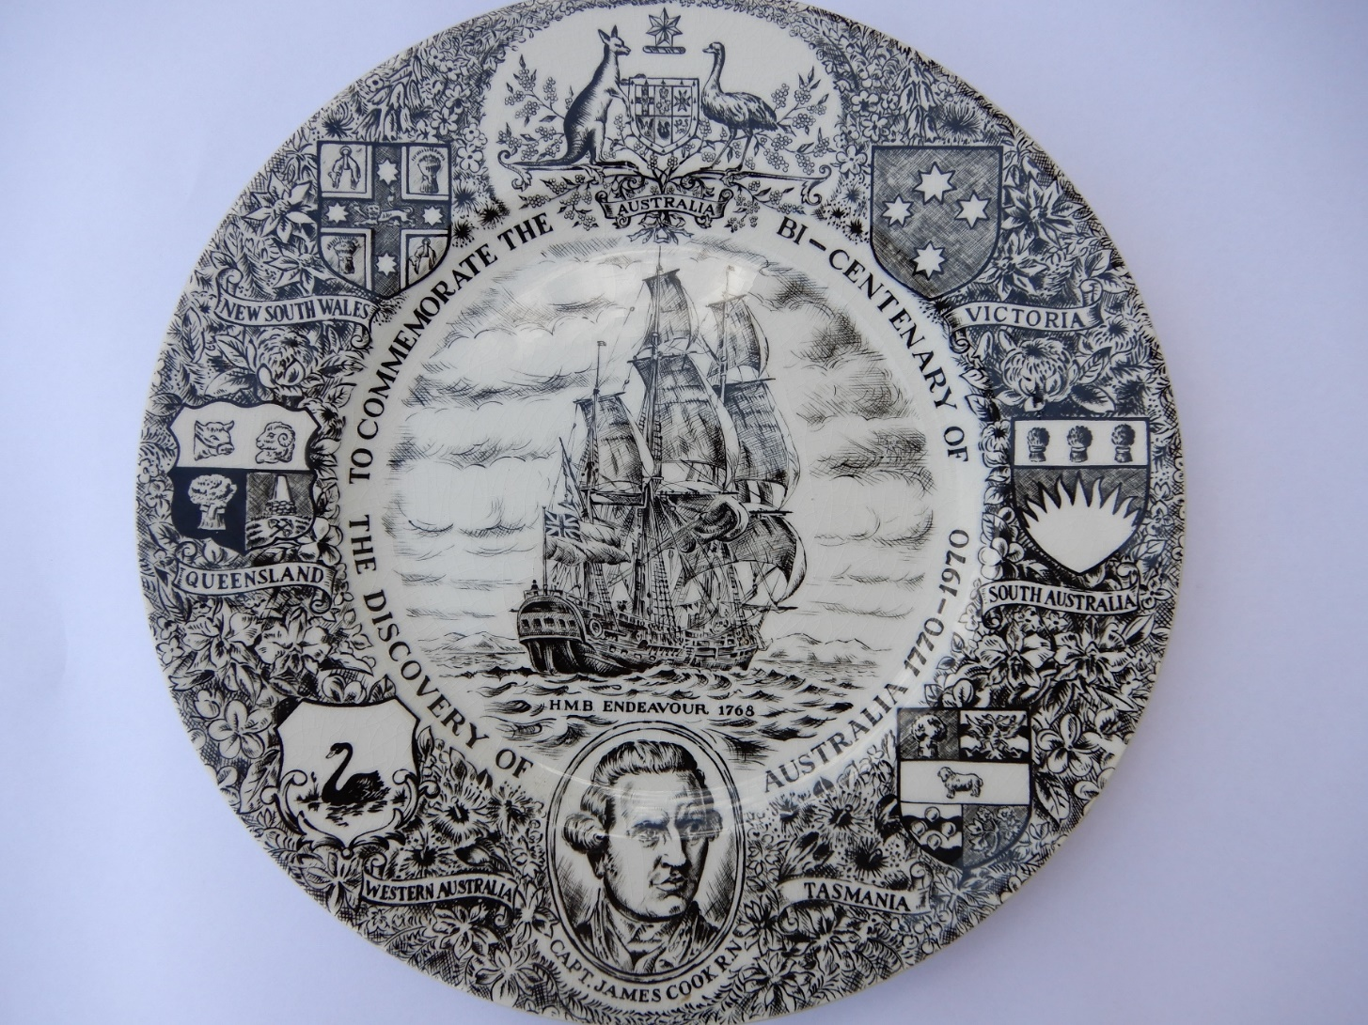

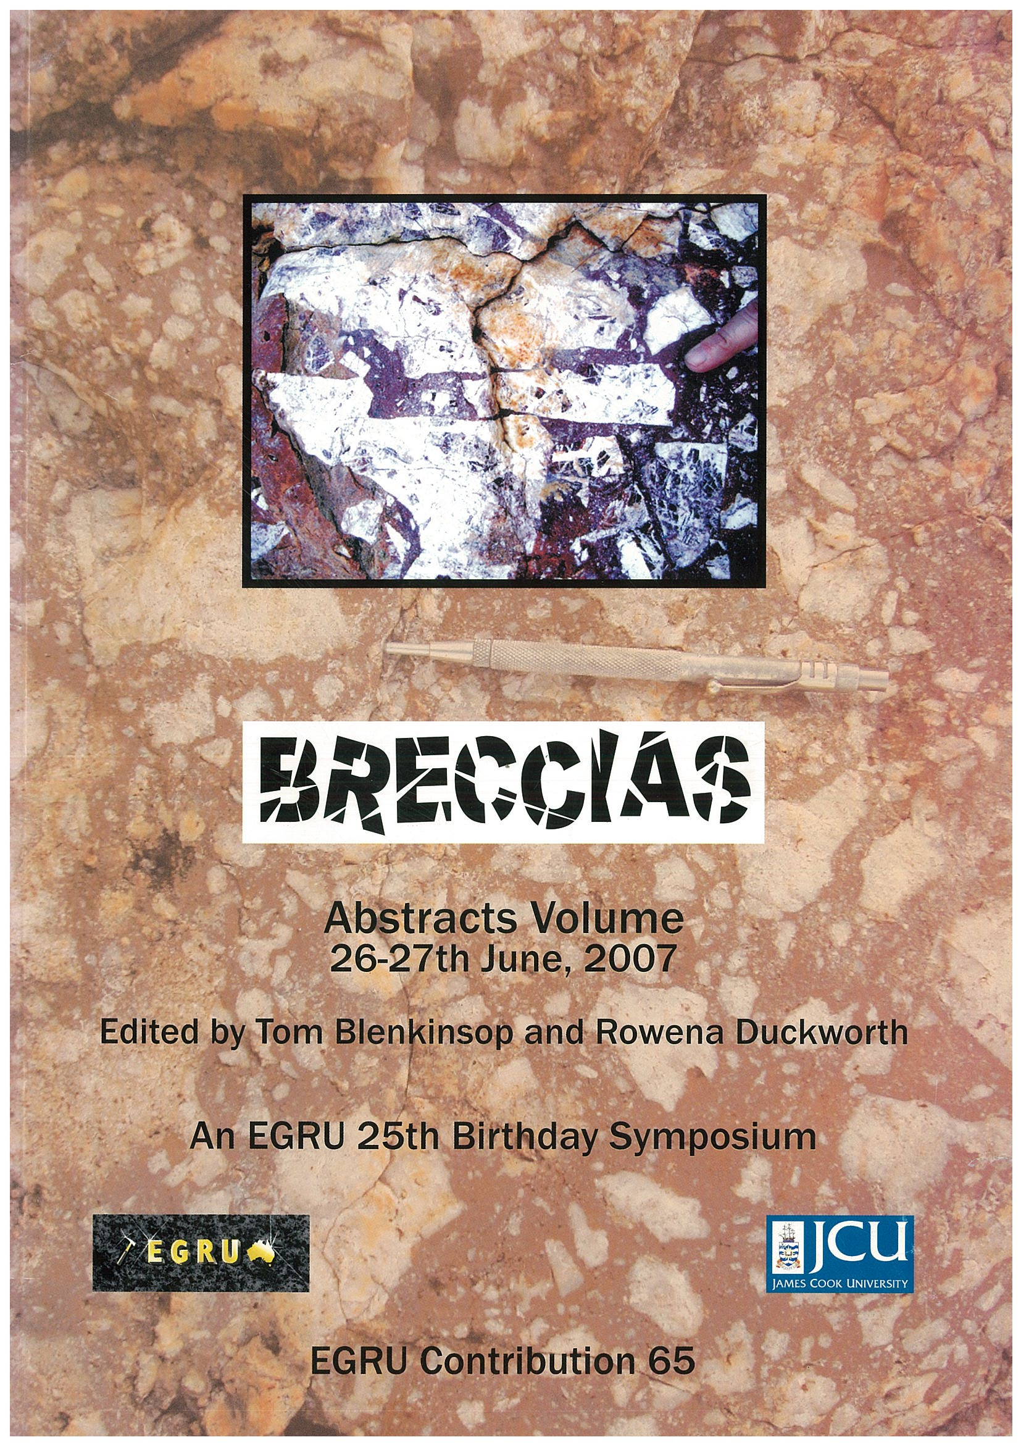

James Cook : Not a Conventional Choice
Son of a farmer, captain of coal ships
Master Navigator, Explorer ,Documenter,
Map Maker , Selfless Protector of his crew.
EGRU ENGAGEMENT DAY 3/11/2022

Slide 3
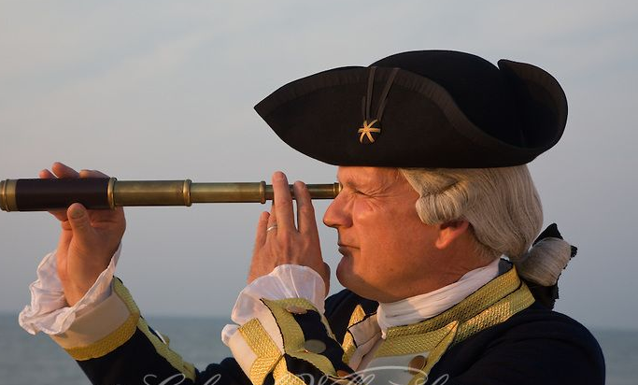
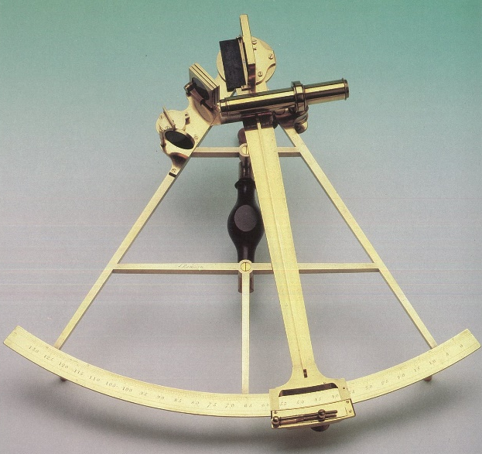
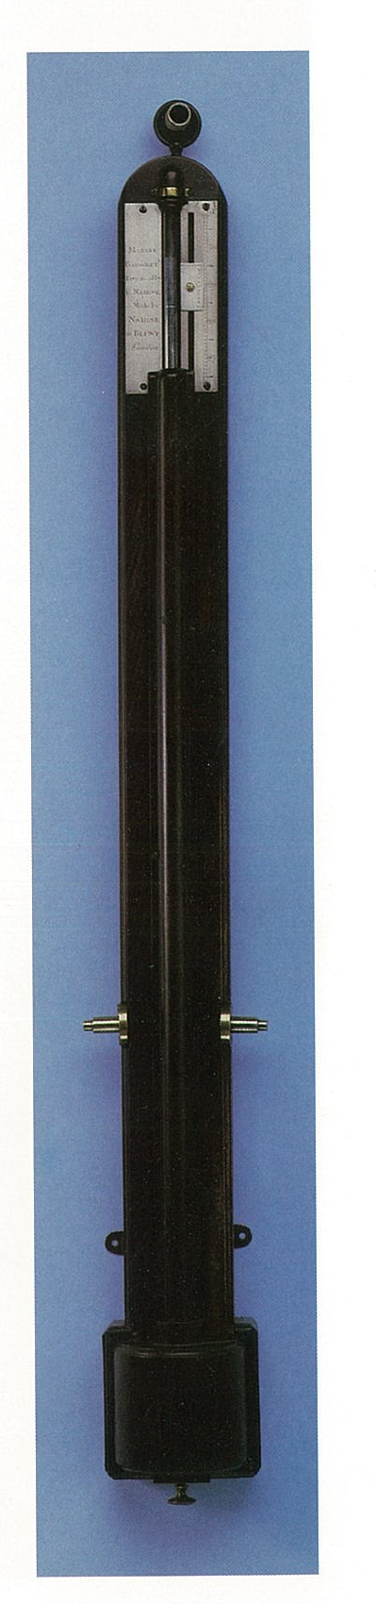
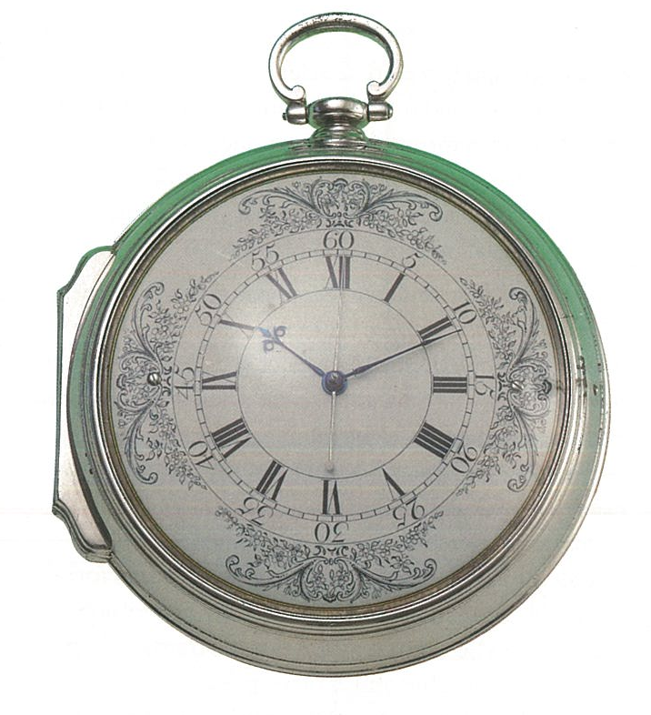
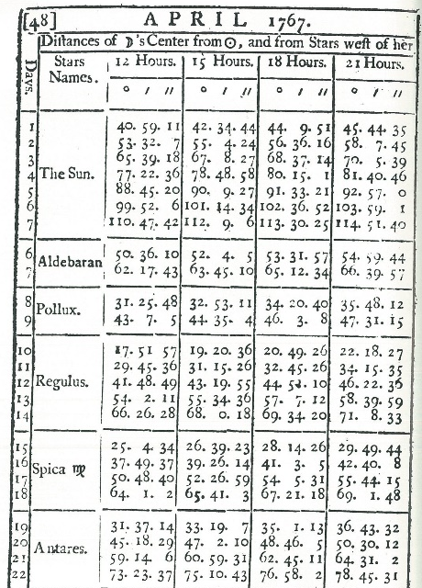
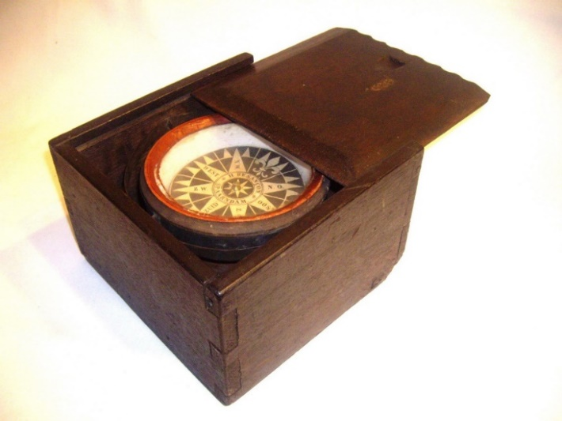
Captain Cook’s data gathering instruments 1770
Telescope
Sextant
Barometer
Chronometer
Compass
Star Chart
EGRU ENGAGEMENT DAY 3/11/2022

Slide 4
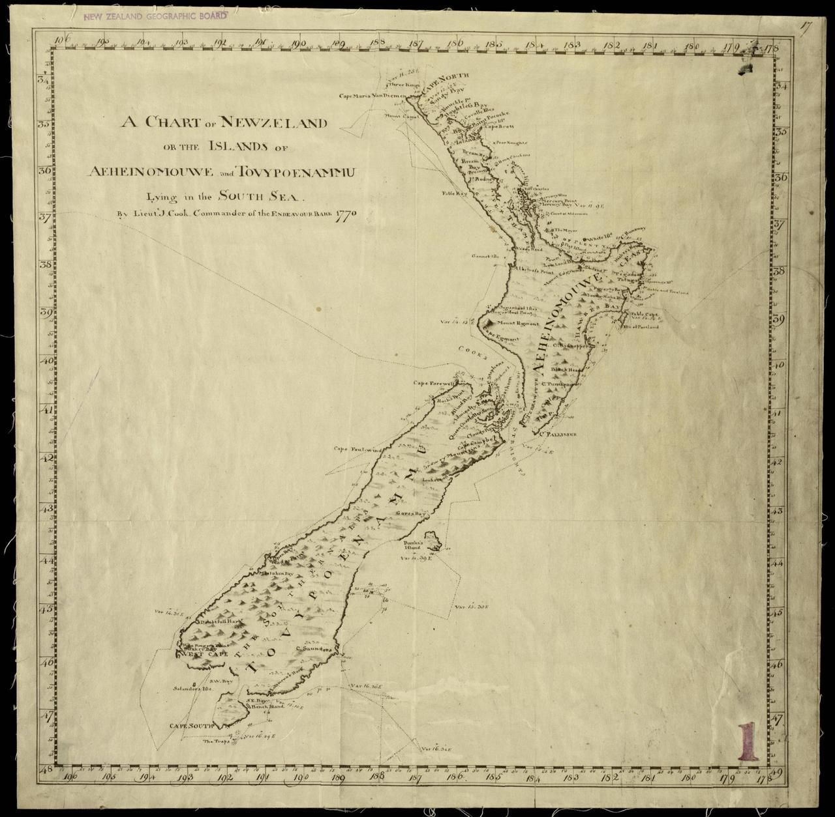
Captain Cook’s 1770 map of
New Zealand
EGRU ENGAGEMENT DAY 3/11/2022

Slide 5
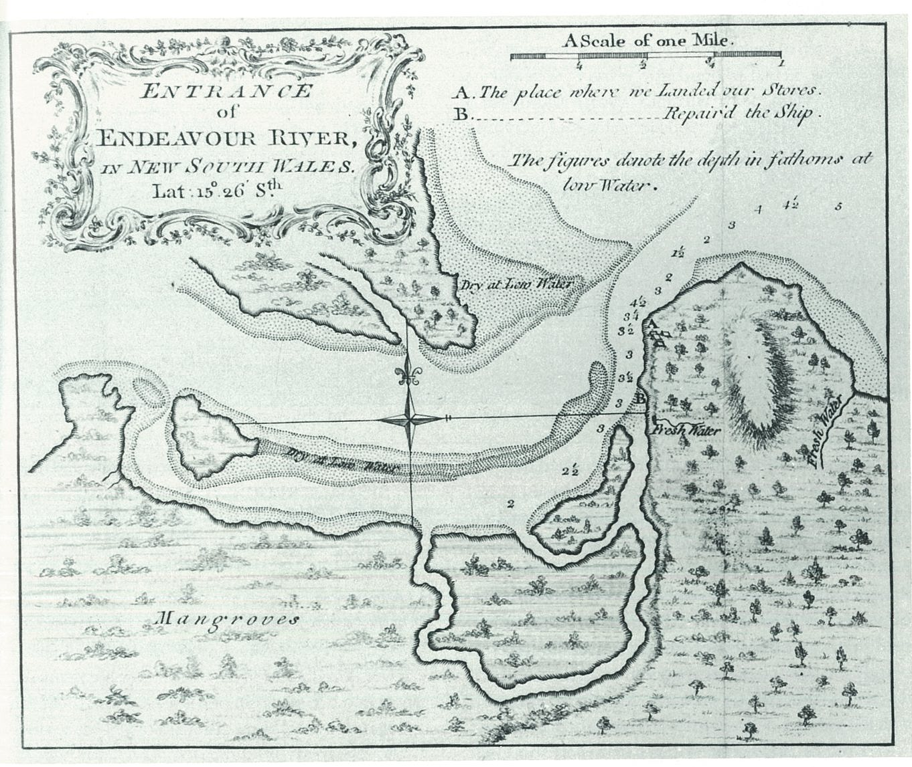
Captain Cook’s 1770 map of
Endeavour River,
Cooktown
Lat 15deg
26min
South
EGRU ENGAGEMENT DAY 3/11/2022

Slide 6
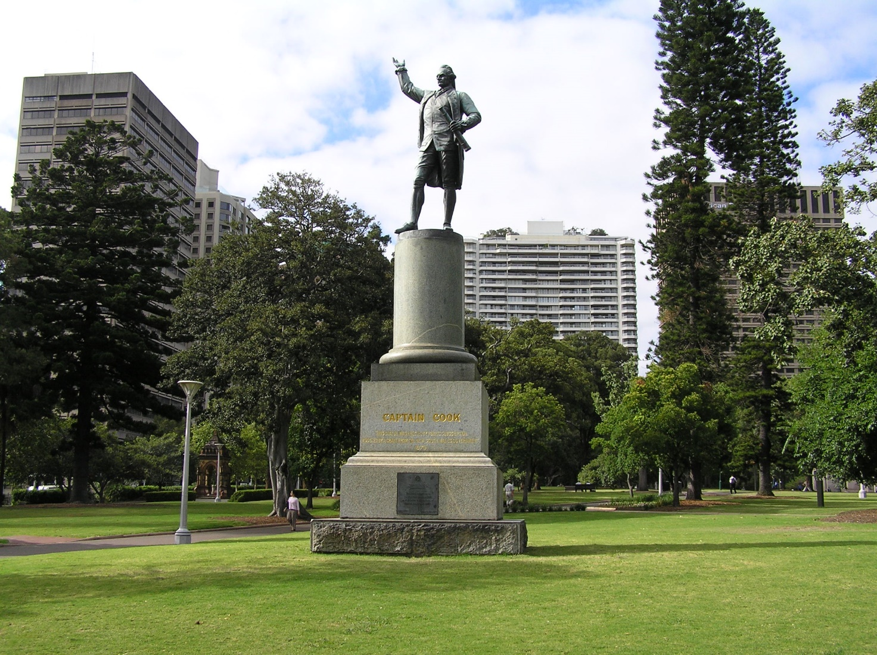
Captain Cook Hyde Park , Sydney, Celebrated as a great figure of the Enlightenment & Scientific Endeavour
EGRU ENGAGEMENT DAY 3/11/2022

Slide 7
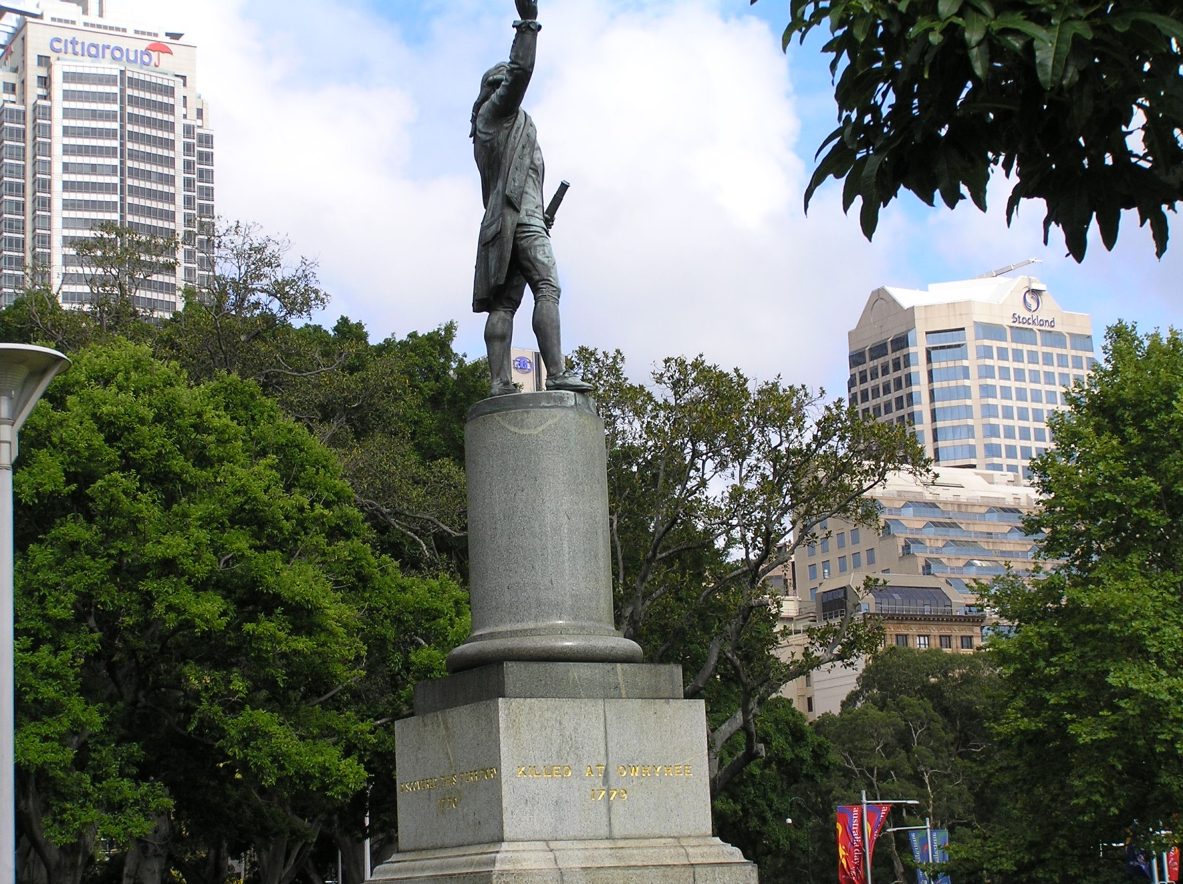
EGRU ENGAGEMENT DAY 3/11/2022

Slide 8
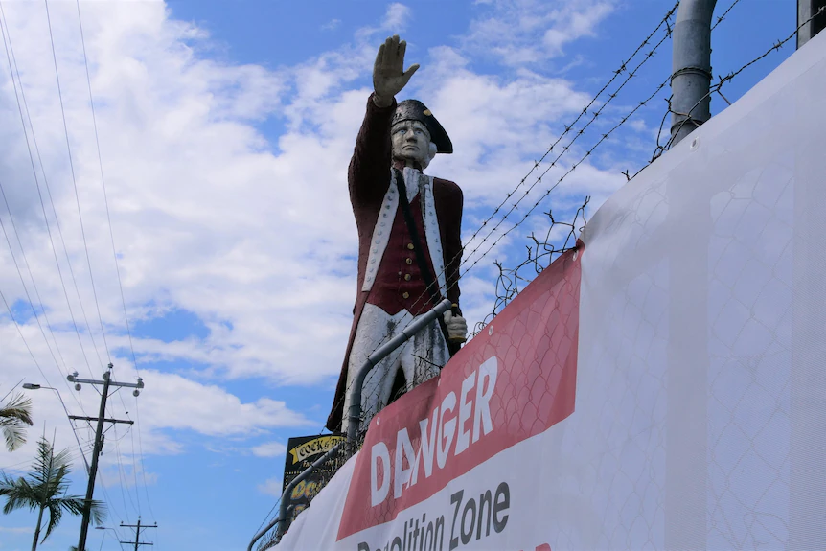
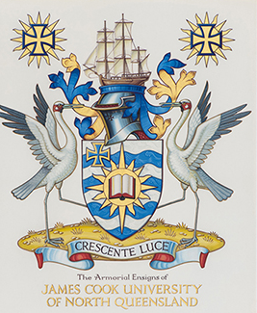
Poor Old Captain Cook & Scientific Endeavour : De-Platforming & Airbrushing of a distinguished elder from the Enlightenment.
EGRU ENGAGEMENT DAY 3/11/2022

Slide 9
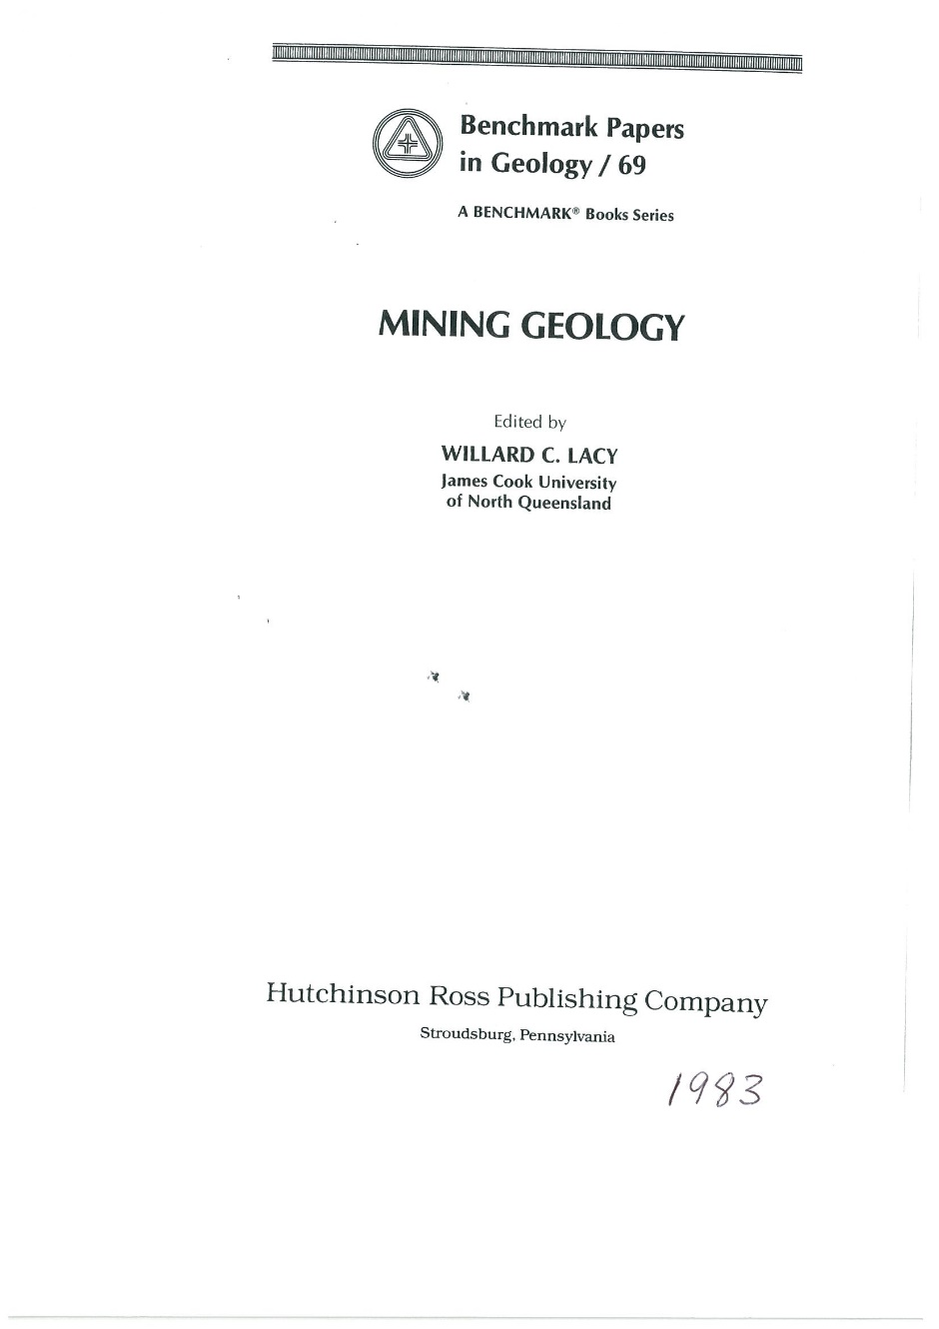

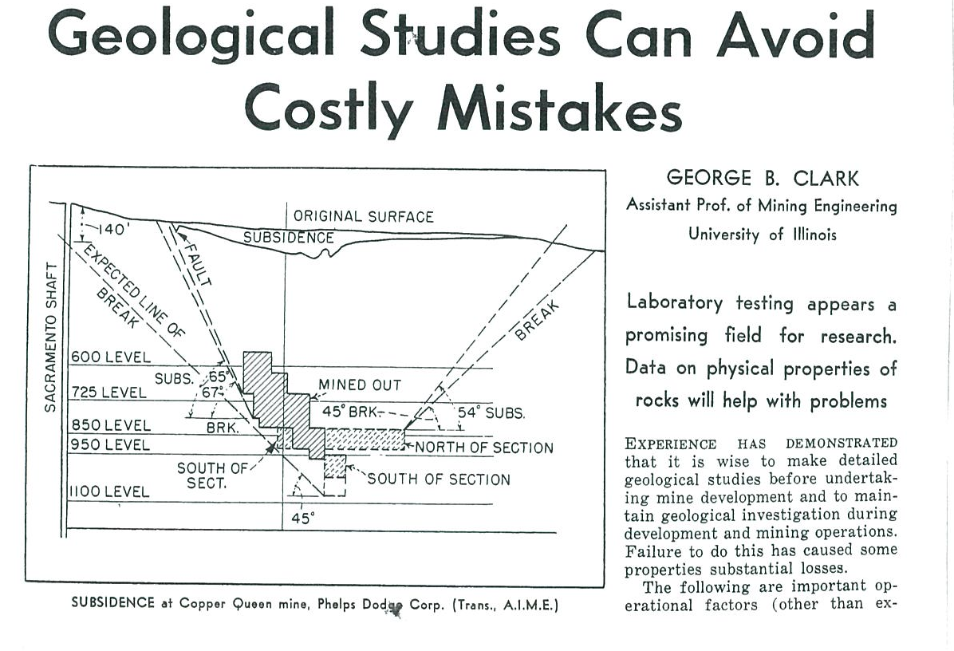
. Prof Bill Lacy Not a conventional choice in 1972
EGRU ENGAGEMENT DAY 3/11/2022

Slide 10
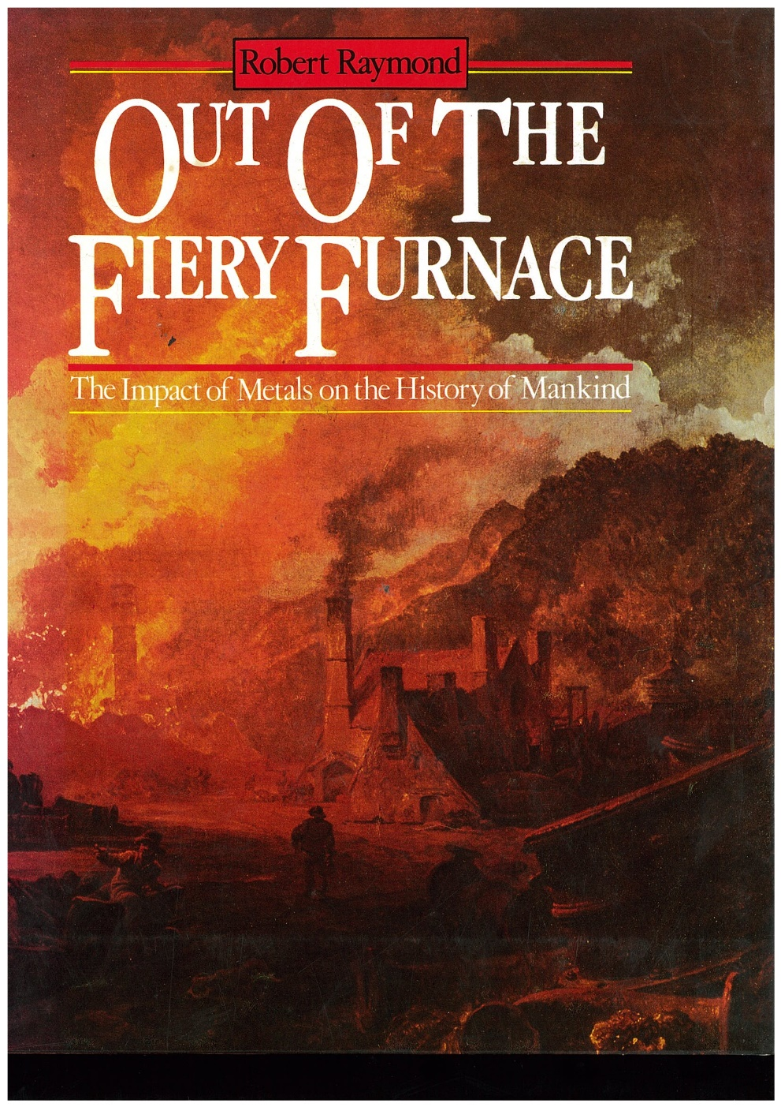
The impact of Metals on the History of Mankind. Technical Adviser Prof Lacy : Described in the Introduction as “ A practicing mining geologist
before becoming Professor of Geology at James Cook University, Townsville : genial and rigorous-minded “
Out of the Fiery Furnace
EGRU ENGAGEMENT DAY 3/11/2022

Slide 11
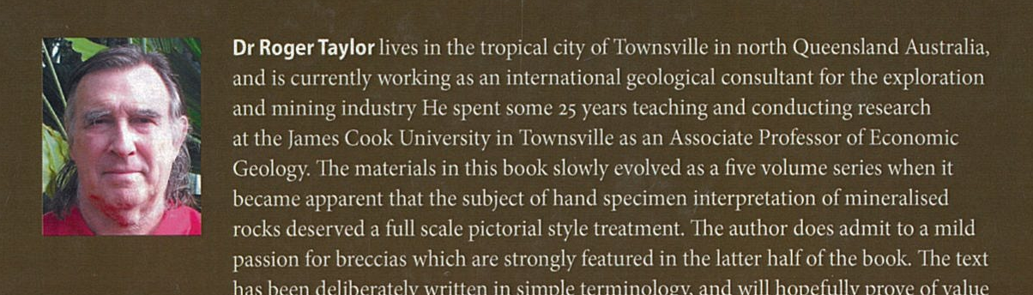
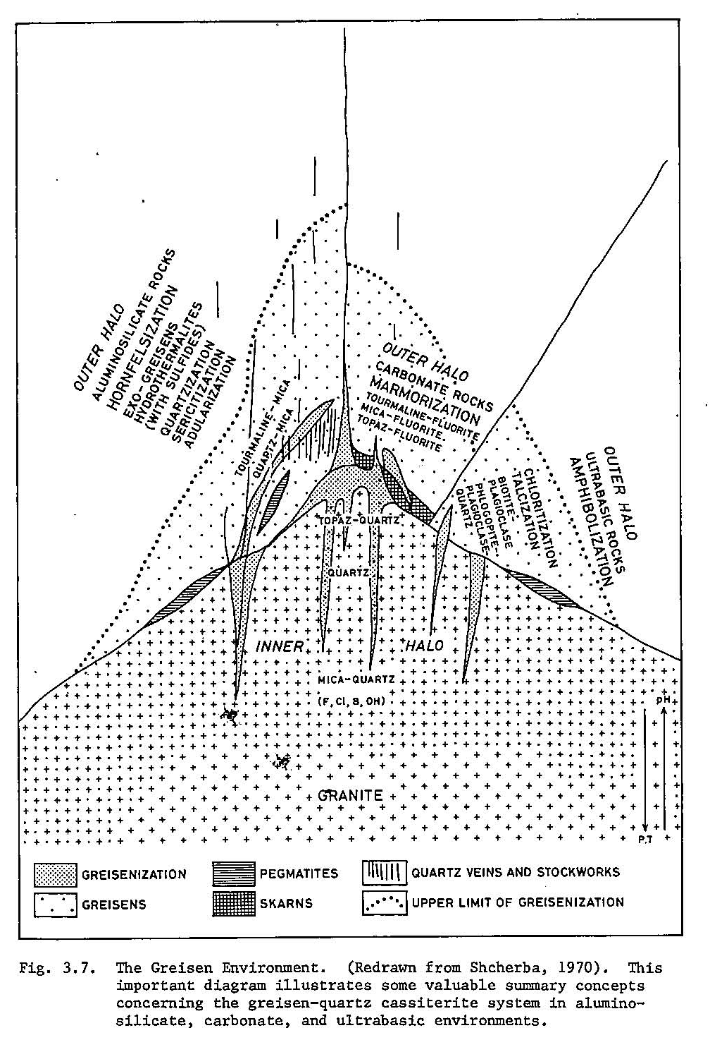
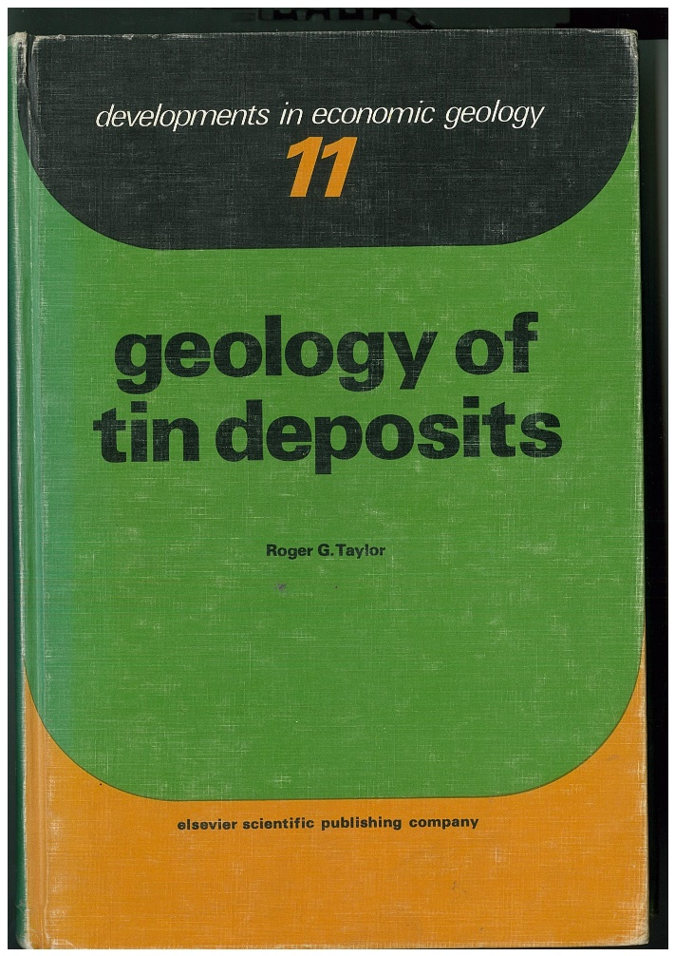
Roger Taylor : Expert in Intrusive related systems
EGRU ENGAGEMENT DAY 3/11/2022

Slide 12
EGRU /James Cook Uni strengths in 1982
Based amongst the great mineral provinces of Northern Australia and SW Pacific
Economic geology led by Prof Lacy & Roger Taylor both with practical Mining & Exploration experience .
Very successful Masters Course : JCU gave a host of practical geologists with wide ranging experiences a chance to renew their economic geology knowledge base with resounding results.
Active engagement with industry at a time of major north Queensland development.
Team of academic staff with diverse expert geological knowledge, with north Qld focus.
EGRU ENGAGEMENT DAY 3/11/2022

Slide 13
EGRU 40 year highlights
Range of industry interactions through major conferences /research priorities/AMIRA projects : as examples : NW & NE Qld Mineral Province; Intrusive and epithermal gold, fluid dynamics, metallogenic and structural controls.
Unique expertise in the significance and metal endowment resulting from development of intrusive & breccia related mineralized fluid systems. The Lacy-Taylor legacy.
Practical Short courses : eg Ore texture recognition.
Projects with careful data collection, documentation & interpretation- just like Captain Cook.
EGRU ENGAGEMENT DAY 3/11/2022

Slide 14
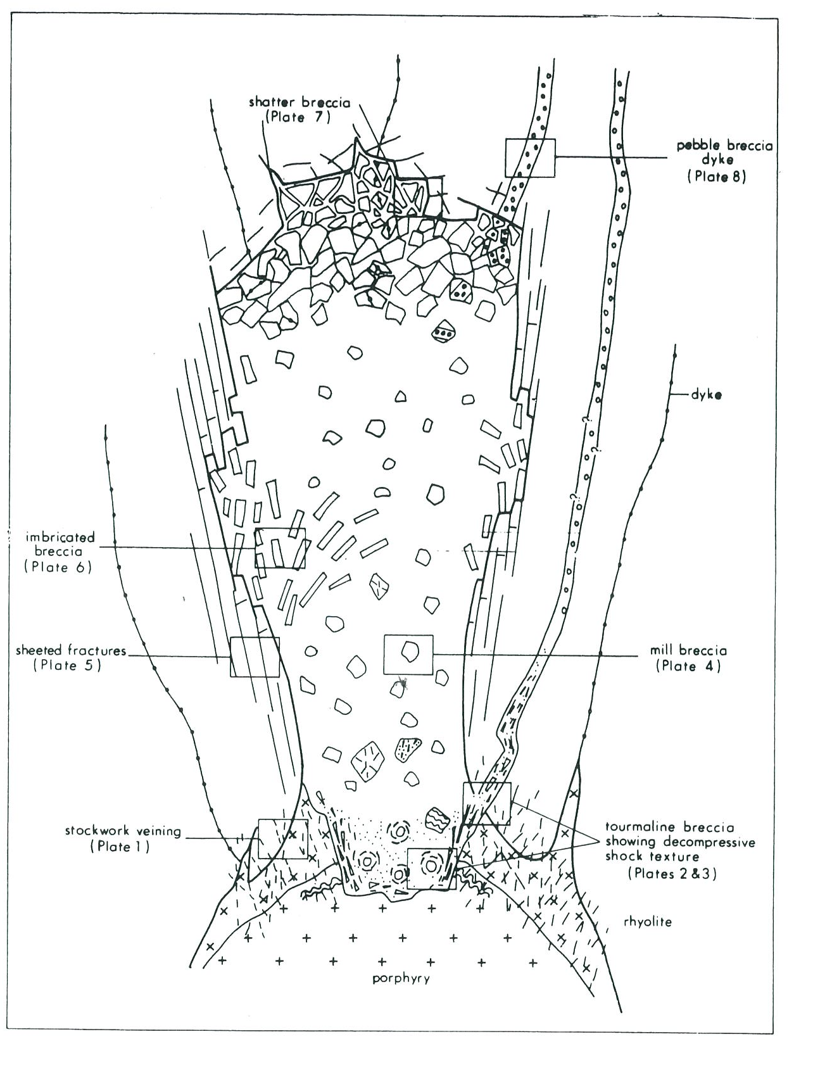
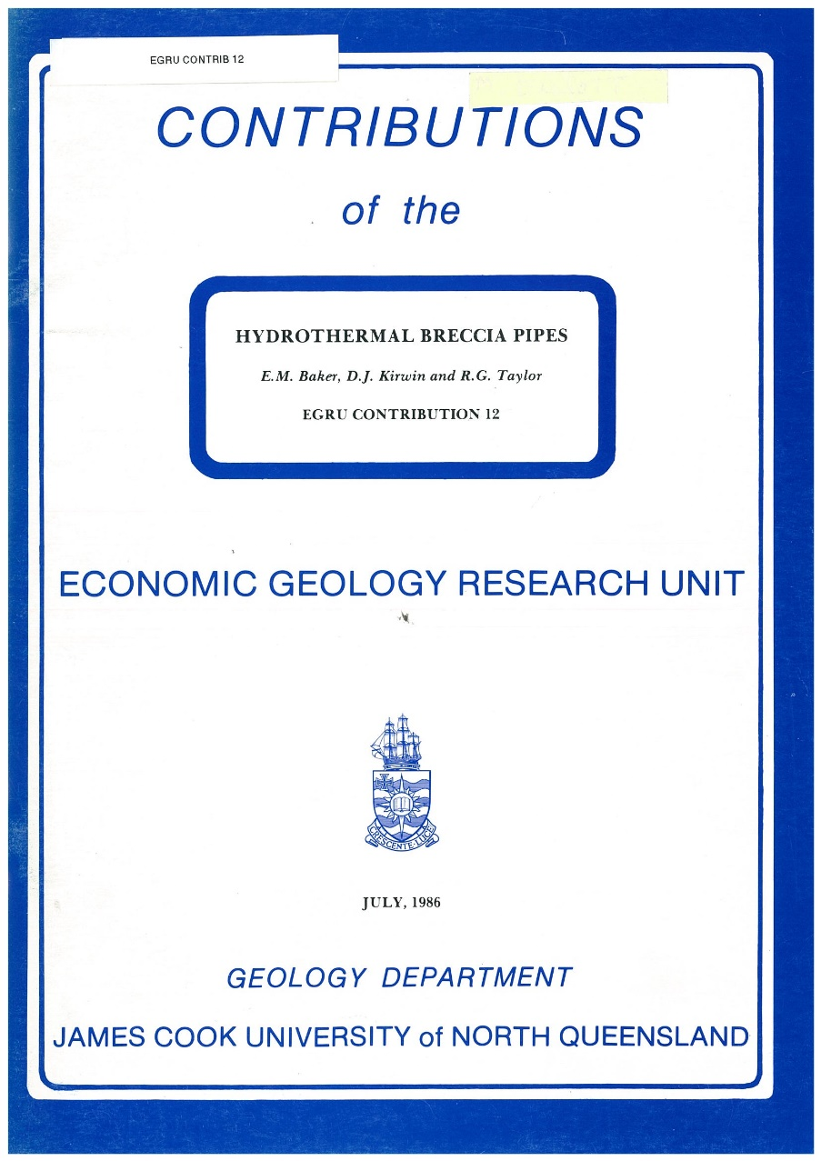
Baker,Kirwin,Taylor, 1986
EGRU # 12
EGRU ENGAGEMENT DAY 3/11/2022

Slide 15
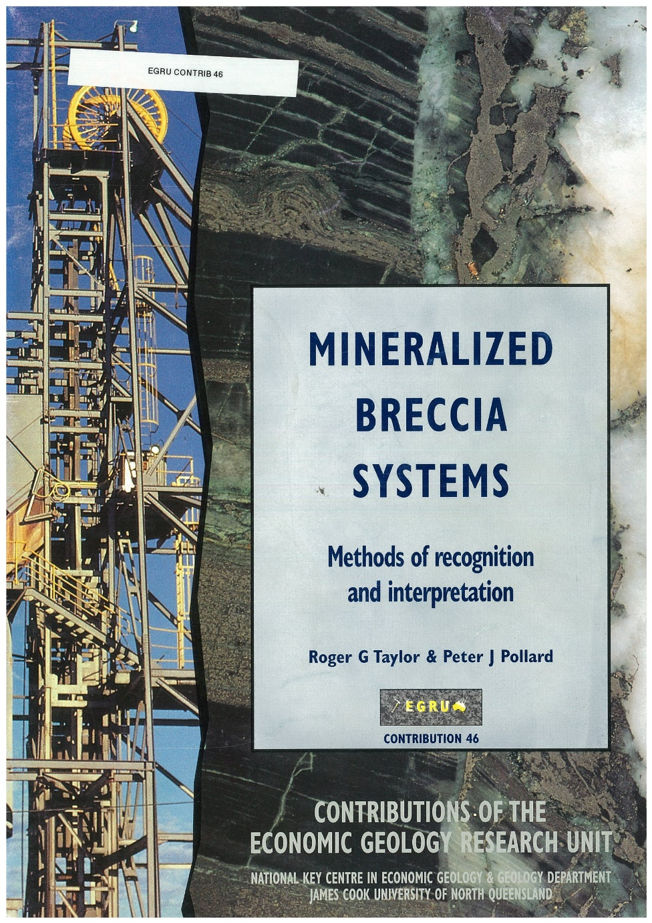
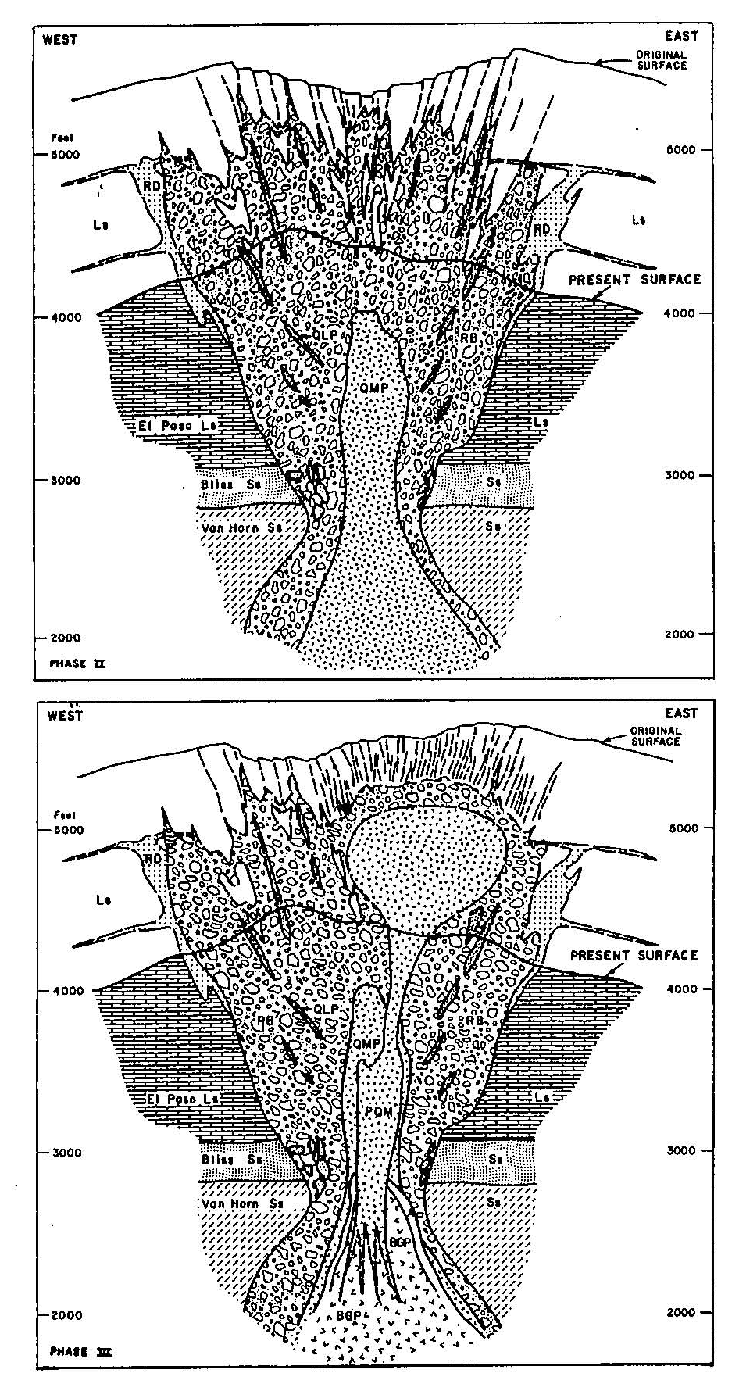
Taylor & Pollard, 1993 EGRU # 46
EGRU ENGAGEMENT DAY 3/11/2022

Slide 16
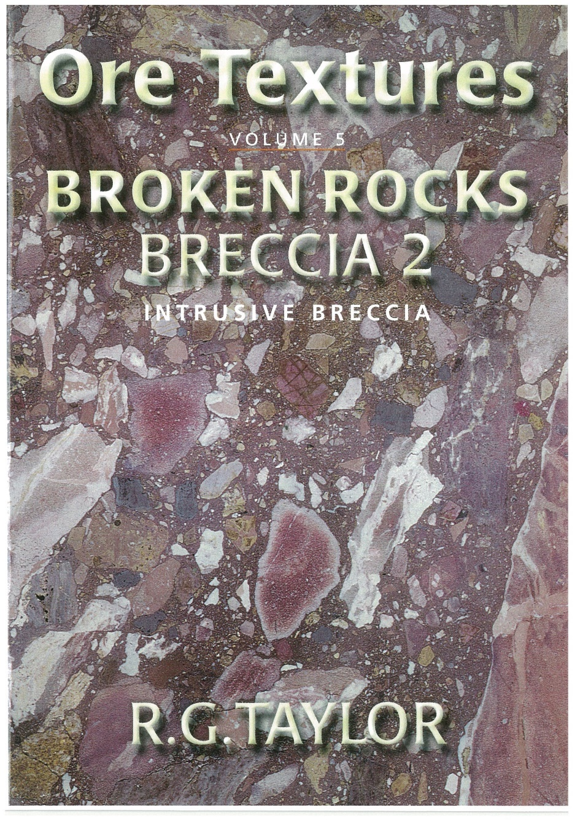

Taylor, 2003
Blenkinsop & Duckworth , 2007 EGRU # 65
EGRU ENGAGEMENT DAY 3/11/2022

Slide 17
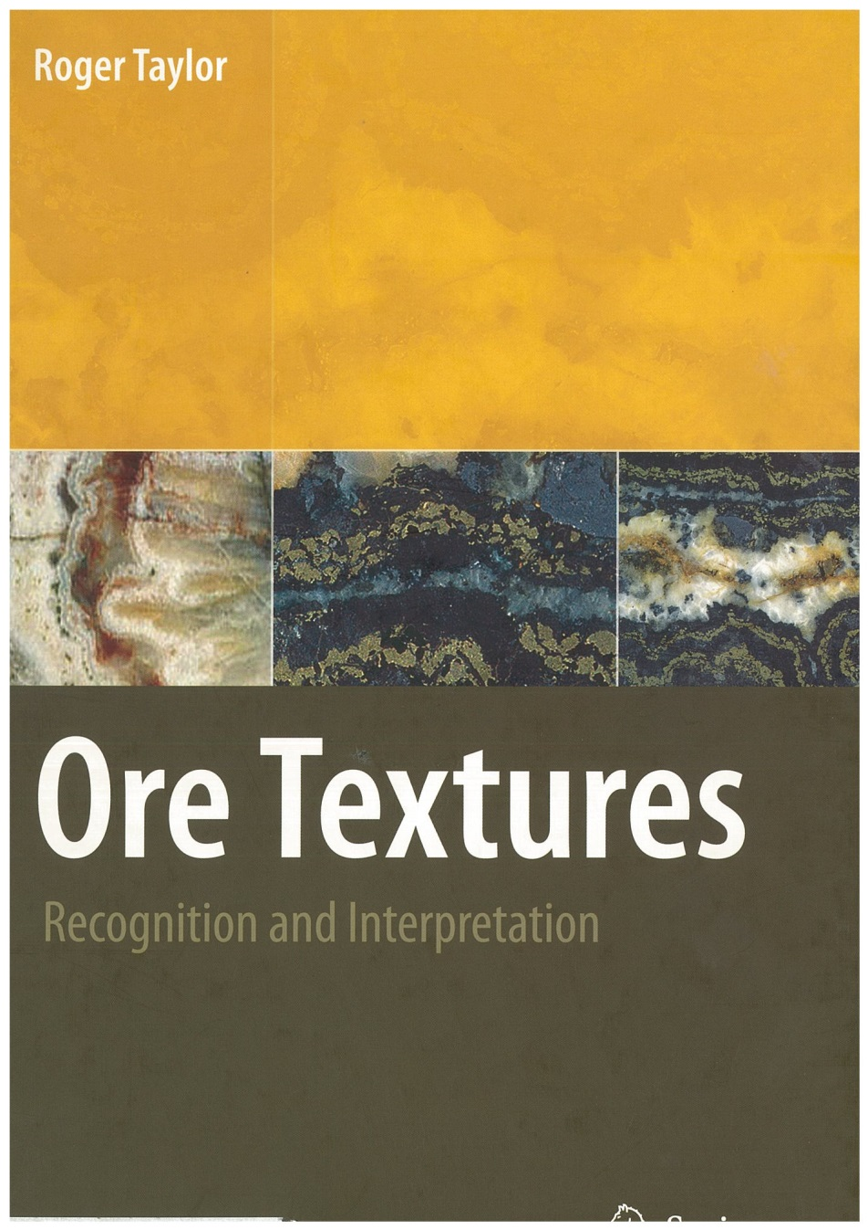
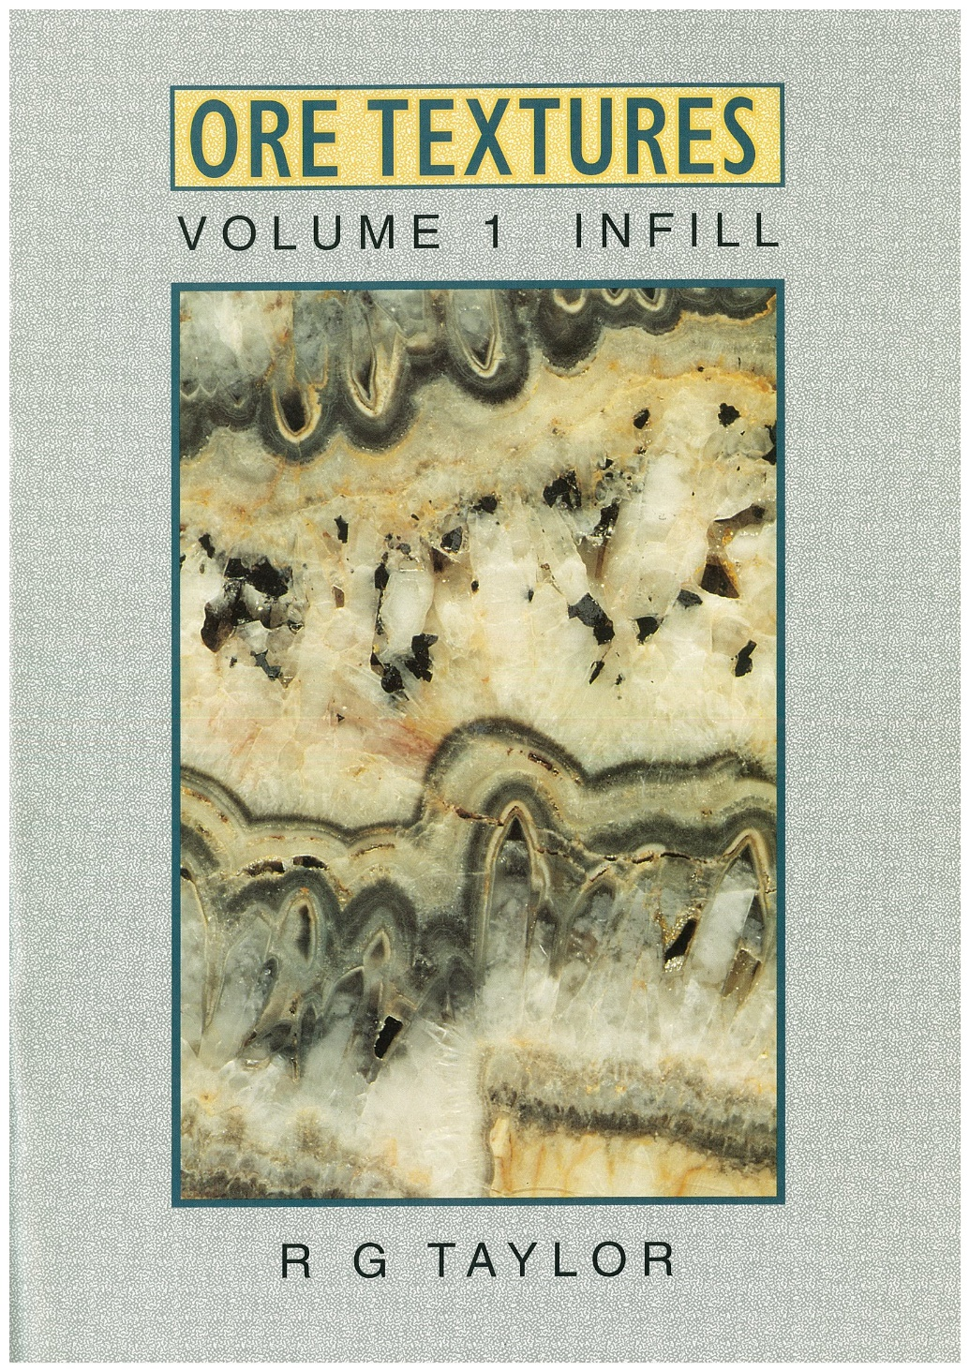
EGRU ENGAGEMENT DAY 3/11/2022

Slide 18
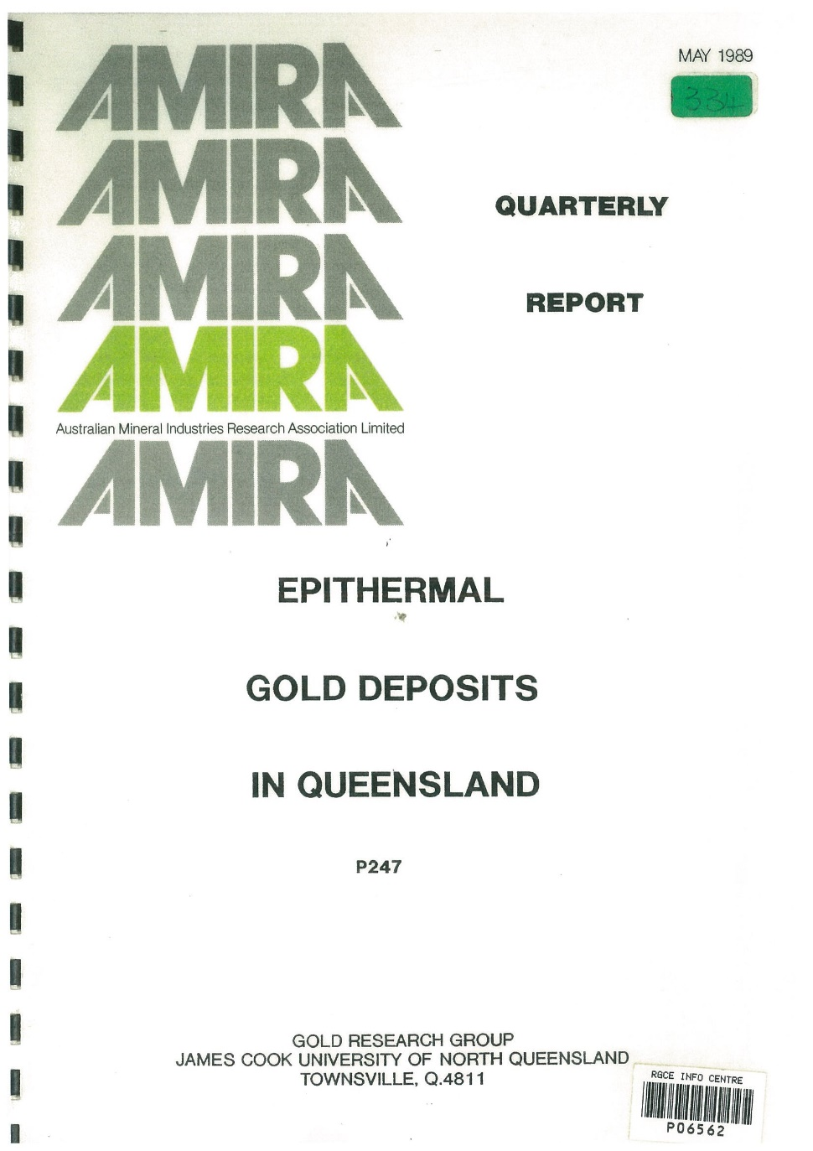
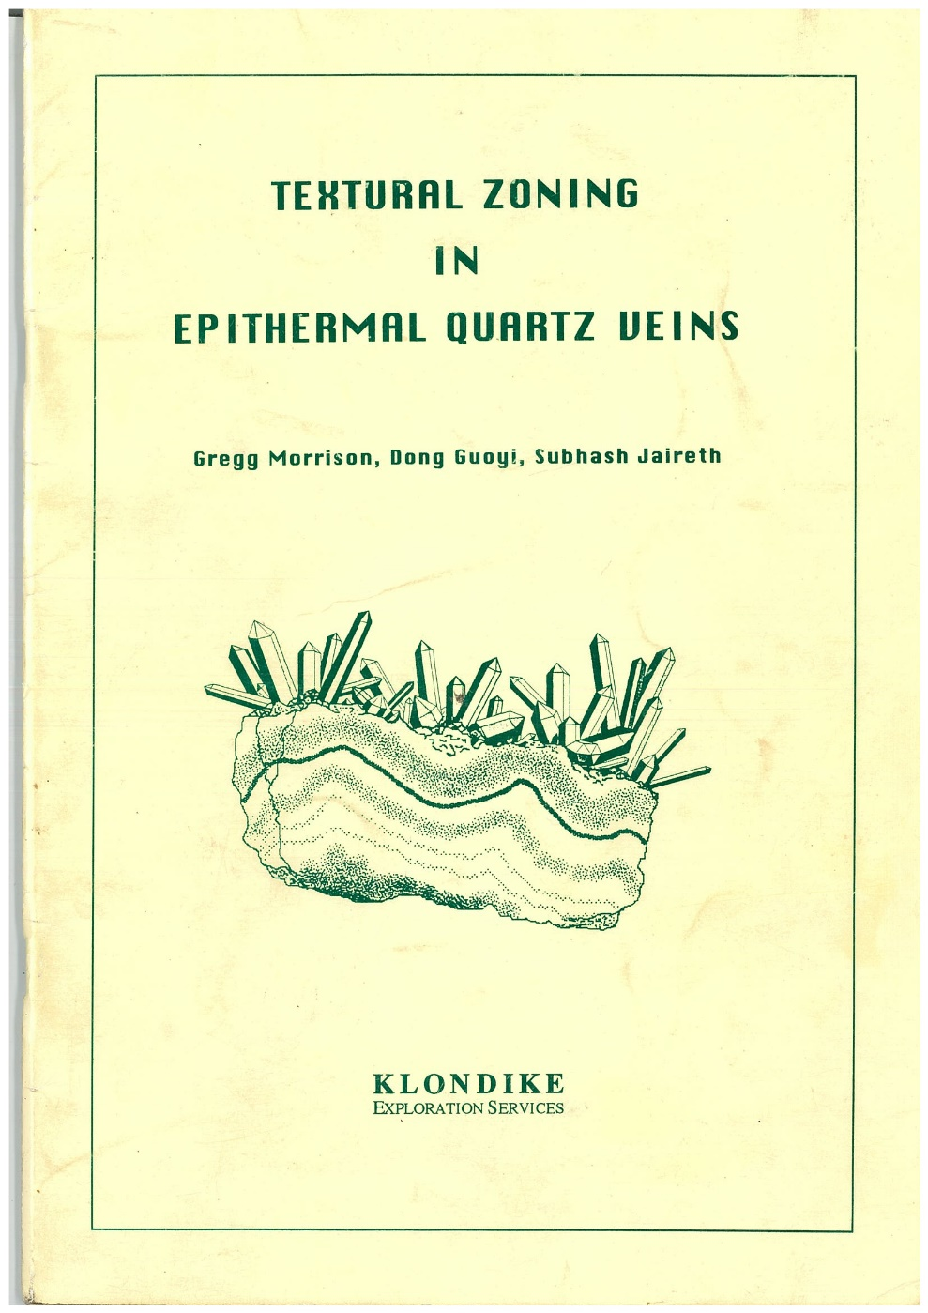
Gregg Morrison, 1983-1991 JCU Gold Research Group
EGRU ENGAGEMENT DAY 3/11/2022

Slide 19
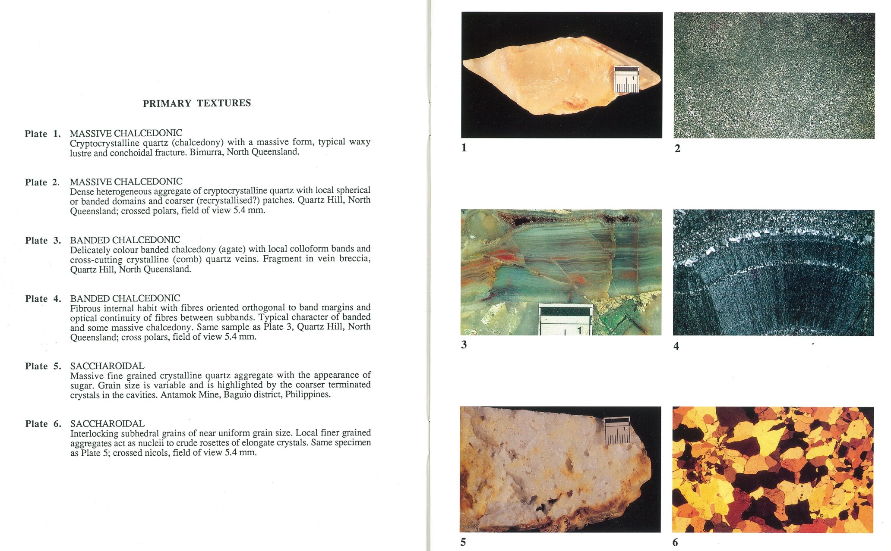
Gregg Morrison, 1990 Epithermal Textures
EGRU ENGAGEMENT DAY 3/11/2022

Slide 20
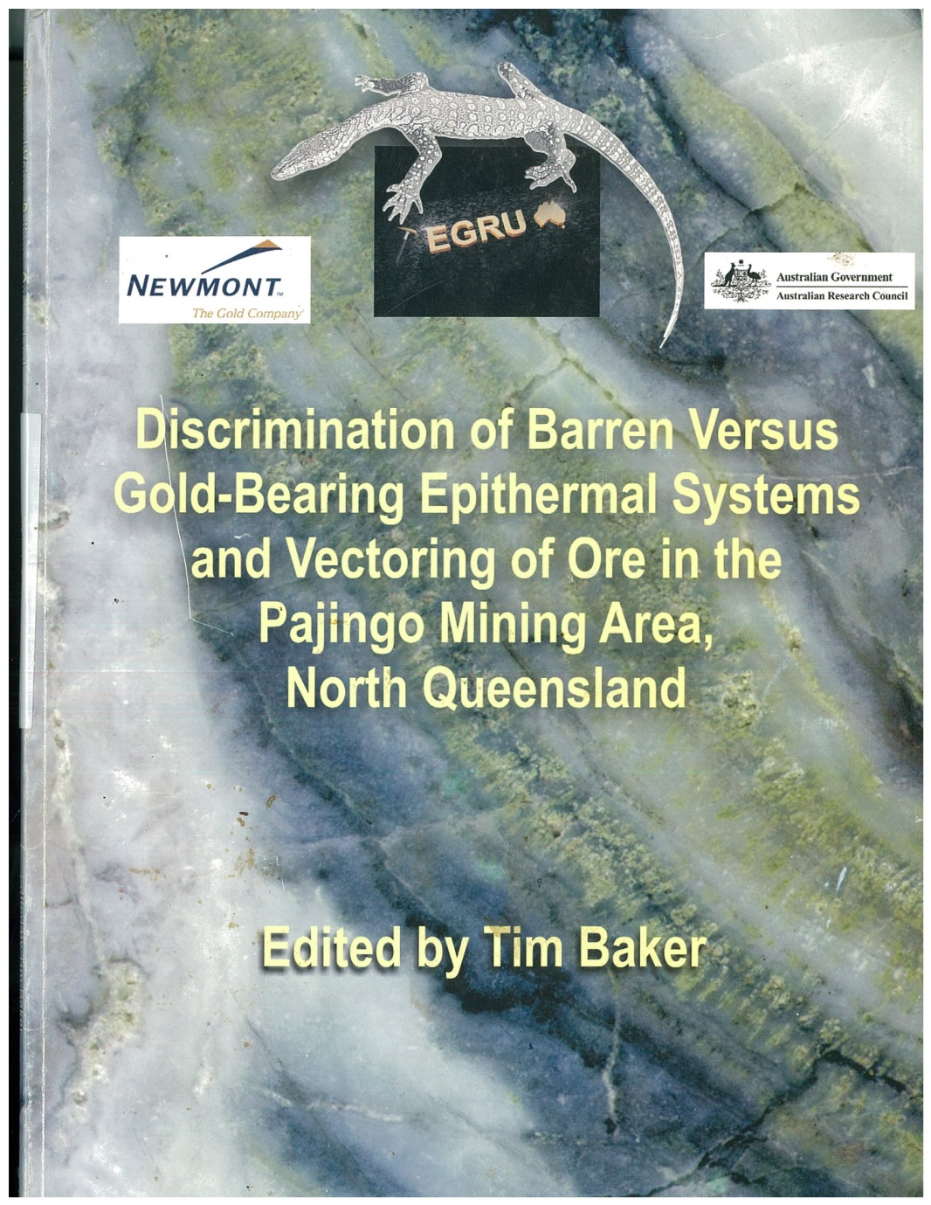
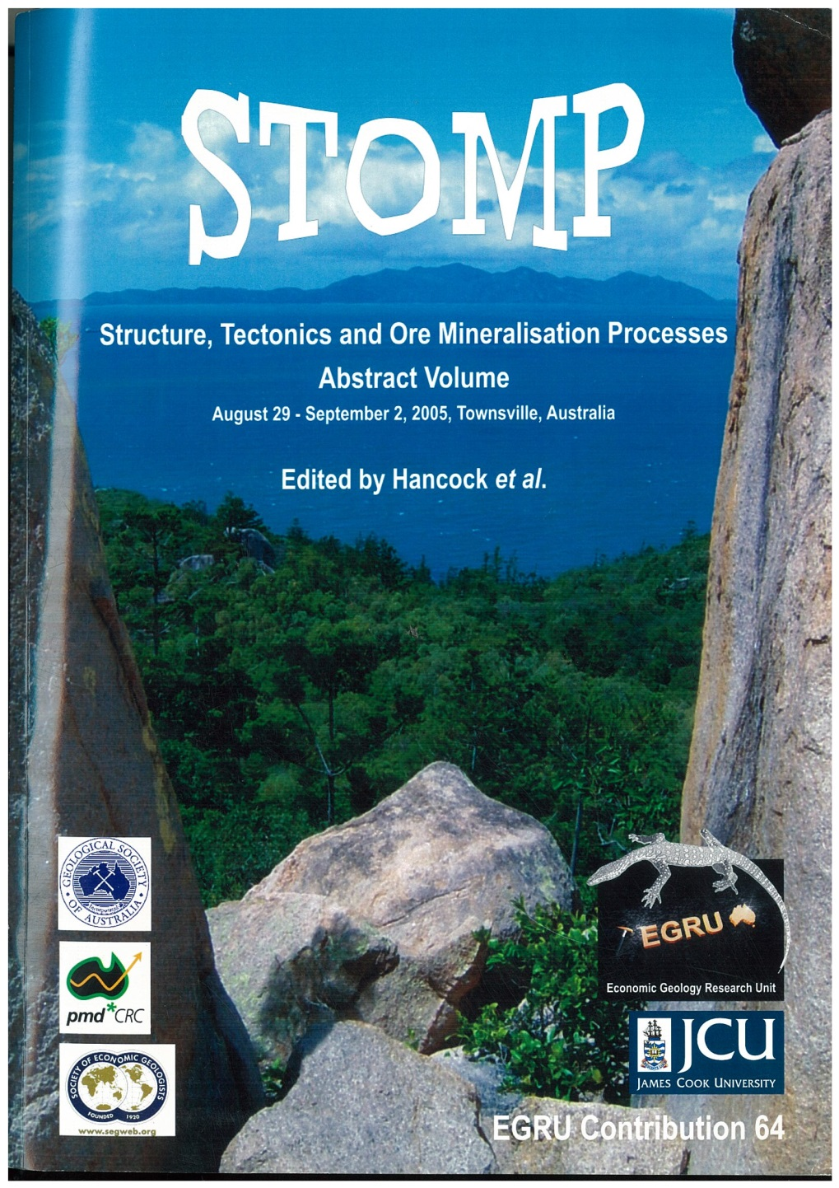
EGRU ENGAGEMENT DAY 3/11/2022

Slide 21
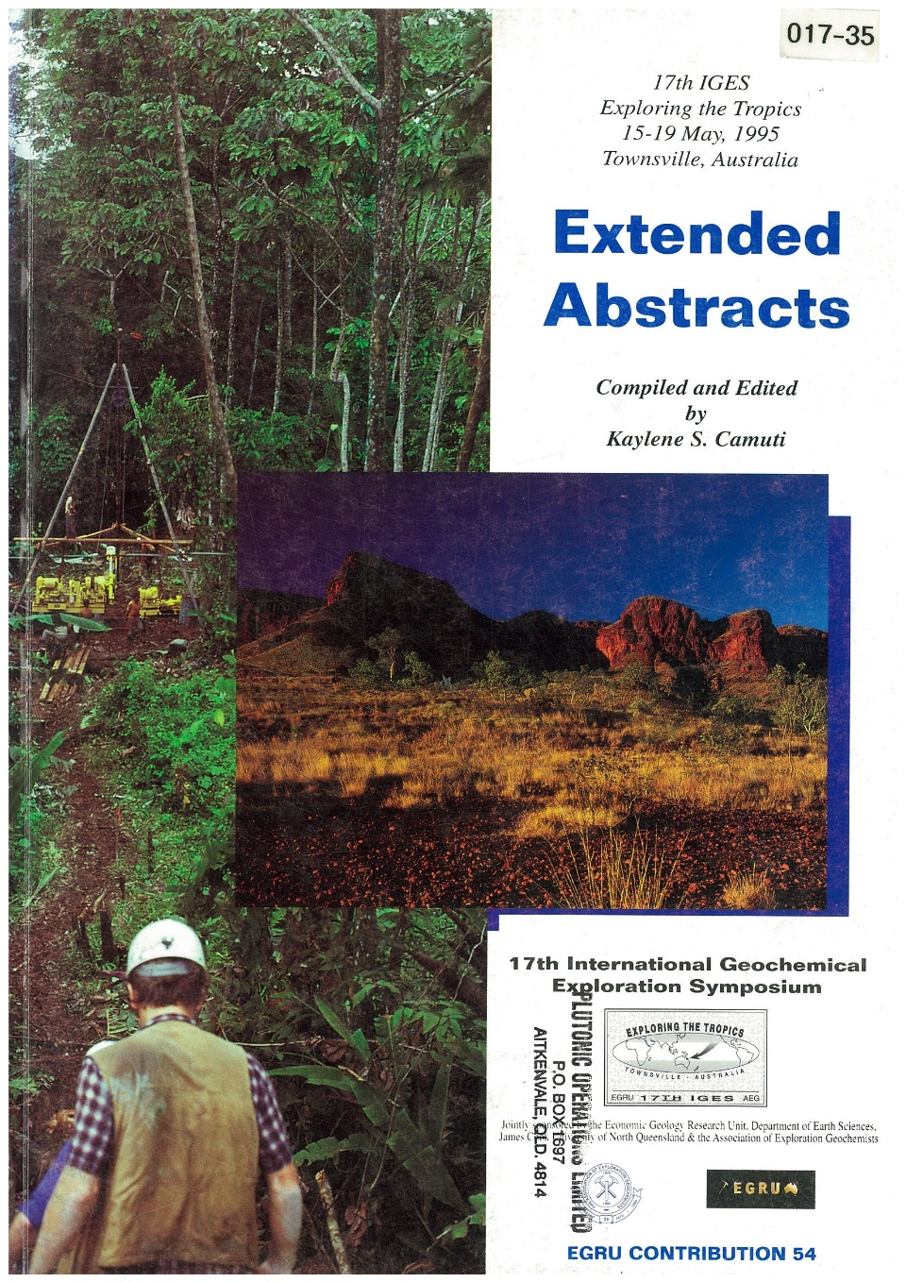
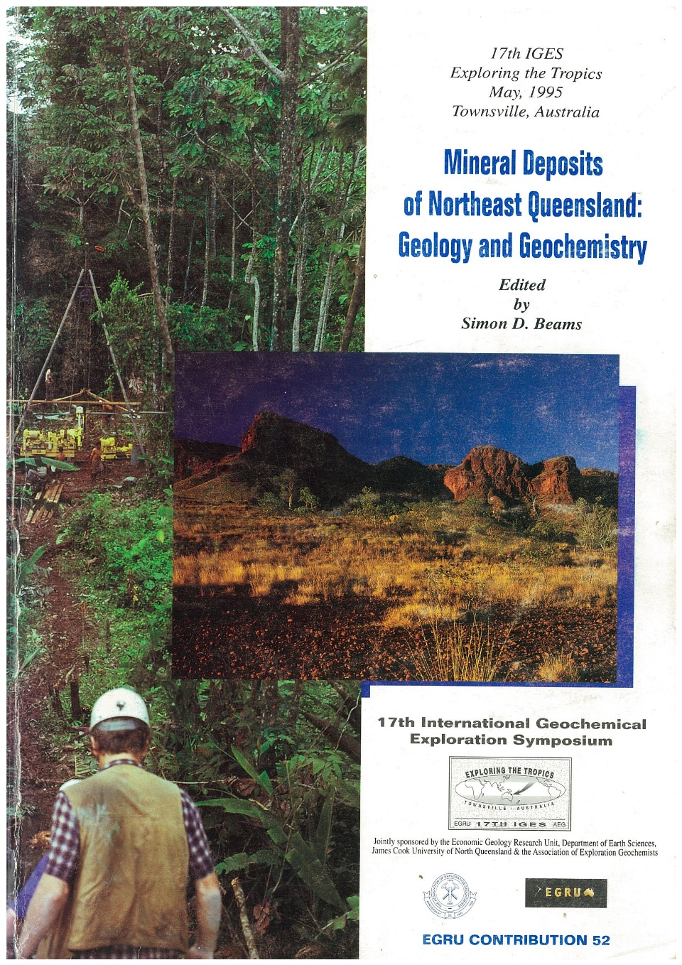
IGES Conference 1995, Camuti EGRU # 54, Beams EGRU # 52
EGRU ENGAGEMENT DAY 3/11/2022

Slide 22
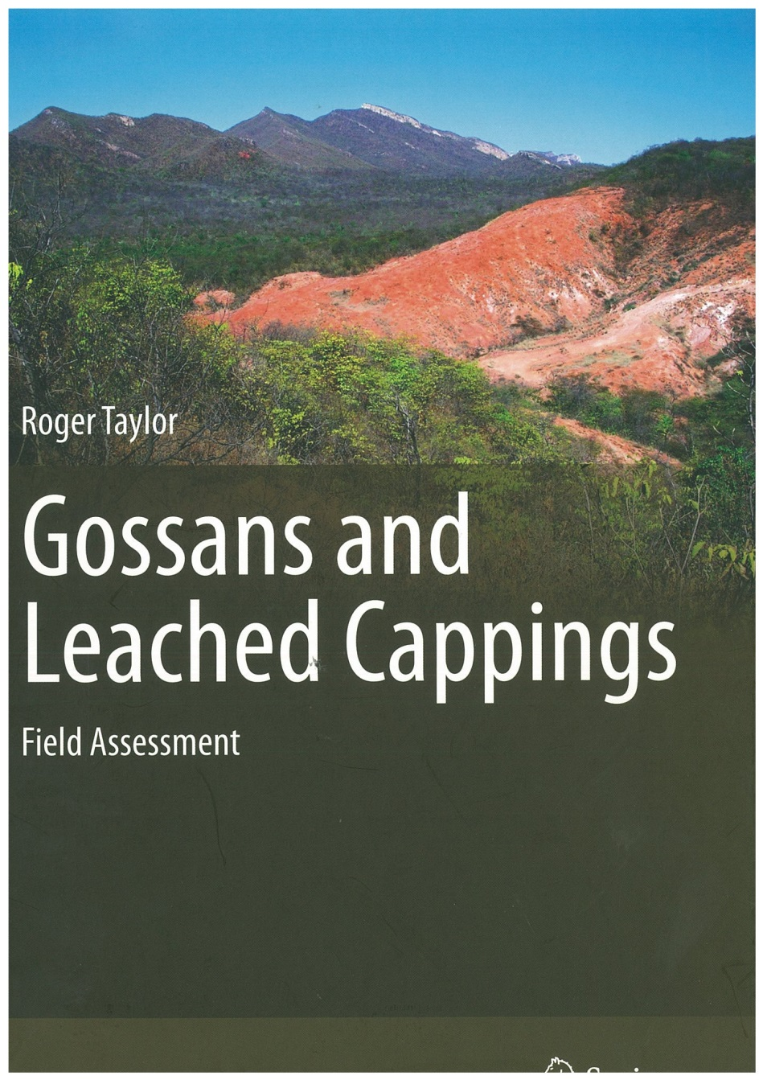
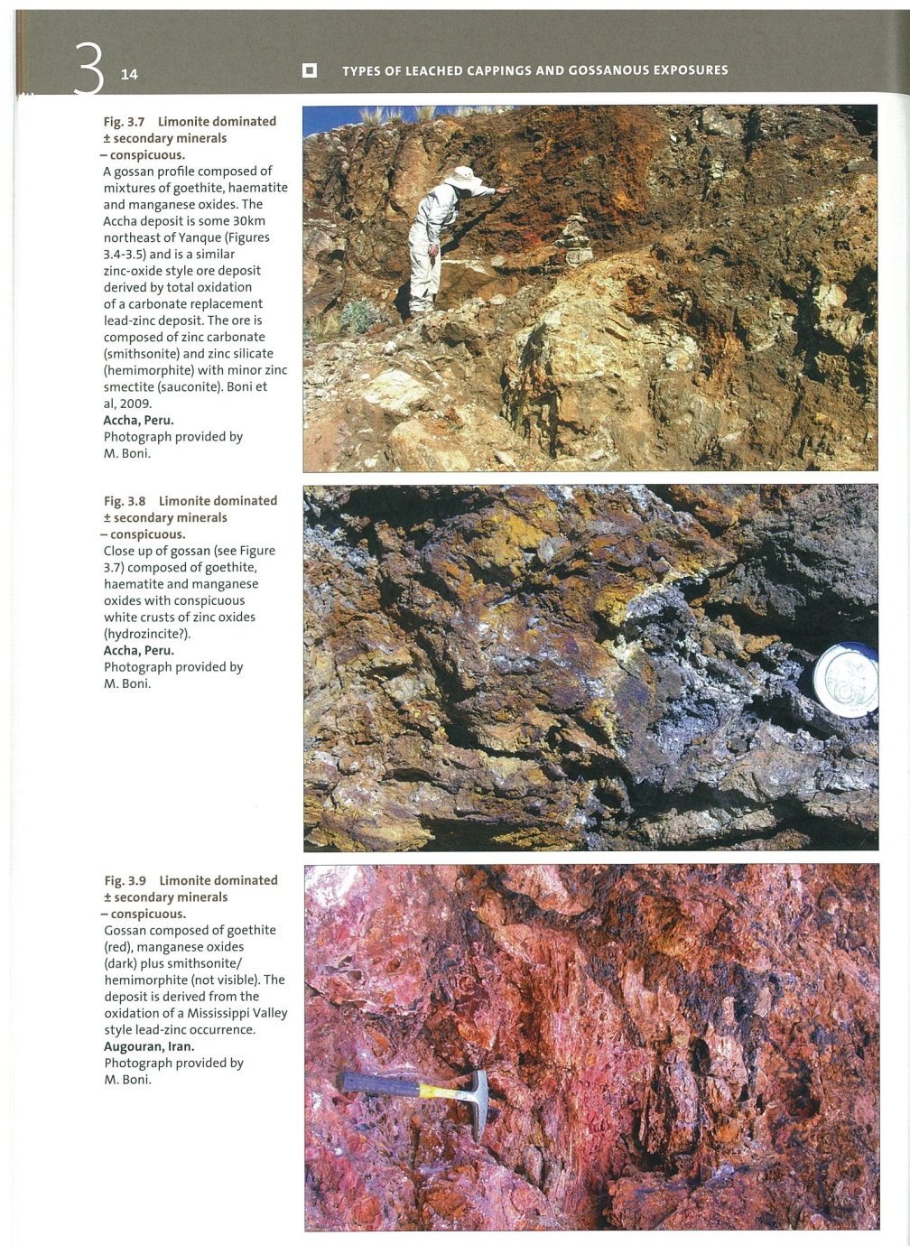
EGRU ENGAGEMENT DAY 3/11/2022

Slide 23
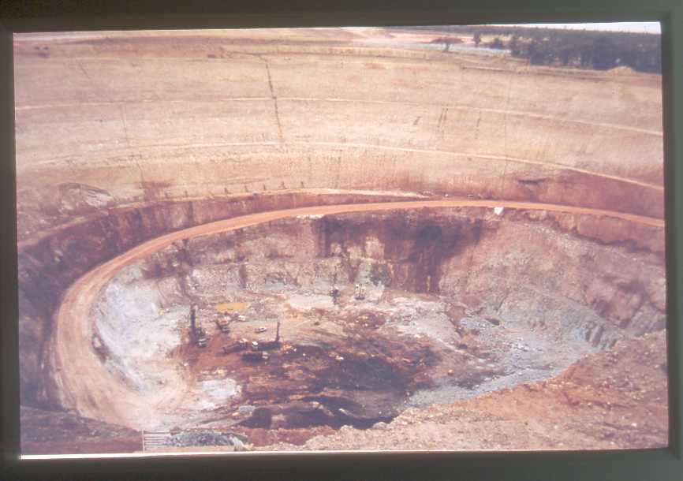
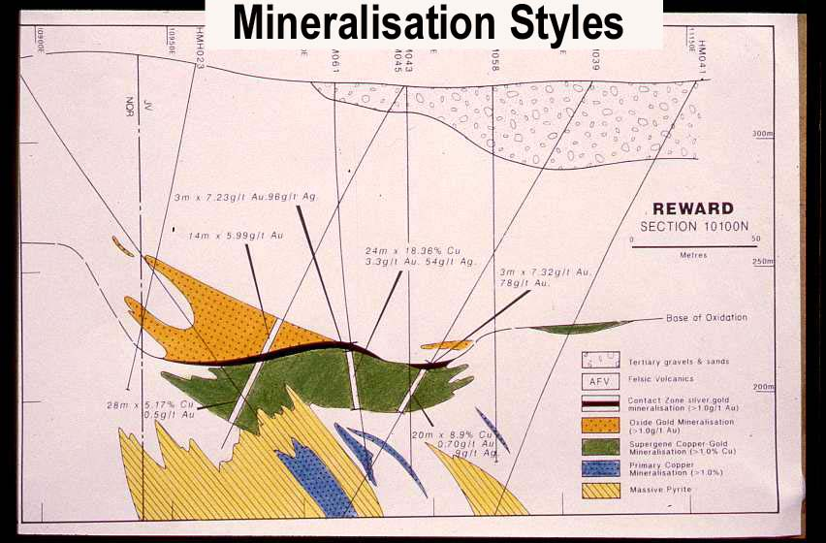
Supergene 24m @ 18% Cu
Understanding leached caps. Highway-Reward. Blind deposit Cu grades >10% in supergene with high gold in oxide
EGRU ENGAGEMENT DAY 3/11/2022

Slide 24
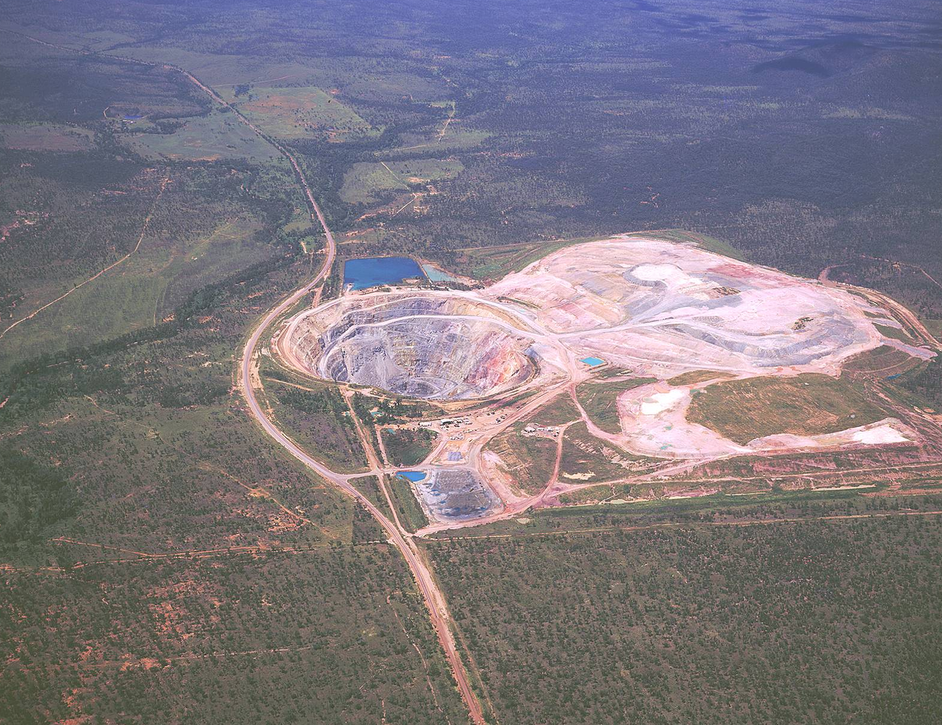
. Highway Reward 220 kt Copper metal. 60 koz Au :
$2.3 billion dollars contained metal current prices. Discovered 1987, Mined 1994-2005
EGRU ENGAGEMENT DAY 3/11/2022

Slide 25
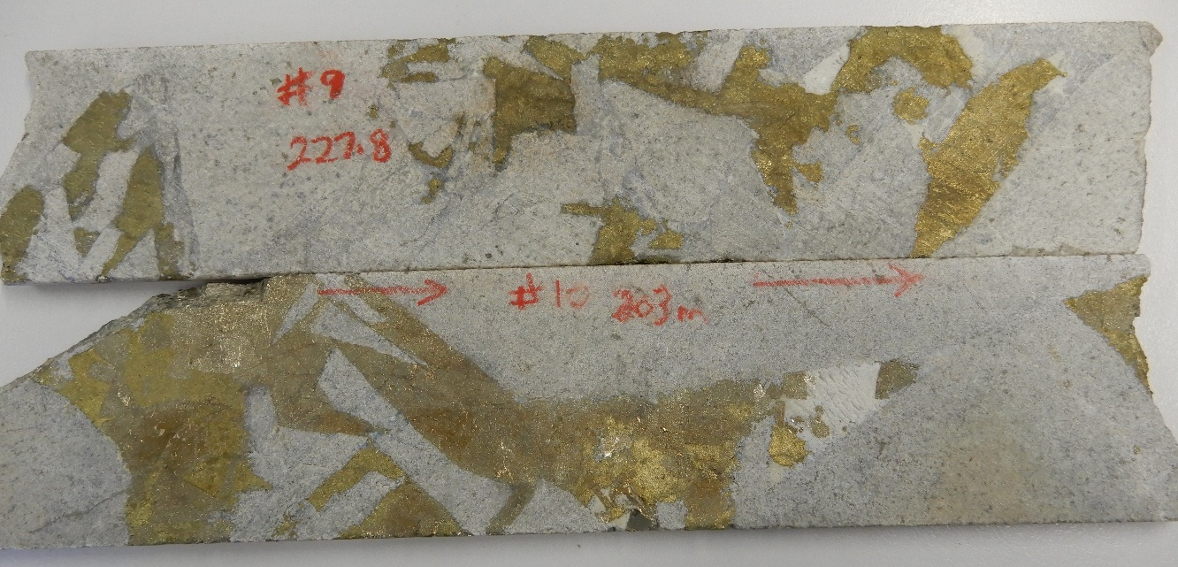
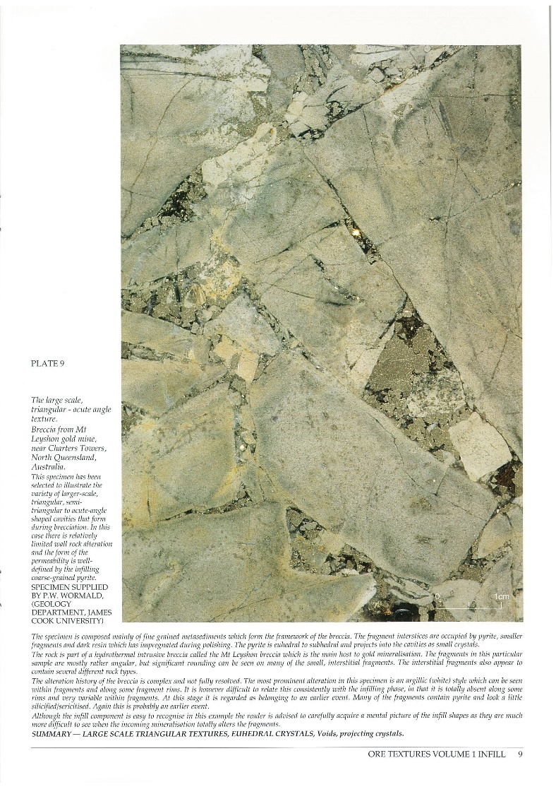
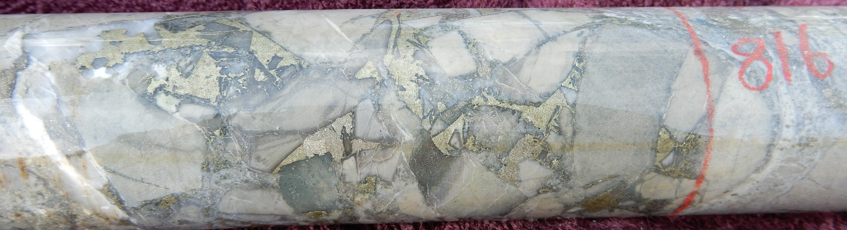
Mt Leyshon Breccia described & studied in detail by EGRU staff & Students 1984-1995.
2022 Drilling Mt Cannindah Copper rich breccia textures.
EGRU ENGAGEMENT DAY 3/11/2022

Slide 26
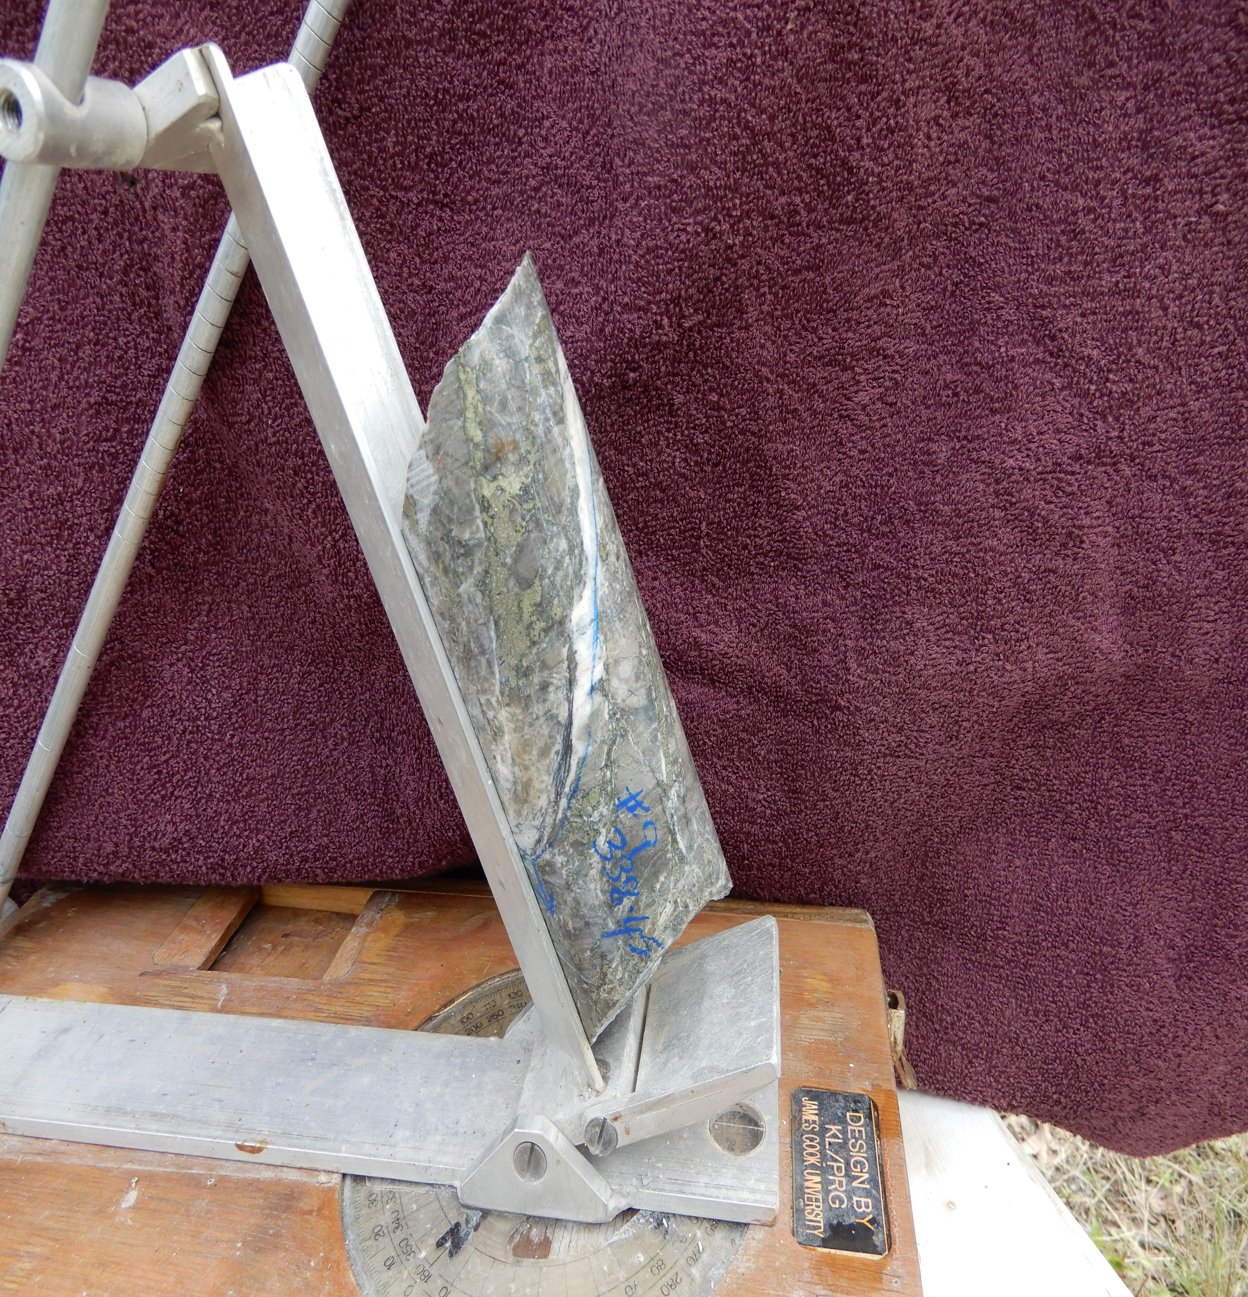
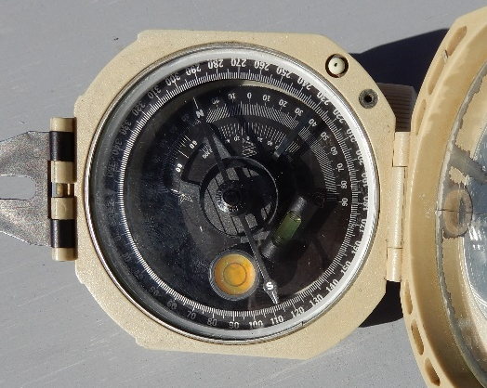
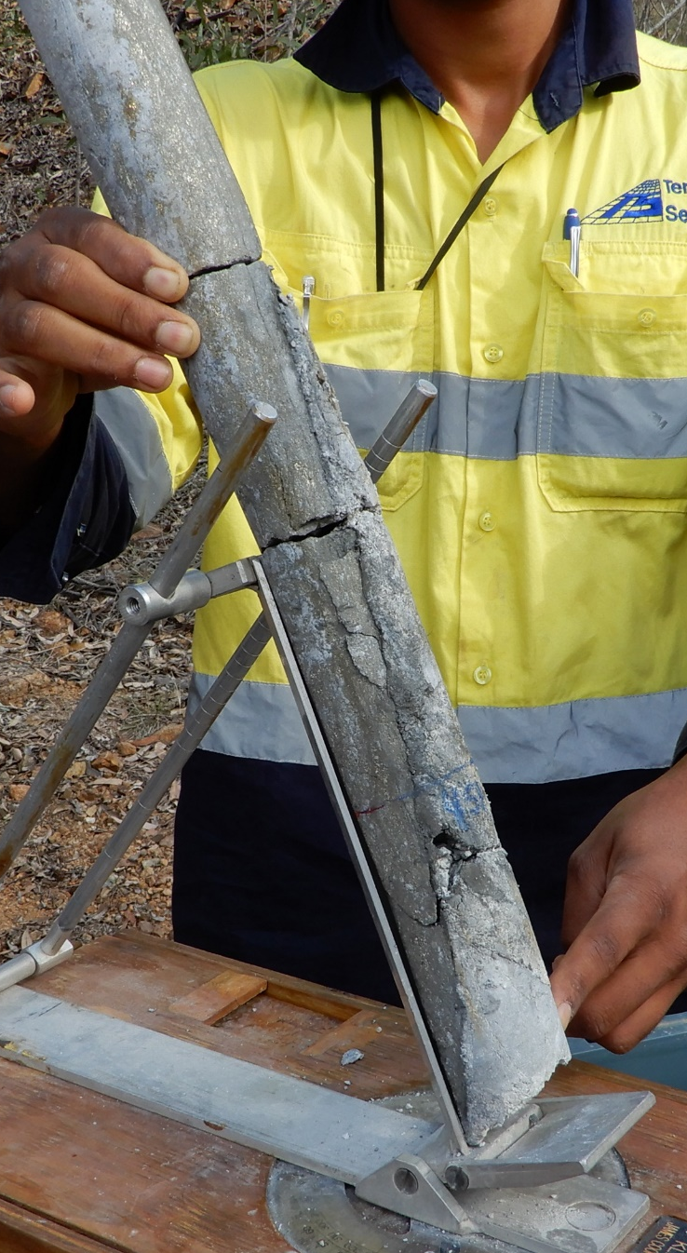
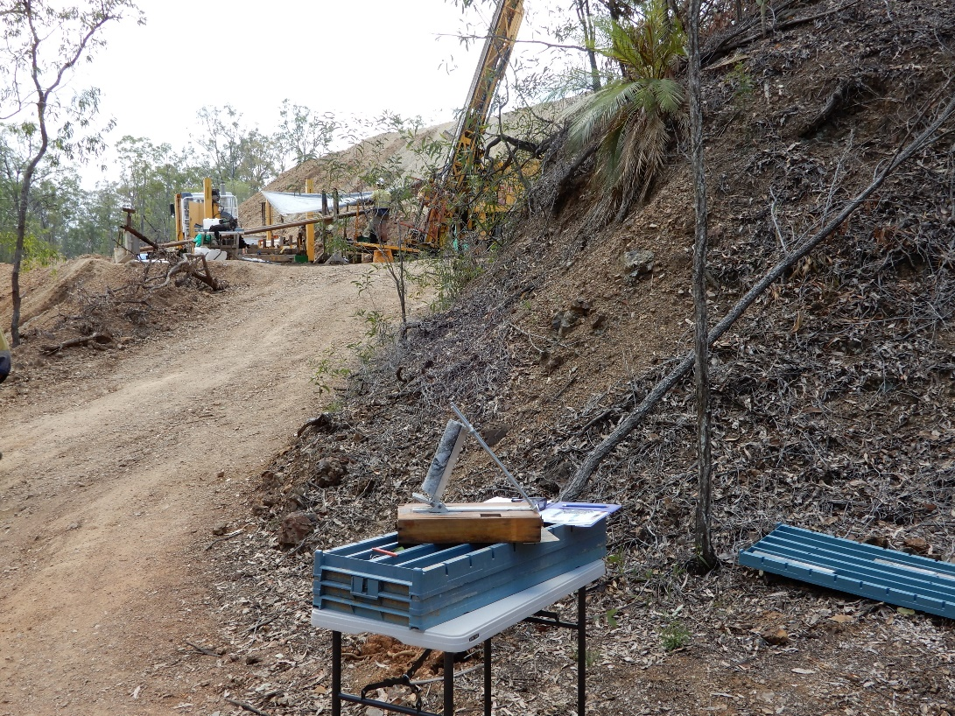
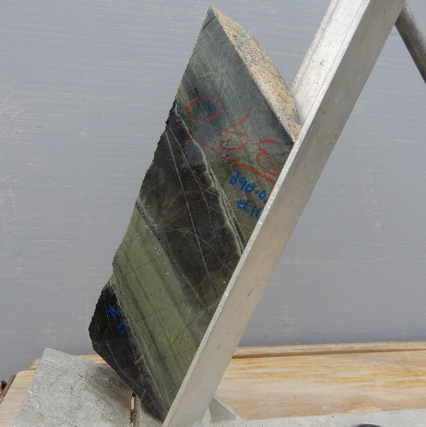
Core Orienting Frame EGRU Innovation
EGRU ENGAGEMENT DAY 3/11/2022

Slide 27
Scientific Process @ JCU
Technical Audit on Climate Science : A missed Opportunity
The people of Australia are desperate for an objective scientific analysis to understand the facts, as opposed to entrenched subjectivity in relation to climate emergency hysteria or the societal impact of energy transformation .
Back in 2009, I urged JCU to put a mix of geoscientists and environmental scientists together, who are prepared to employ the utmost scientific rigour and carry out an independent audit on the data used in climate change science and the mathematical models.
In a similar fashion to resource modelling every data point should be subjected to scrutiny and scientific rigour before a sign off by competent professionals.
Unquestioning acceptance or dogma is the enemy of science.
High profile JCU scientists such as Professor Bob Carter and Dr Peter Ridd would have given the project great credibility, and potentially global recognition. ALAS !! A MISSED OPPORTUNITY
EGRU ENGAGEMENT DAY 3/11/2022

Slide 28
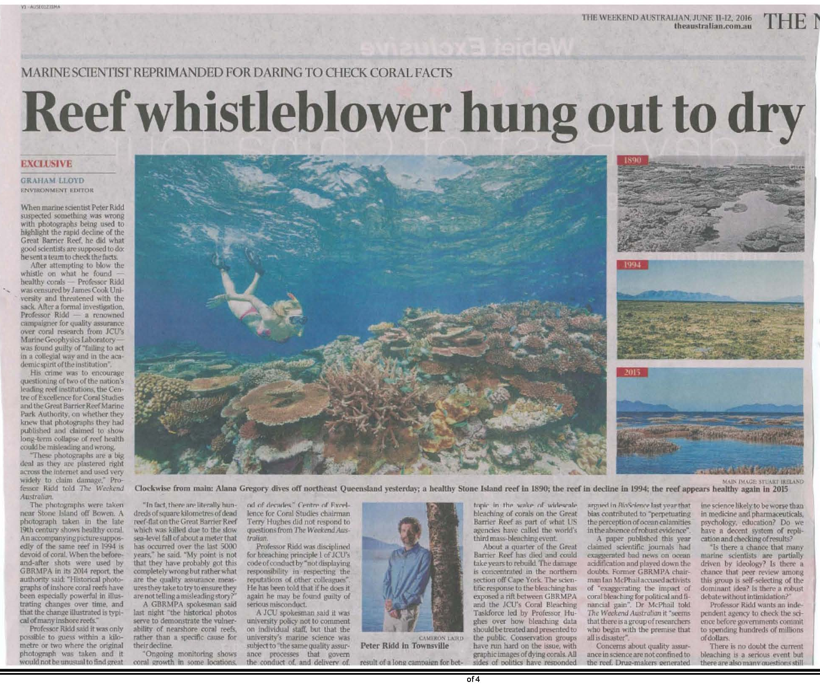
JCUs Actions
De-platforms
Professor Carter
Sacks
Dr Peter Ridd
Contest of Ideas should be a fundamental tenet of a university
EGRU ENGAGEMENT DAY 3/11/2022

Slide 29
Industry requires new professionals. This will be solved . It will be up to EGRU/JCU how involved it wants to be in the process.
I
In one of the regular reviews of EGRU ,back in 2009 , I pointed out as an active owner of an exploration business and explorer , there will be more requirements for hard science. I feel that this is what the world is crying out for. Soft science courses are already two a penny. First principle understanding of mineralogy, mineral chemistry, structural geology, fluid pathways, geophysics are all needed in combination with geology interpretation and recognition of the ore environment .
This hard science link is partially under way with the Faculty of Engineering & Science., but more needs to be done, eg exploration geophysics.
There is an obvious need to encourage and incentivize students to look at a professional career in the Resource Sector as full of Job Satisfaction and making a great contributor to our Commonwealth.
Skill shortage applies to field technicians –Cross over with TAFE but seems clear that unis are not interested.
EGRU ENGAGEMENT DAY 3/11/2022

Slide 30
Practical Exploration Opportunities identified in 1994, 2009, Many still need to be addressed.
Fill the skill shortage with job ready graduates with strong geological knowledge and exploration skills.
More mutually beneficial collaboration with industry on geological , geochemical, geophysical aspects of exploration.
Take advantage of case histories and high quality data being collected across north Qld , the perfect laboratory for more field conferences cf. 1980s AMIRA projects .
Don’t Forget the likes of Captain Cook ,Prof Lacy, Roger Taylor : Meet The Challenges of the Future by Respecting the Scientific Legacy of the Past .
EGRU ENGAGEMENT DAY 3/11/2022

