Slide 1
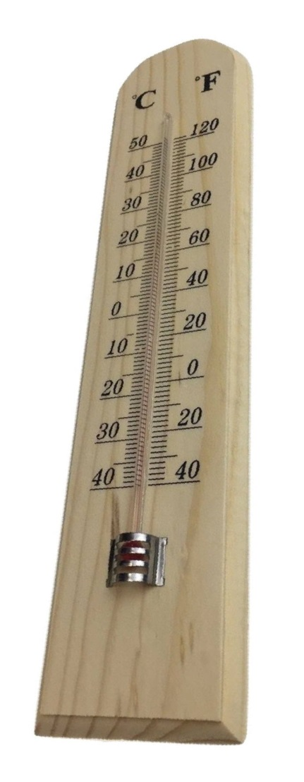
500 DEGREES OF SEPARATION
Geological wonders from Century and Mary Kathleen, NW Qld
G M Derrick
Century
Mt Isa
Mary Kathleen
Notes:
An aside: Earthquakes are the dark side of geology: in China, Premier Wen Jiabao is attending to the needs of earthquake victims, and he is a trained geologist
Good evening to you all. If the opening slide is a bit obtuse, it reflects my ongoing affair with not only geology, but also digital photography and the allure of the earth. These are quartz grains weathering from a Stanthorpe adamellite.

Slide 2
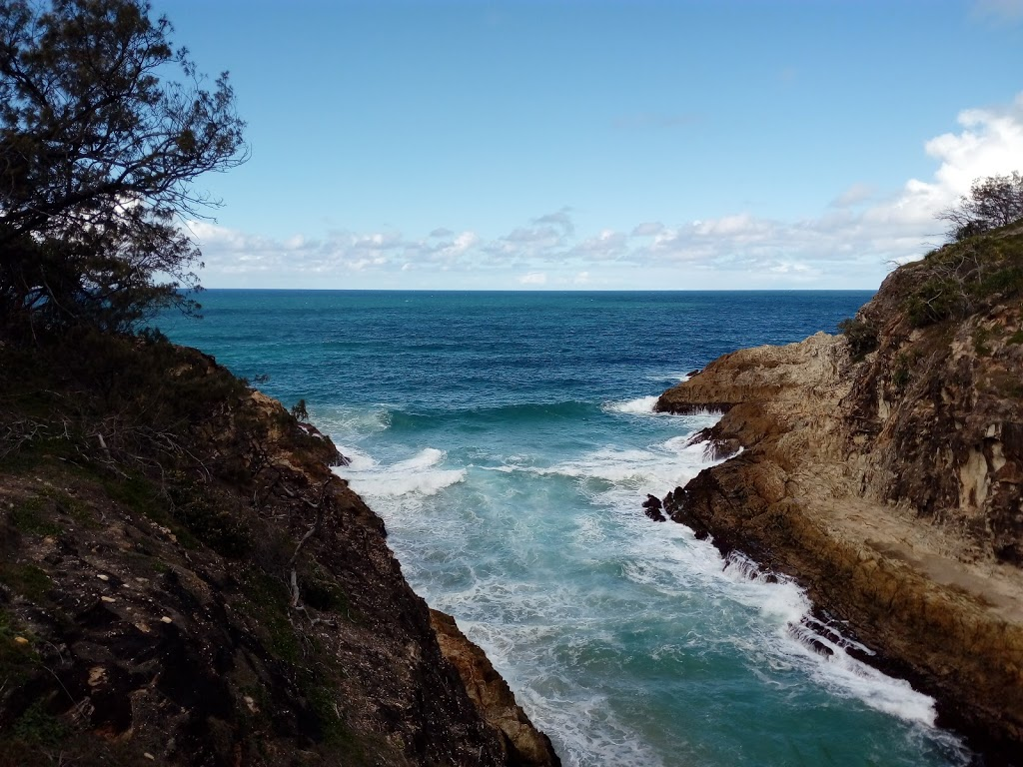
2
It all started in late 1959, in company with my fishing mates. . . .
Pt Lookout main gorge
Kimberley for Dummies Newly Weds, 1964
Geoff and Helen Derrick, Probus, May 2021

Slide 3
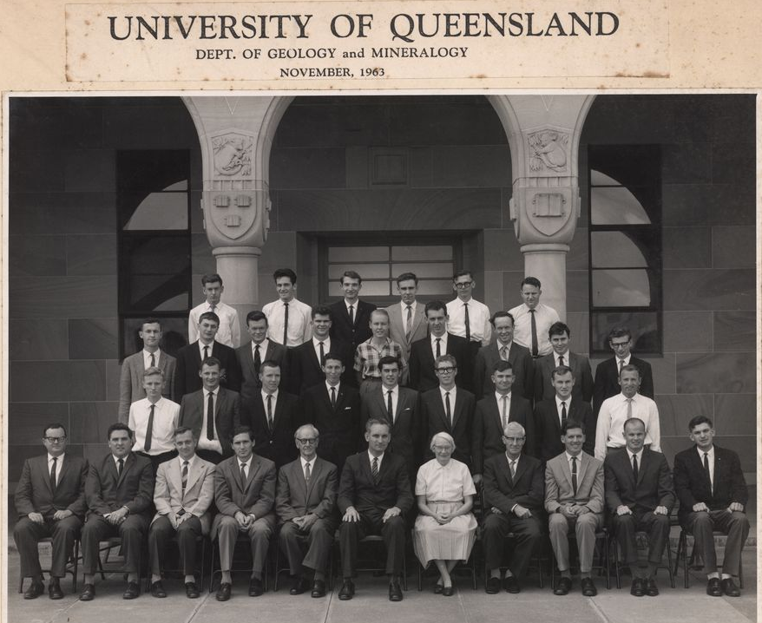
Dorothy Hill
Ralph Kretz - transformationist
Pat Conaghan
Evan Phillips - magmatist
Chris Powell
Geoff Derrick: SMEDG meeting, Sydney Thursday 28 September 2023

Slide 4
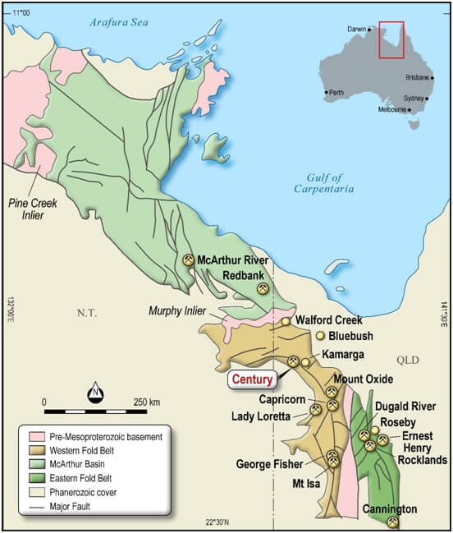
The Mt Isa Inlier – still a world class minerals powerhouse . . .
Note: ‘Capricorn’ = Gunpowder
Geoff Derrick: SMEDG meeting, Sydney Thursday 28 September 2023

Slide 5
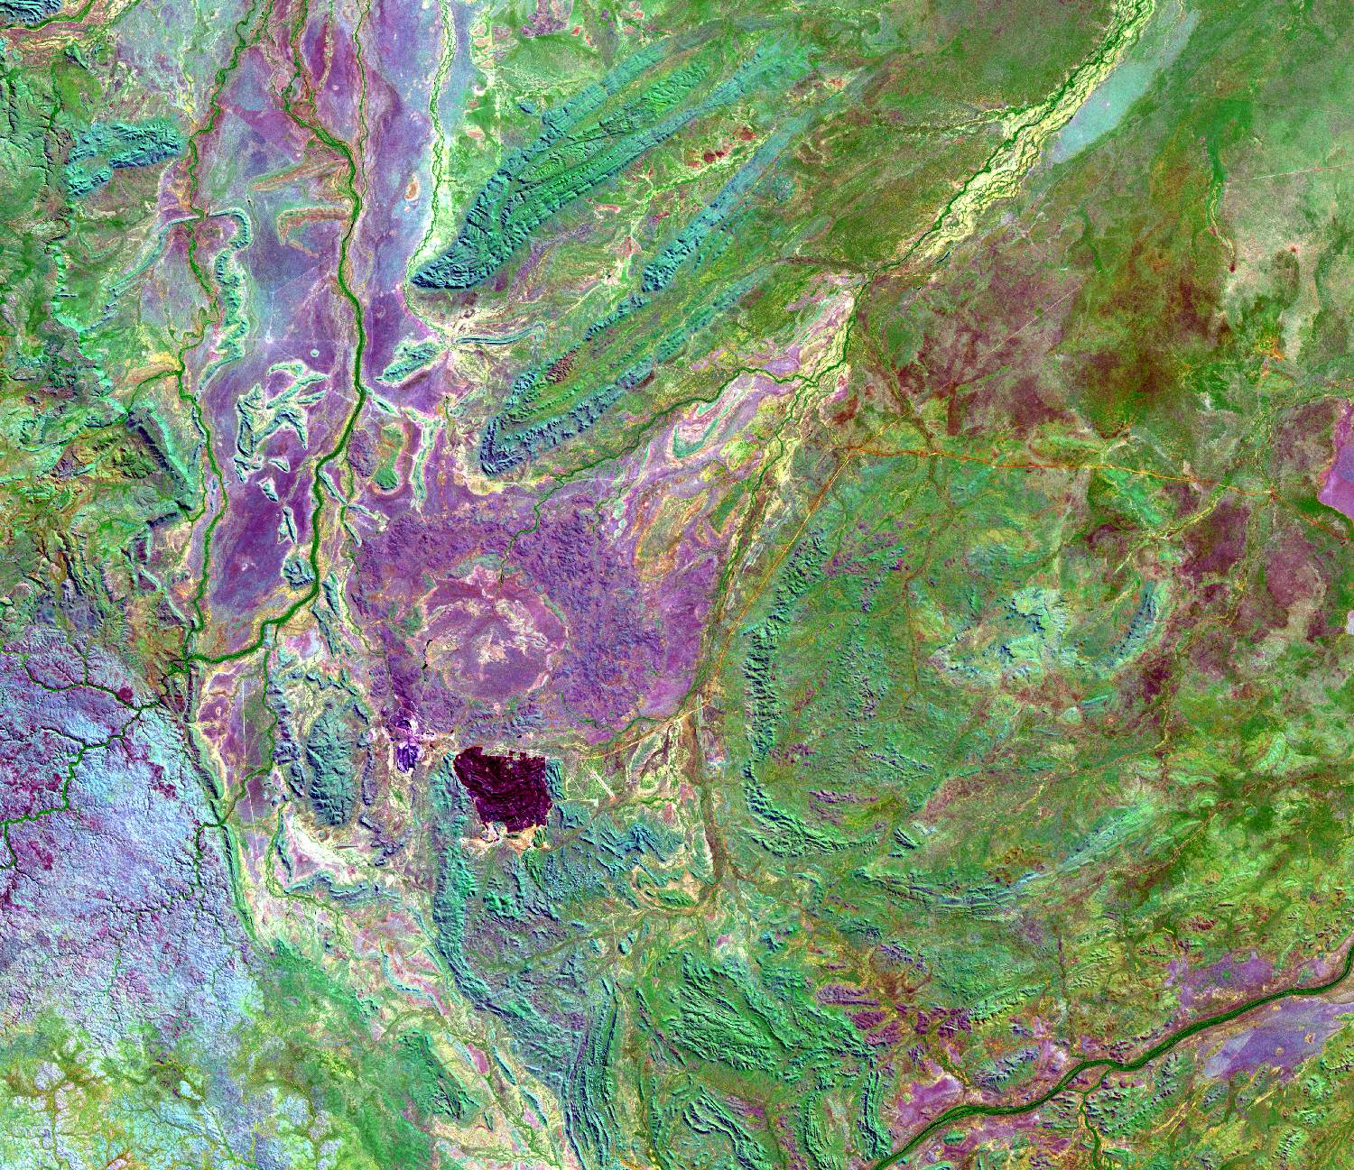

Century: Regional location
Archie Ck
Mt Caroline Anticline
Ploughed Mt Anticline
Mainly folded McNamara Group sediments 1700-1580Ma overlain by Cambrian Georgina Basin limestones. TRF = Termite Range Fault
Cambrian
annulus
Kamarga Dome
TRF
CENTURY
Cambrian
cover
Gregory River
N
TRF
10km
Geoff Derrick: SMEDG meeting, Sydney Thursday 28 September 2023

Slide 6
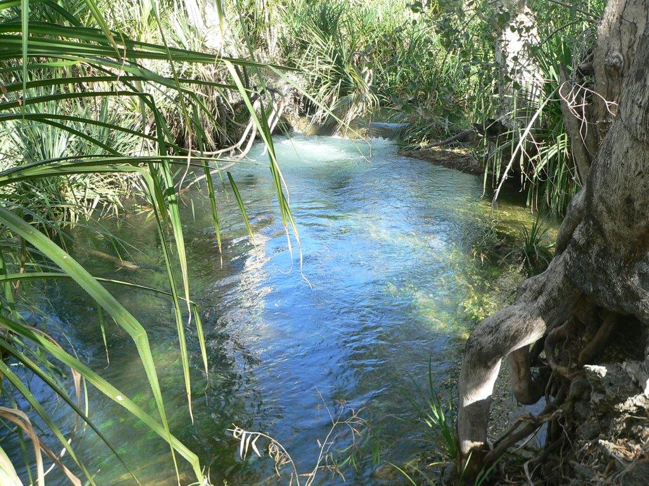
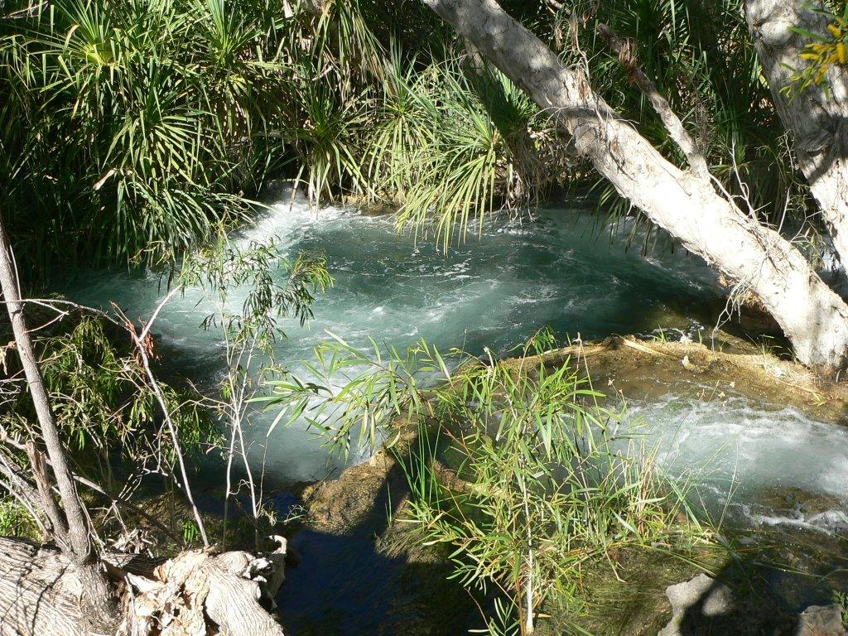
Australia’s best – the Gregory River

Slide 7
Century – Current status
January 2016: MMG ceases all production and shipping at Century, and joins with Century Bull , early 2017
Mid-2017: Attila Resources changes name to New Century Resources, and raises $53 million in a capital raising, Nov 2017.
New Century Resources acquires 100% of Century Bull, and estimates earnings of $450 million pa for 7 years by retreating tailings. First production Zn cons August 2018
New Century Resources purchased by Sibanye Stillwater, May 2023, for retreating of tailings.
SIBANYA offered $1.10/share for the 80% not owned, in March 2023; offer accepted for A$120 million, settled May 2023.
Geoff Derrick: SMEDG meeting, Sydney Thursday 28 September 2023

Slide 8

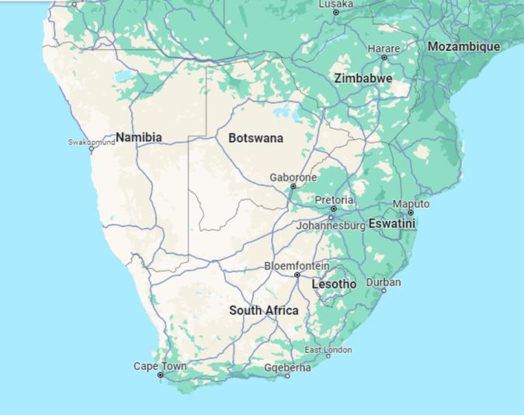

Who are Sibanye Stillwater ??
SS are a major South African metals multinational miner with interests in the CRITICAL metals needed for ‘decarbonisation’. They like ‘Grey elephants’ (above).
Geoff Derrick: SMEDG meeting, Sydney Thursday 28 September 2023

Slide 9
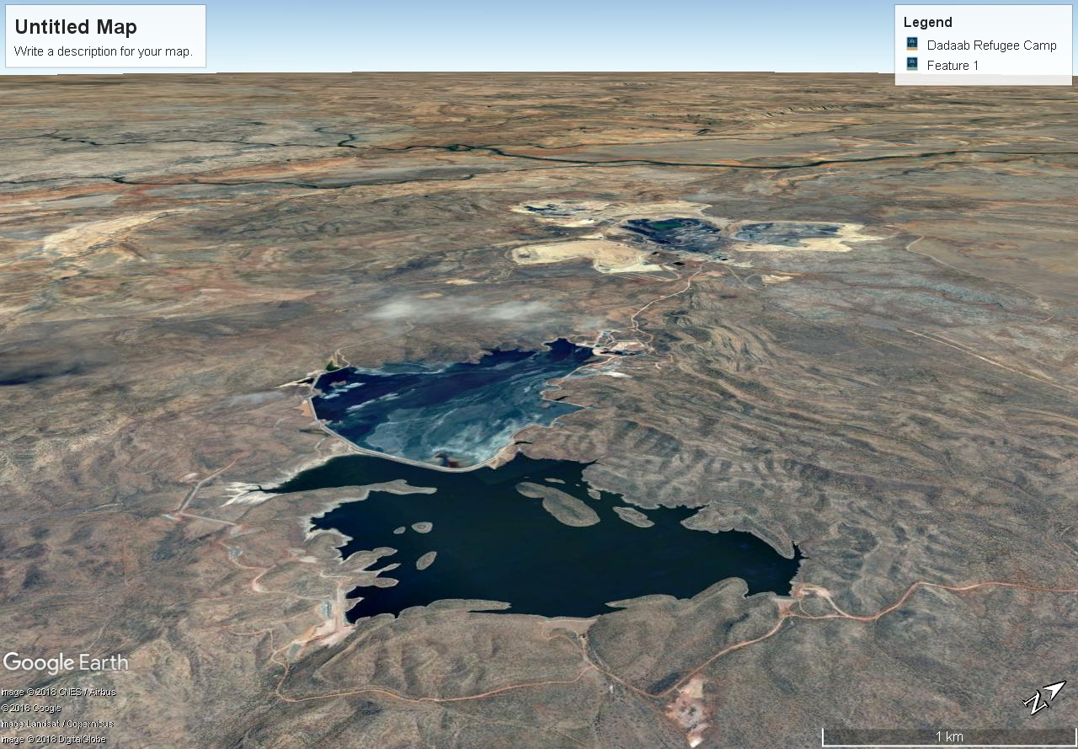
Century - Inclined Google Earth view to NNW
Tailings Dam – ore source for New Century Resources – purchased 2023 by Sibanye Stillwater
Dr Geoff Derrick , G.M.Derrick Geology
AIG Meeting 9 Oct. 2018

Slide 10
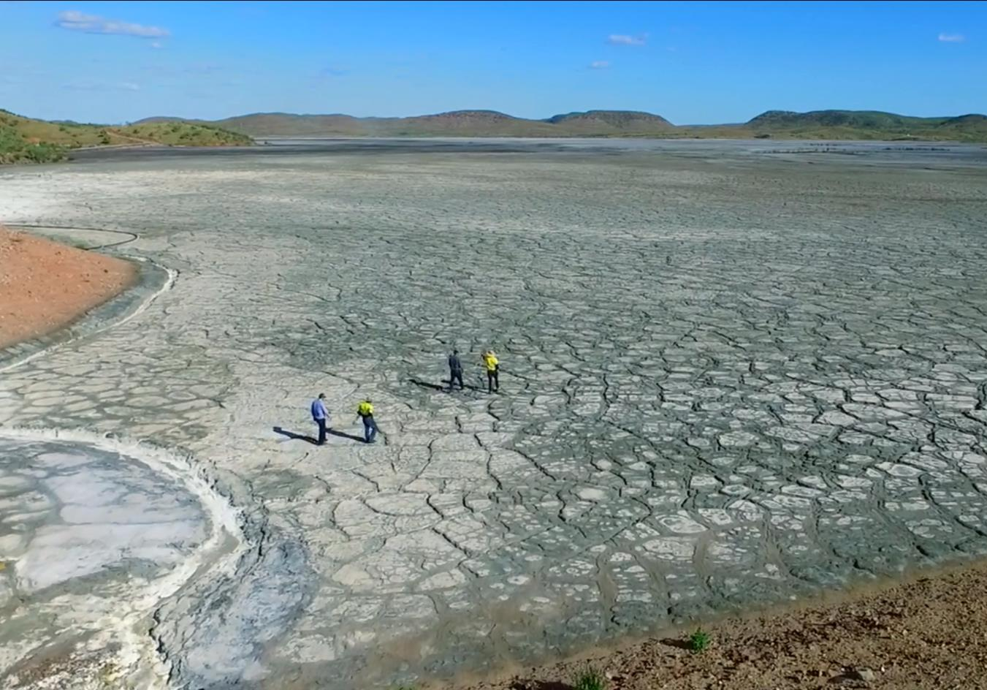
The Tailings resource (1)
Geoff Derrick: SMEDG meeting, Sydney Thursday 28 September 2023

Slide 11
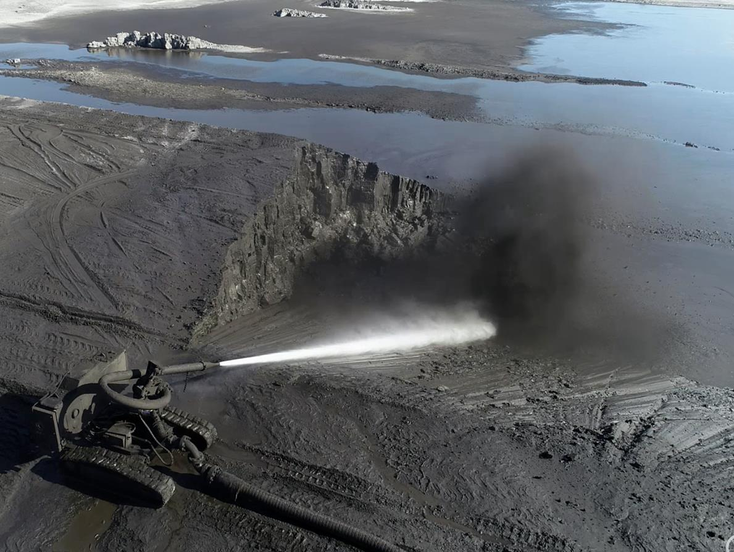
The Tailings sluicing (2)
Geoff Derrick: SMEDG meeting, Sydney Thursday 28 September 2023

Slide 12
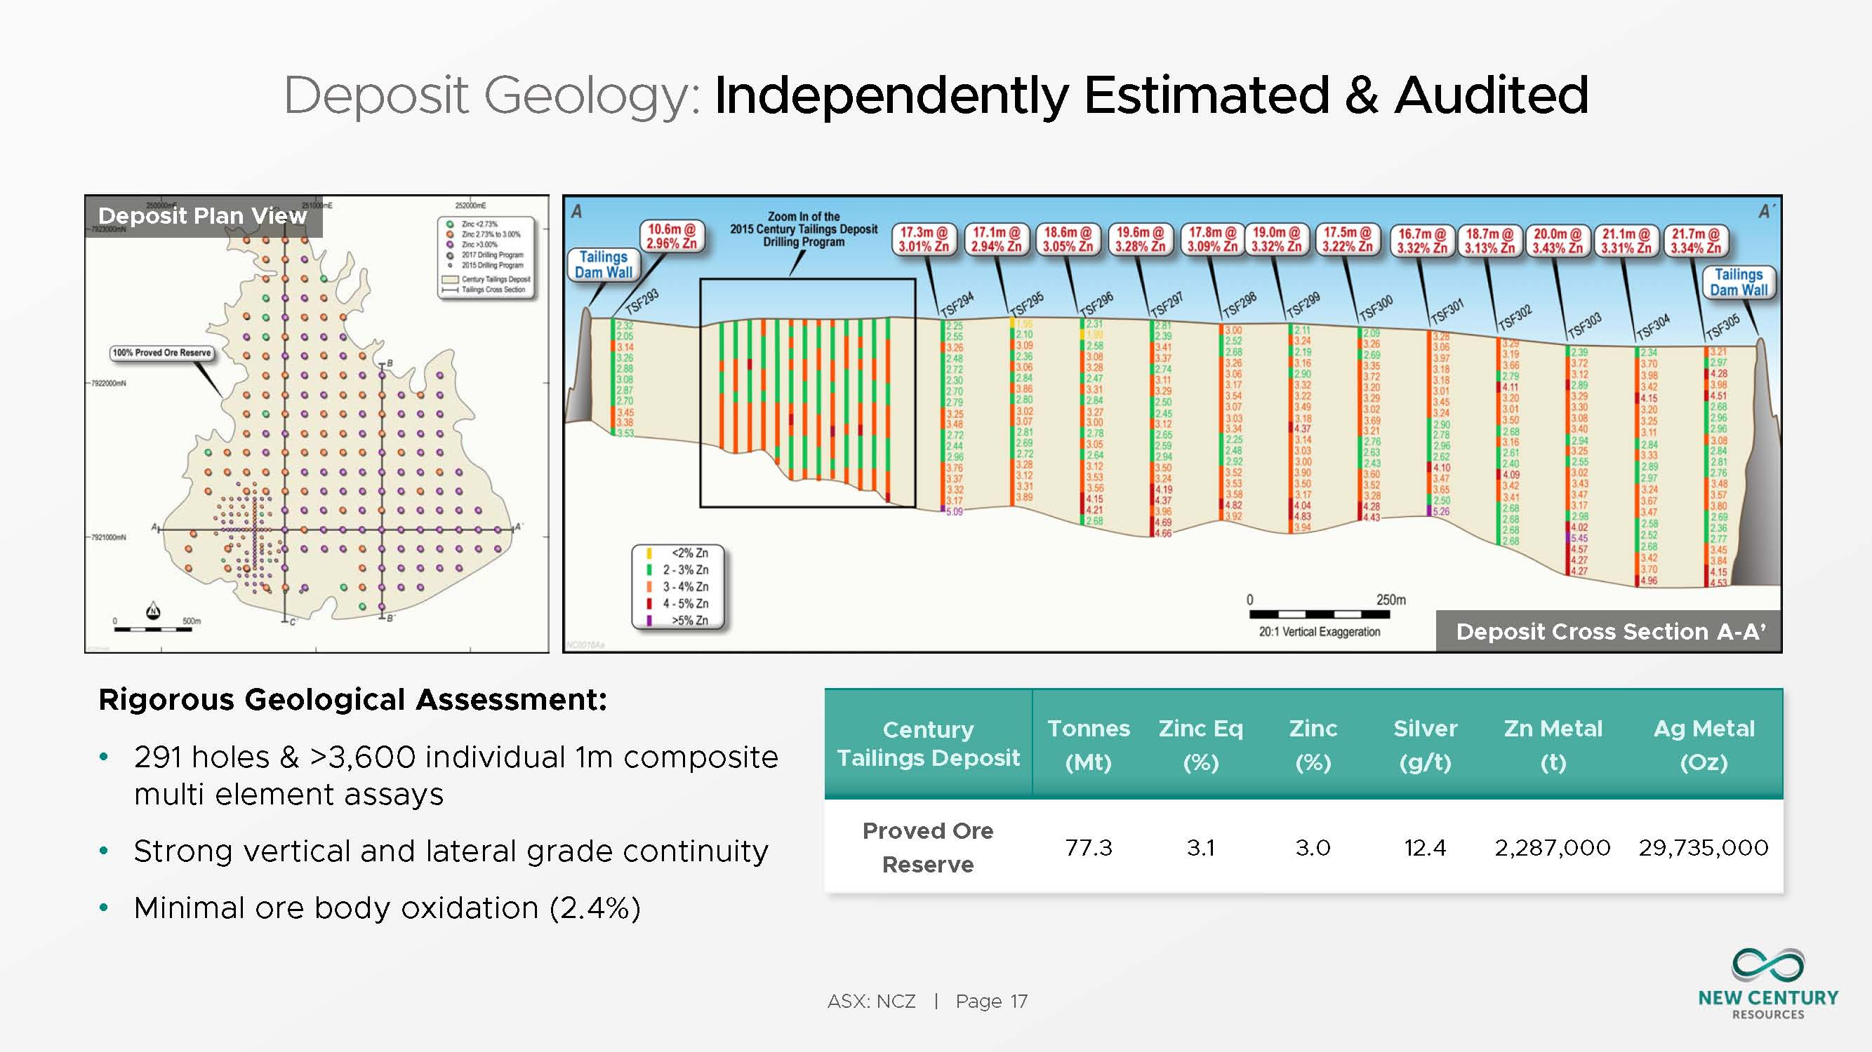
E-W cross section of tailings dam, viewed to NORTH.
Reserve 77.3mt @ 3% Zn, 12.4g/t Ag
2,287,000t Zn metal, 29.7 mozs Ag
Good grade continuity
A
A’

Slide 13
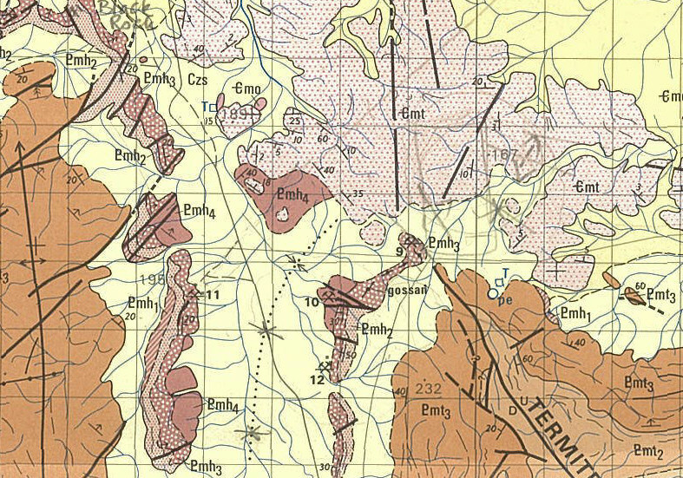
Our interest is in the hardrock deposit at Century
Discovery Hill
Magazine Hill
Note the 40º dip on the Century ore sequence , 100K map

Slide 14
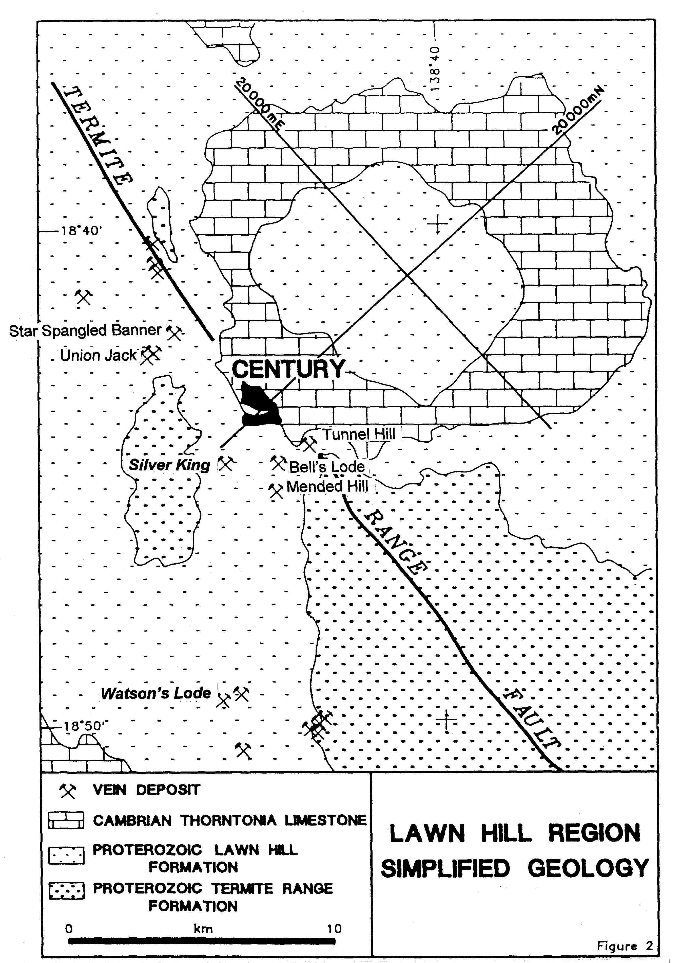
This deposit defied geophysics, and ultimately was a ‘geochemical’ discovery in Sept 1990
The major focus of work was a soil geochemical survey set up during January to April 1988 along two lines each 20km long oriented NW-SE and NE-SW; each soil sample point, 100m apart, also involved magnetics taken every 20m and gravity measurements taken every 100m.
From Broadbent 1995, Waltho et al., 1993

Slide 15
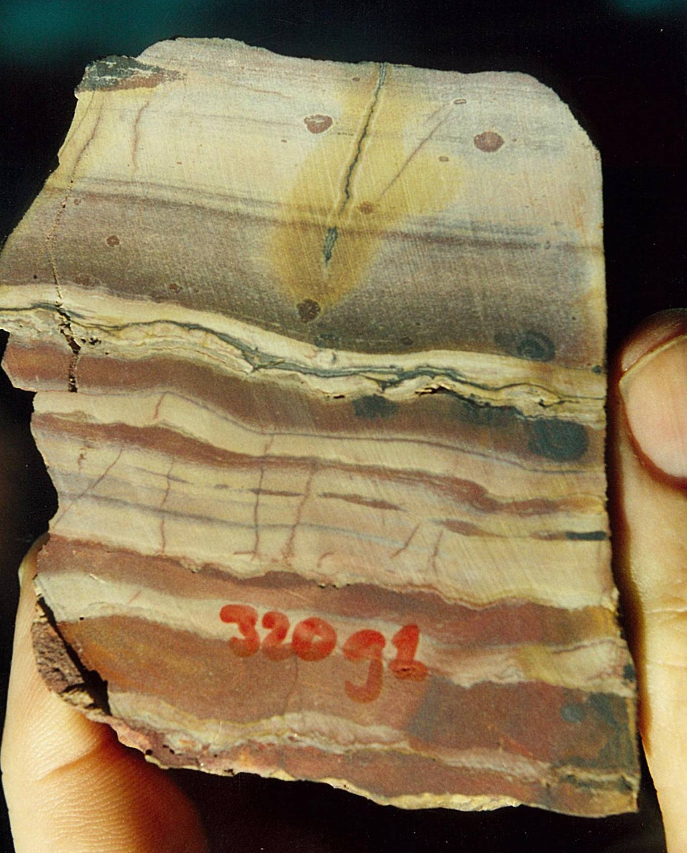
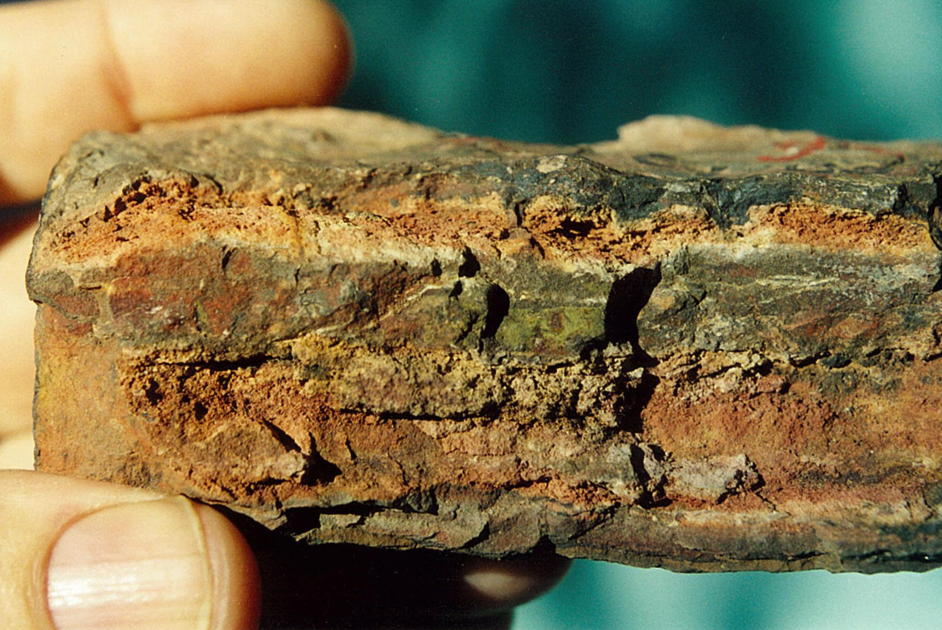
Samples of Lawn Hill Fmn from Discovery Hill – NO PYRITE!!
sampled and assayed by GMD
3300ppm Pb, 5300 ppm Zn, 1ppm Ag
3500ppm Pb, 6100 ppm Zn, 3ppm Ag
CRA assays 1988
“several thousand ppm Pb and Zn, and up to 30ppm Ag” (but also in Cambrian)
Geoff Derrick: SMEDG meeting, Sydney Thursday 28 September 2023

Slide 16
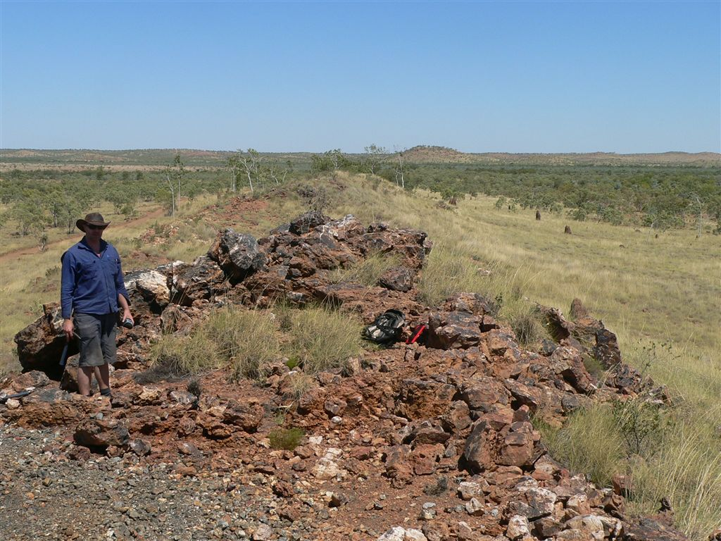
CRA re-focussed on veins like Watsons Lode in 1989; they were following up an intercept in a small u/g crosscut of 10m @ 20.5% Zn

Slide 17
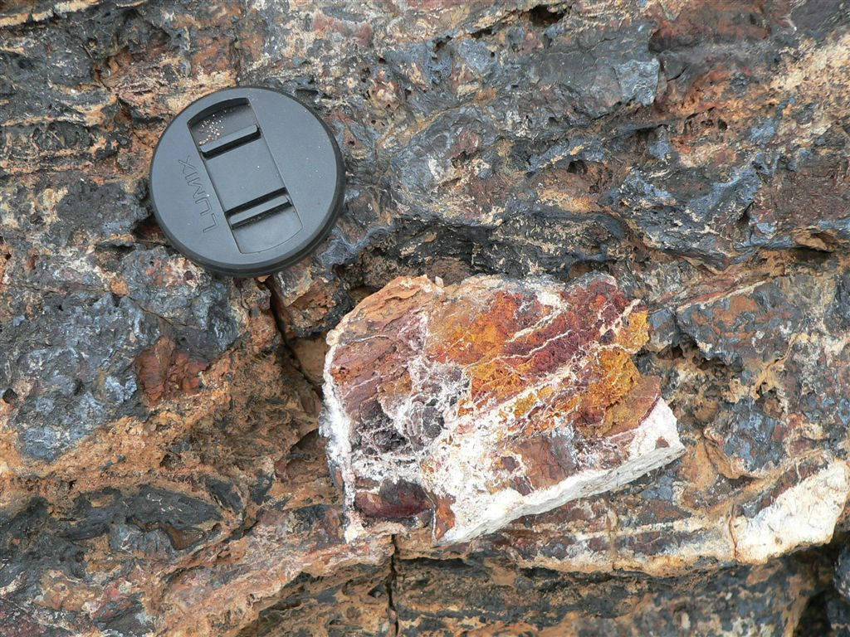
Multistage quartz veining with sphalerite and ex-sphalerite and galena boxworks

Slide 18
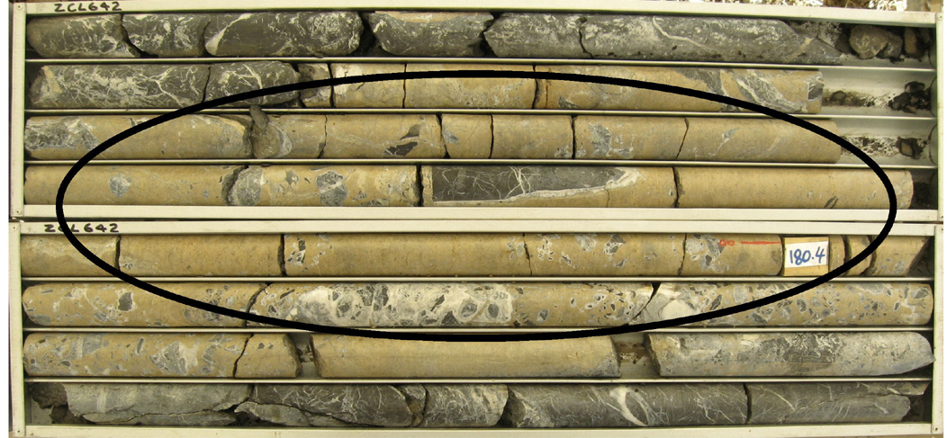
Watsons Lode : massive sulphide (mainly sphalerite) – Hole ZCL 642 – 5m @ 47.3% Zn
CRA drilled Watsons Lode in 1989, with intercepts of +10% Zn. More importantly, they identified a soil geochemical response similar to that seen at Century (presumably up to 5000ppm Zn or so)

Slide 19
So what had CRA discovered?
Stratigraphy and rock types of the Century discovery
Geoff Derrick: SMEDG meeting, Sydney Thursday 28 September 2023

Slide 20
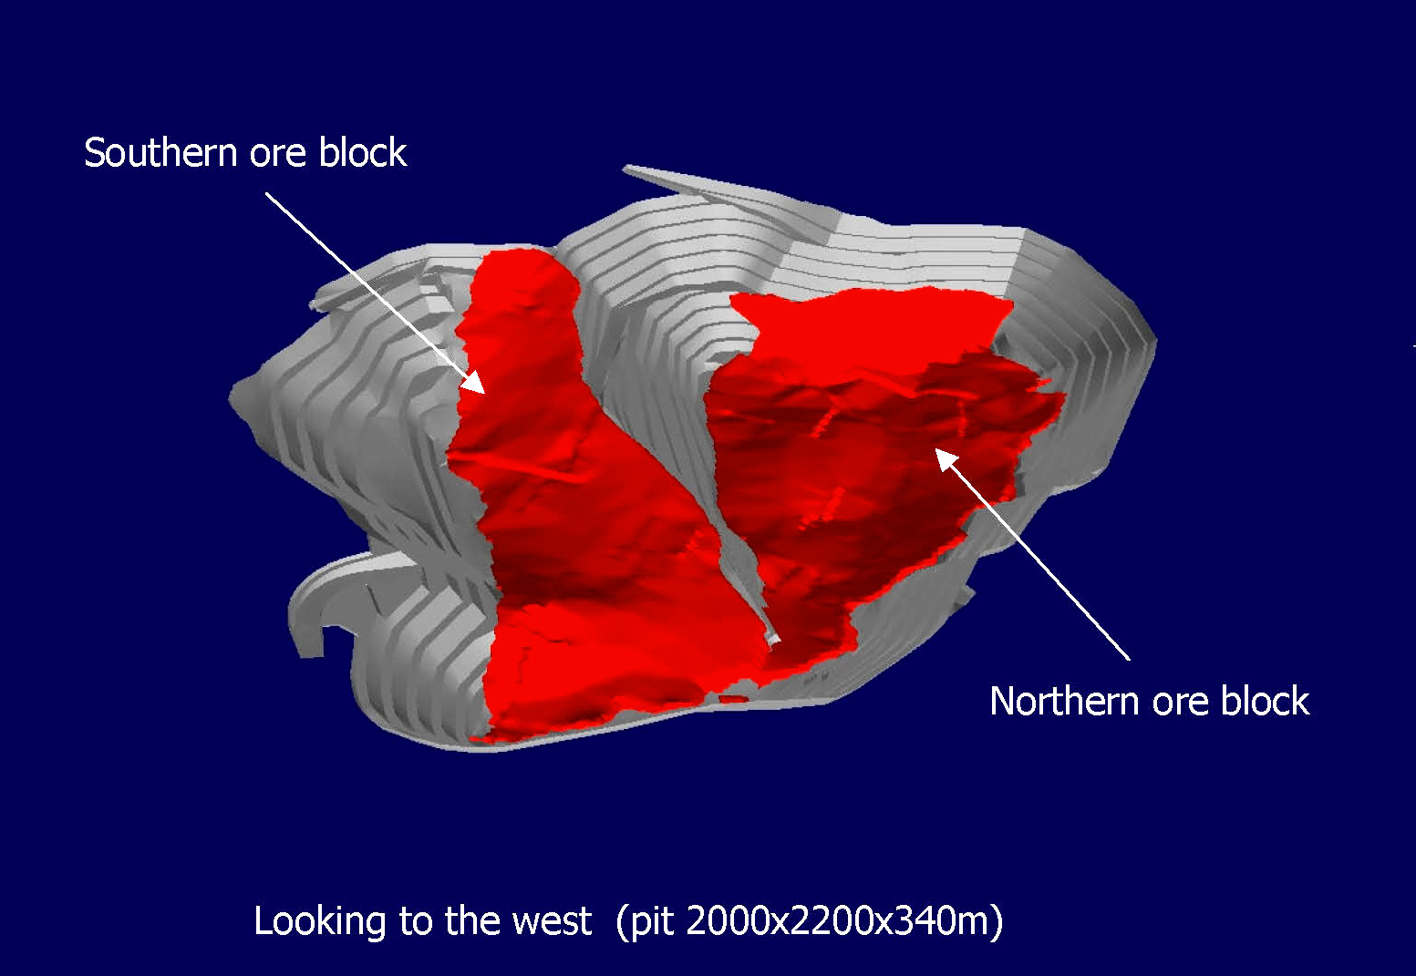
Geoff Derrick: SMEDG meeting, Sydney Thursday 28 September 2023

Slide 21
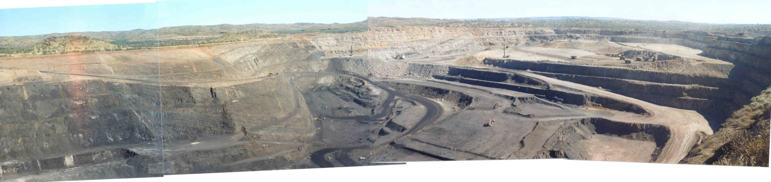
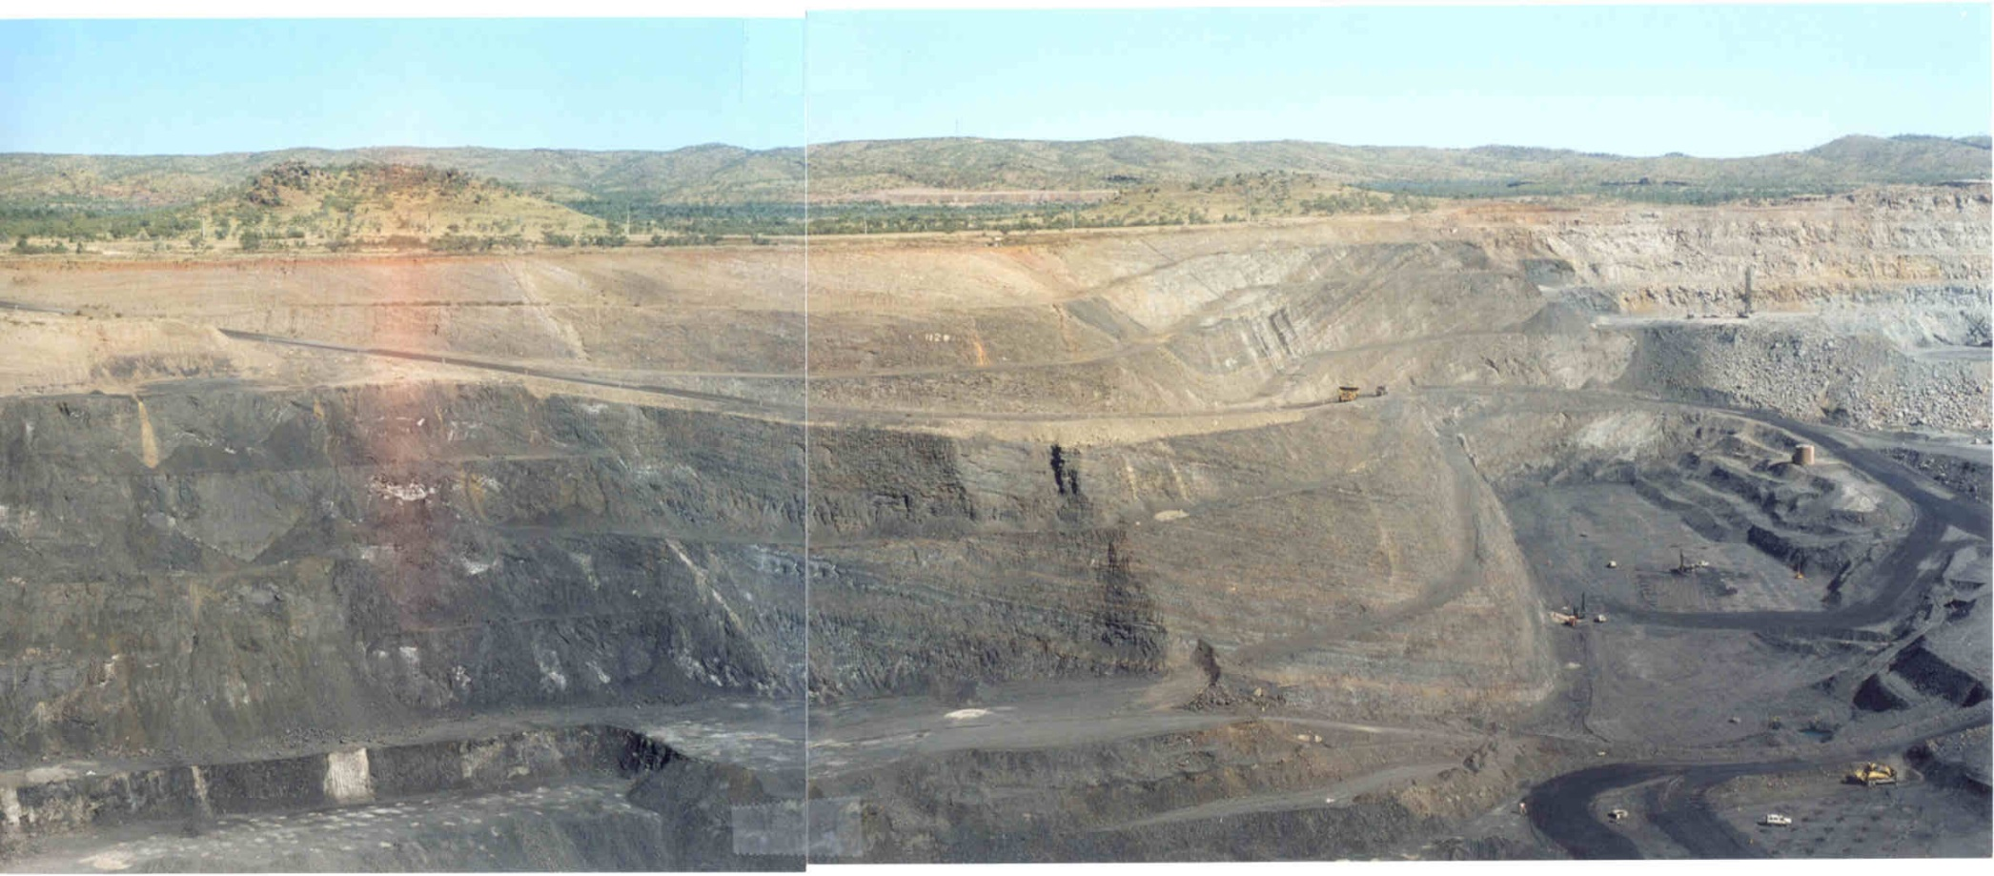
(a)
Pandoras Fault
Northern block prestrip
Cambrian cover
Southern block production
(b)
Magazine Hill
Discovery Hill
Pandoras Fault
Magazine Hill Fault
LH4
LH5
Barren gap
27m @ 6.3% Zn
50m @ 1500ppm Zn
Top of orebody approx.
Siderite zone 320
Lower ore zones 400-440
Panoramas of the Century open pit, June 2001; view is to WSW, showing traces of
major faults and parts of the ore zone within the pit, and approx position of holes LH4 & LH5

Slide 22
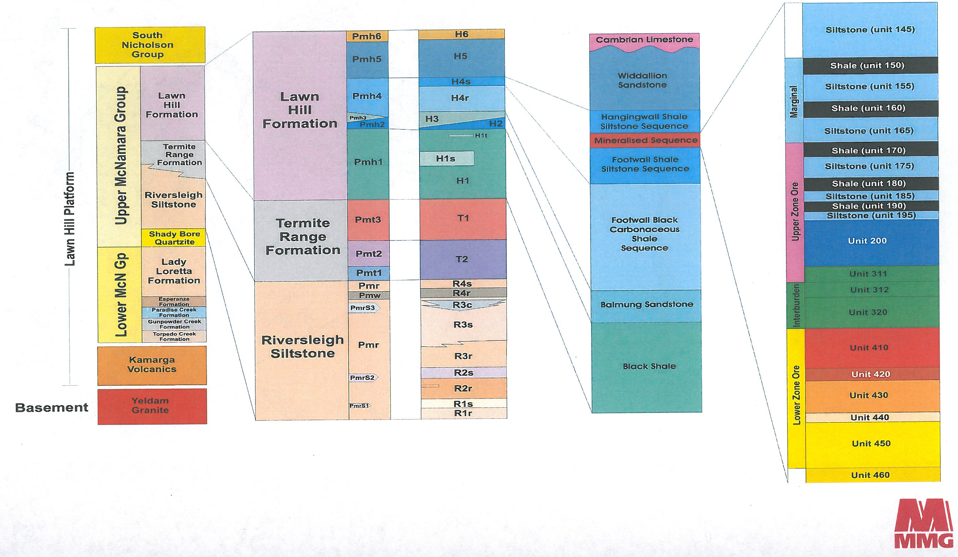
Cambrian
ORE
Depositional age U-Pb 1595±6 Ma
Mineralisation age Pb-Pb 1575Ma
STRATIGRAPHY
Geoff Derrick: SMEDG meeting, Sydney Thursday 28 September 2023

Slide 23
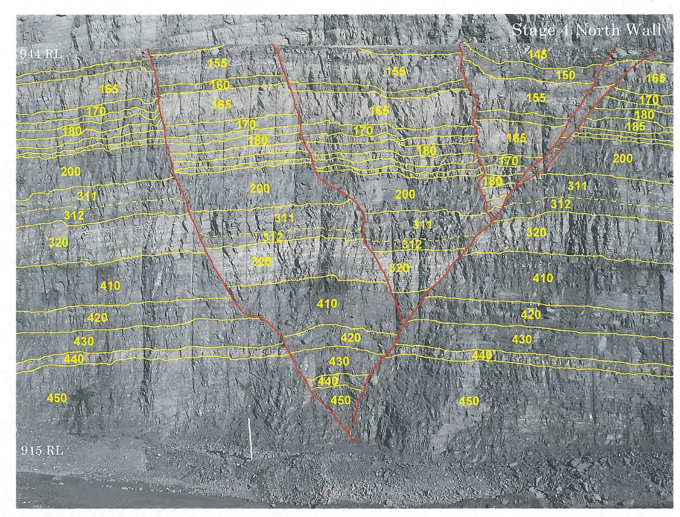
SIDERITE SILT
Units mappable across the deposit. . .

Slide 24
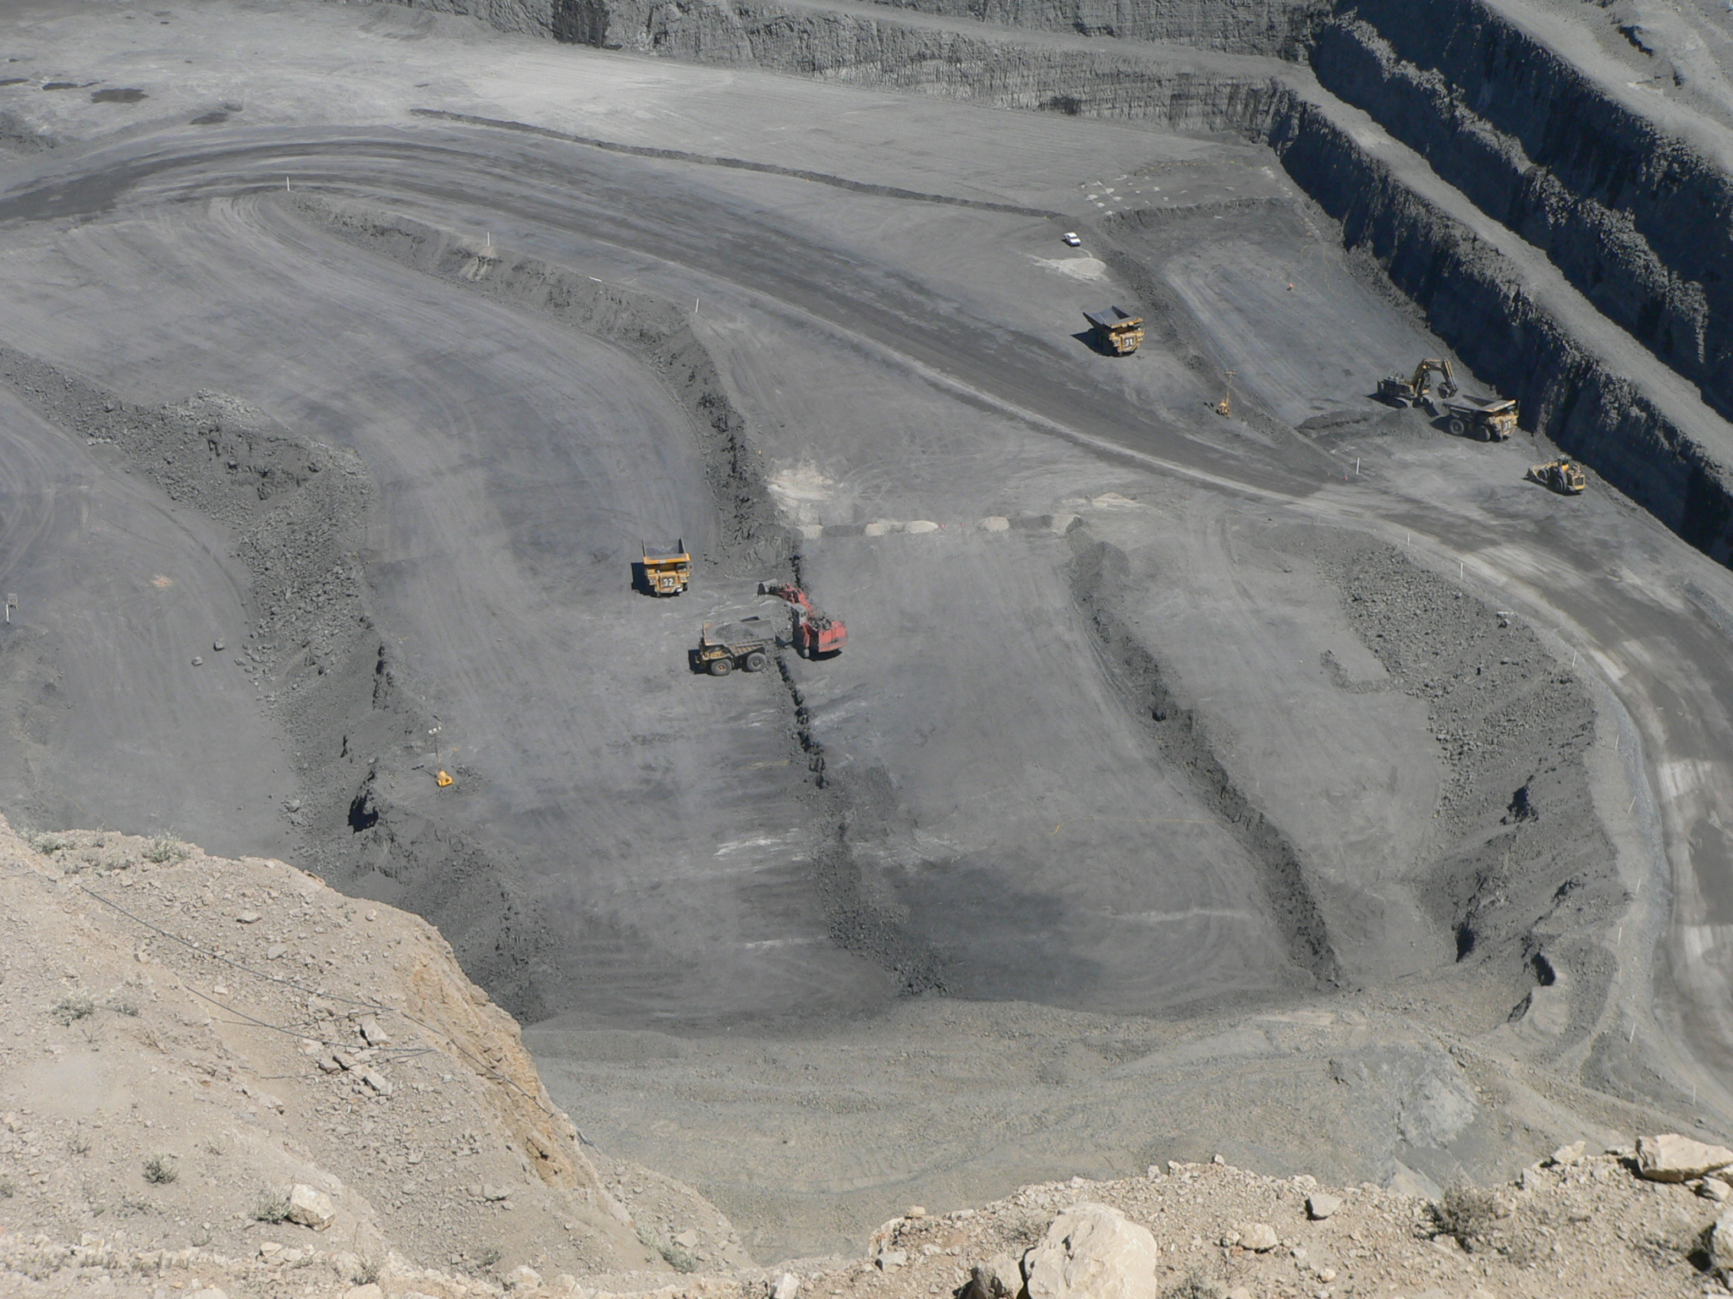
But at times a little harder to see on the pit floor. . .
HW
Upper ore zones 160-200
Zone 320 - barren siderite siltstone
Lower ore zones 410 -450
FW
N

Slide 25
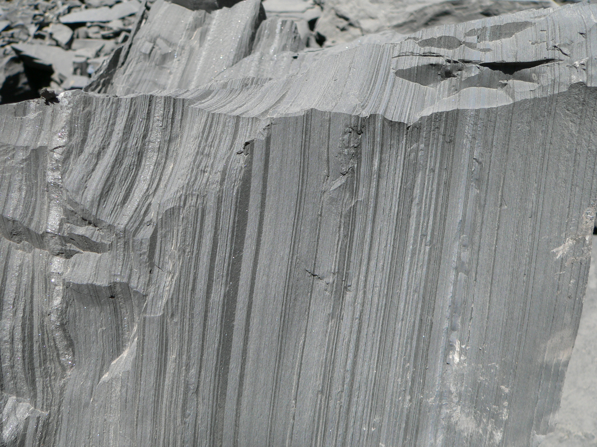
How can this be anything but a sediment formed in a brine pool??
siderite
Zone 430:
High grade Zn with only minor shale bands ; speckled band above is boudinaged sideritic layer
Zone 430 –
23.4% Zn, 1.5% Pb, 22g/t Ag
Geoff Derrick: SMEDG meeting, Sydney Thursday 28 September 2023

Slide 26
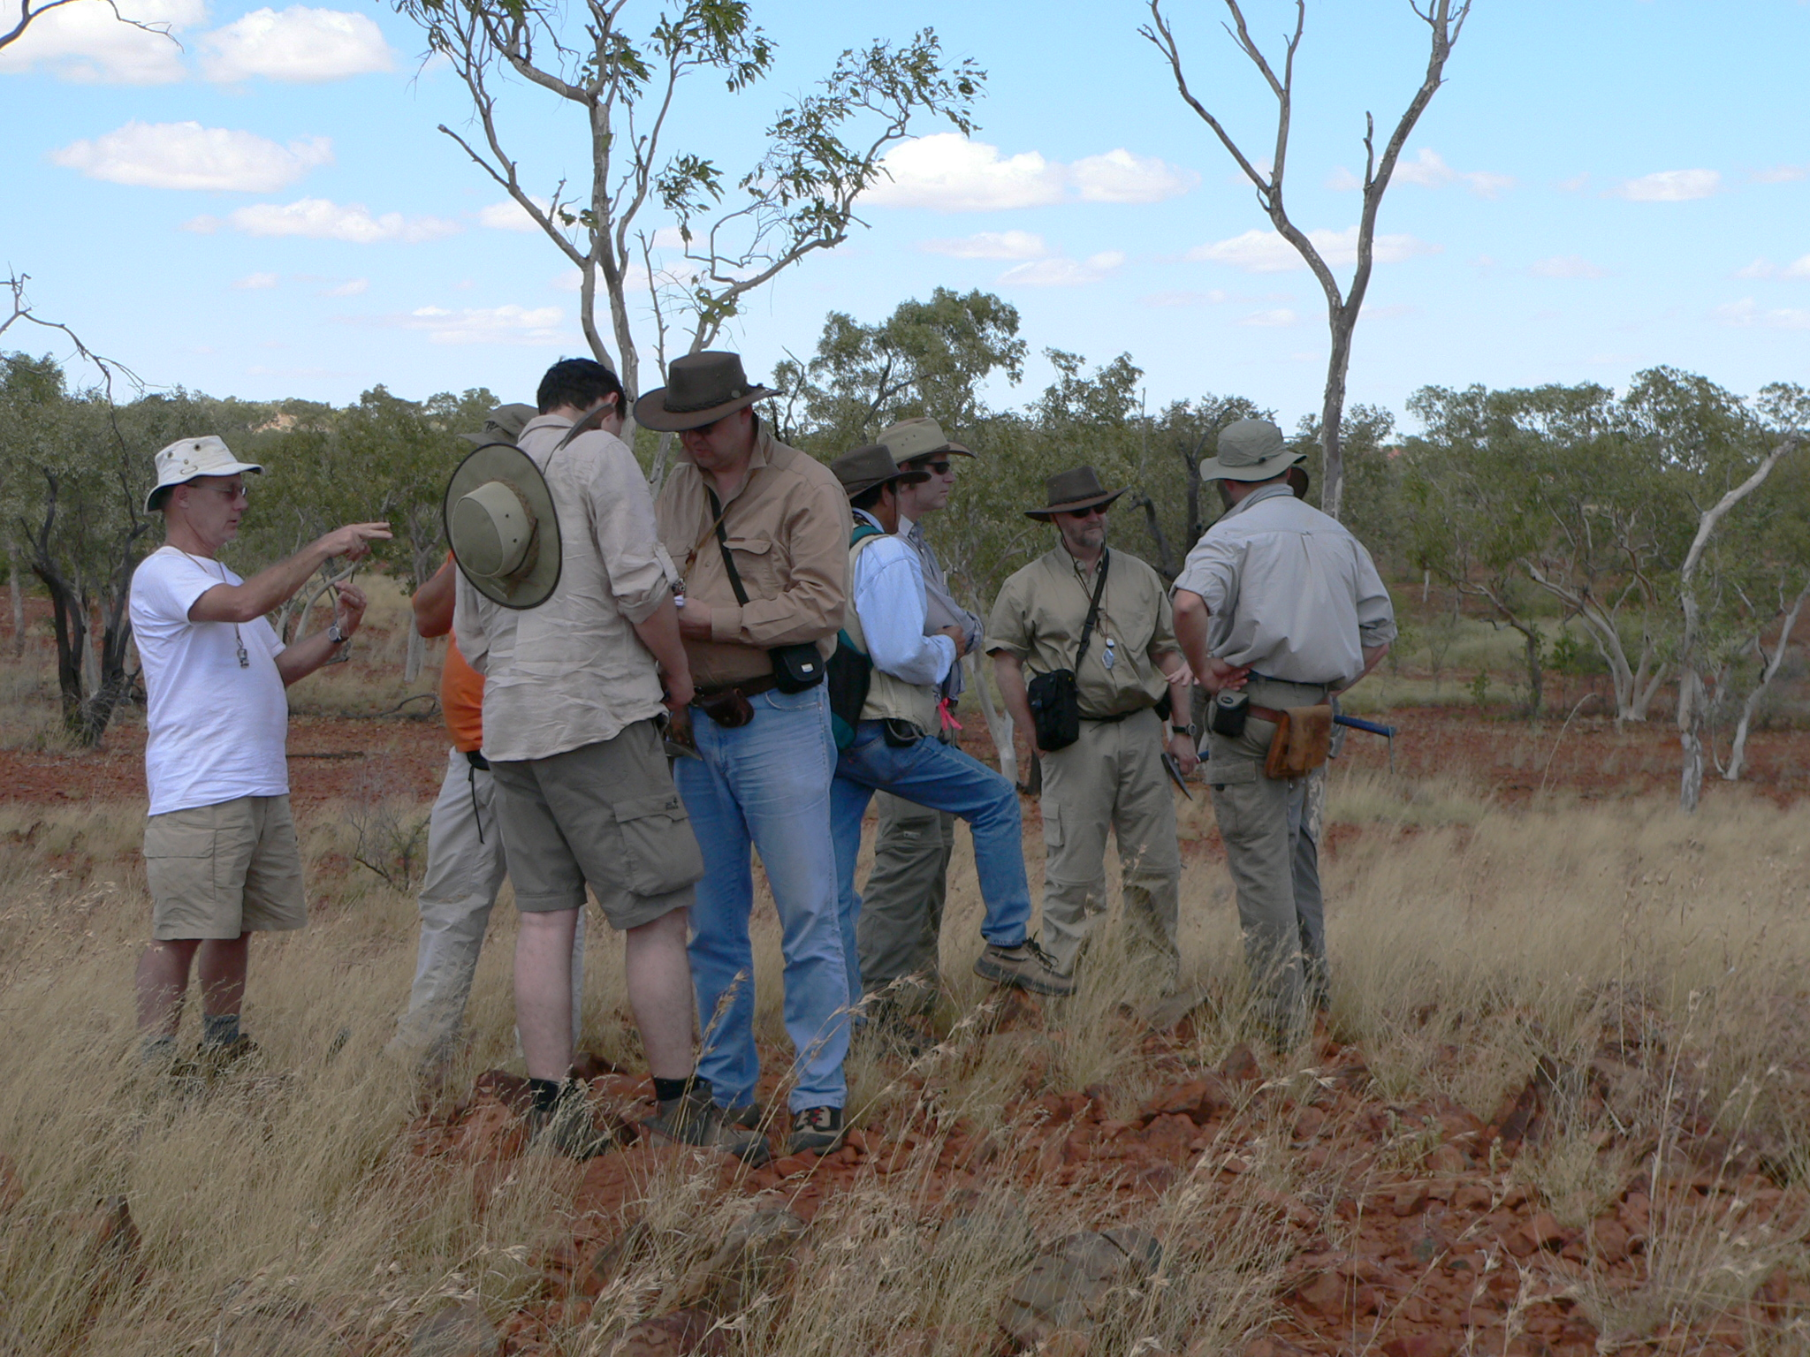
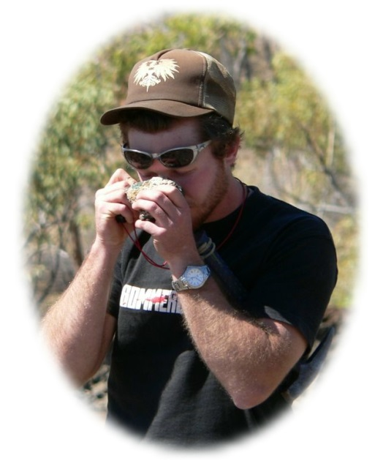
Teck Cominco geologists on the outcrop, Mt Isa inlier; Cam Allen at left
With sea-floor deposits like Red Dog and Sullivan, these Teck lads saw nothing but brine pools. . . .
Geoff Derrick: SMEDG meeting, Sydney Thursday 28 September 2023

Slide 27
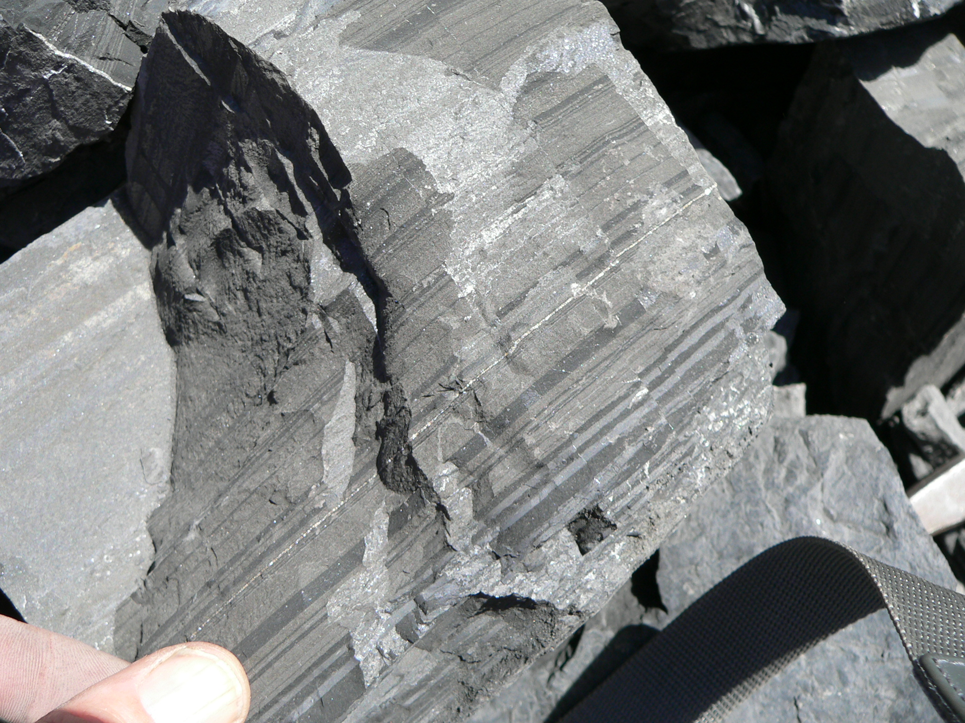
Zone 450 pyritic siltstone in contact with Zn-rich siltstone (grey) near base of orebody; contact appears concordant but can be structural
pyritic
Zone 450
sphaleritic
Geoff Derrick: SMEDG meeting, Sydney Thursday 28 September 2023

Slide 28
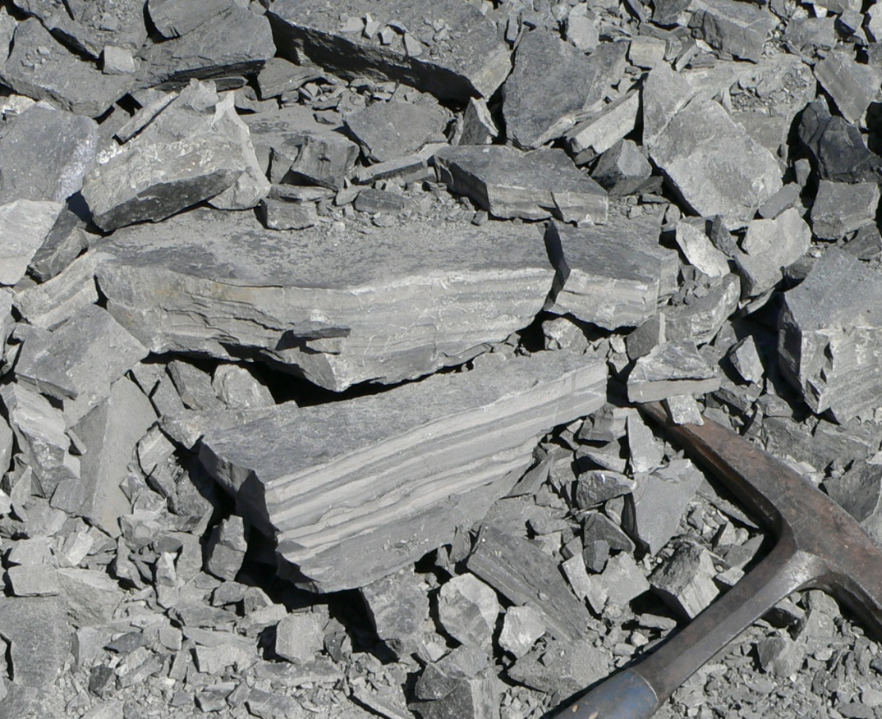
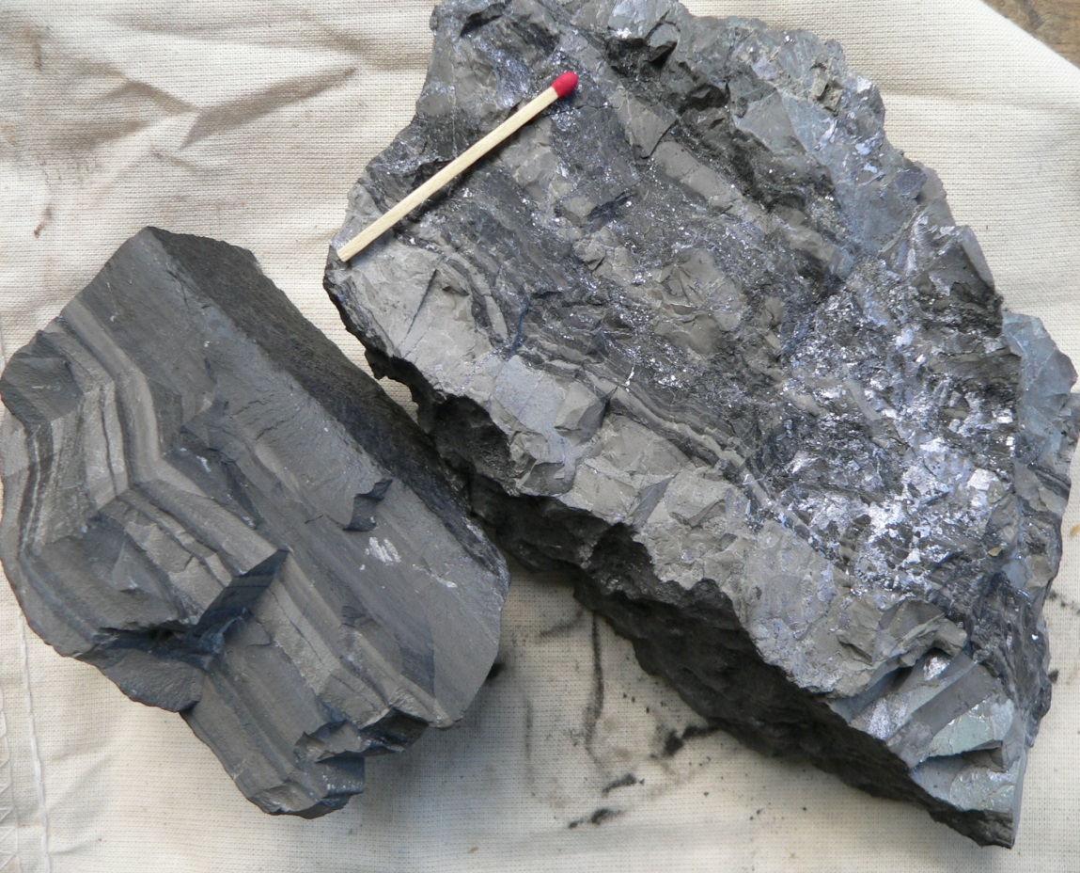
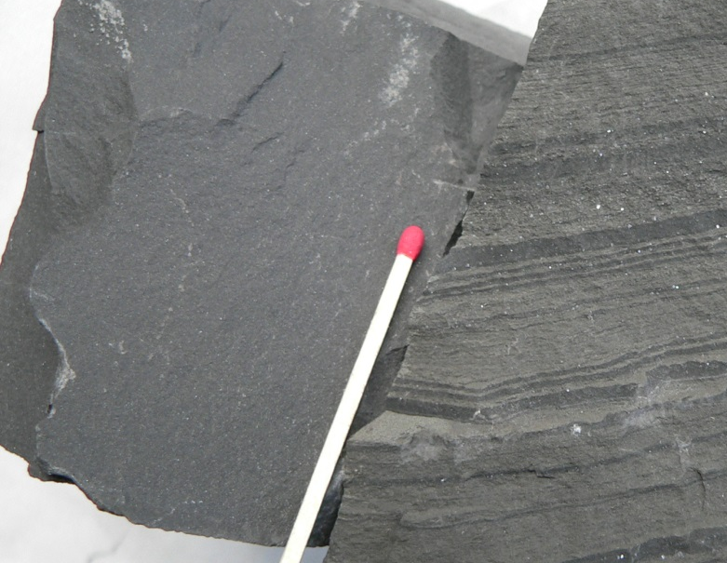
Waste material: Left: Zone 320 - main sideritic siltstone zone on floor of pit; below - pale grey sideritic siltstone unit 320, with some fracture coatings of galena, and wavy stylolitic banding
Waste Zone 420 - massive mudstone and pyritic siltstone unit 450.
Waste Zone 320
Geoff Derrick: SMEDG meeting, Sydney Thursday 28 September 2023

Slide 29
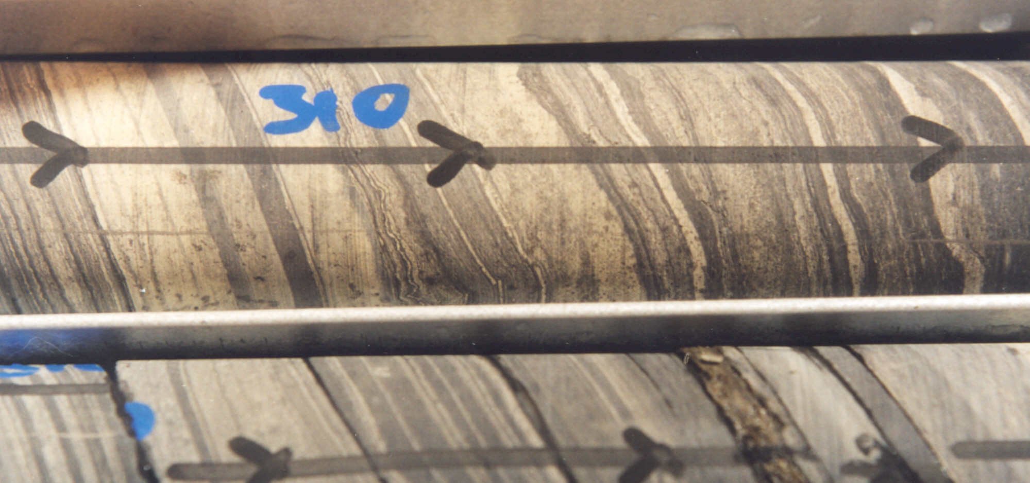
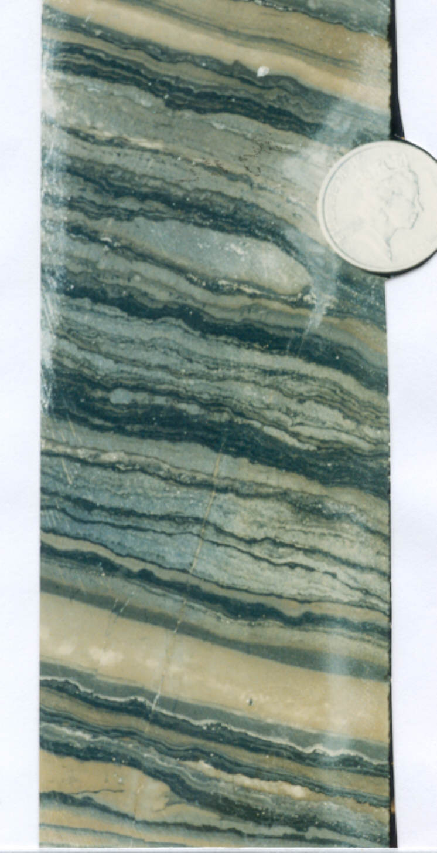
Siderite alteration and stylolites
Geoff Derrick: SMEDG meeting, Sydney Thursday 28 September 2023

Slide 30
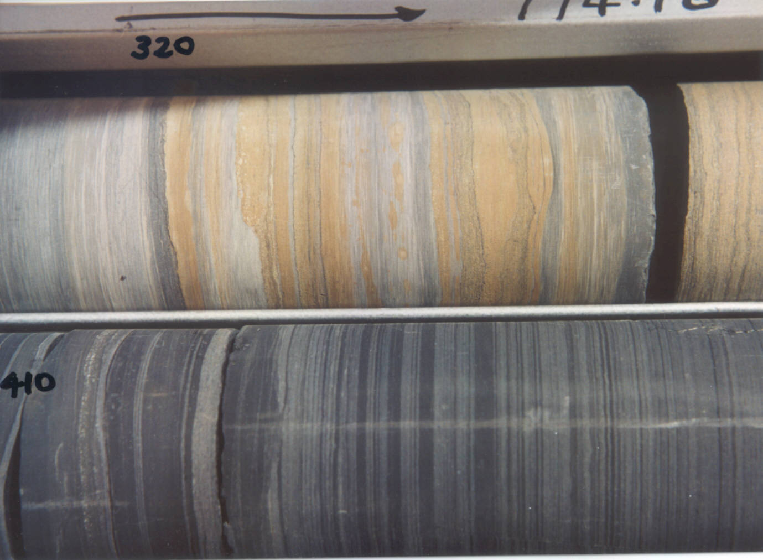
Siderite alteration and stylolites (continued)
Sideritic waste interbed 320
Geoff Derrick – QUT presentation Century Zn mine, 25 March 2009
Non-sideritic lower ore zone 410
Geoff Derrick: SMEDG meeting, Sydney Thursday 28 September 2023

Slide 31
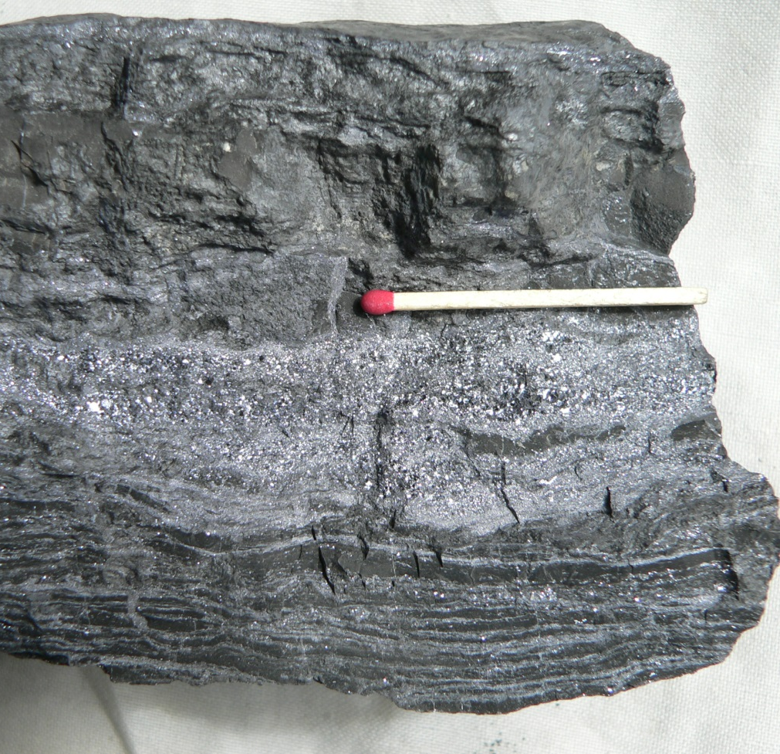
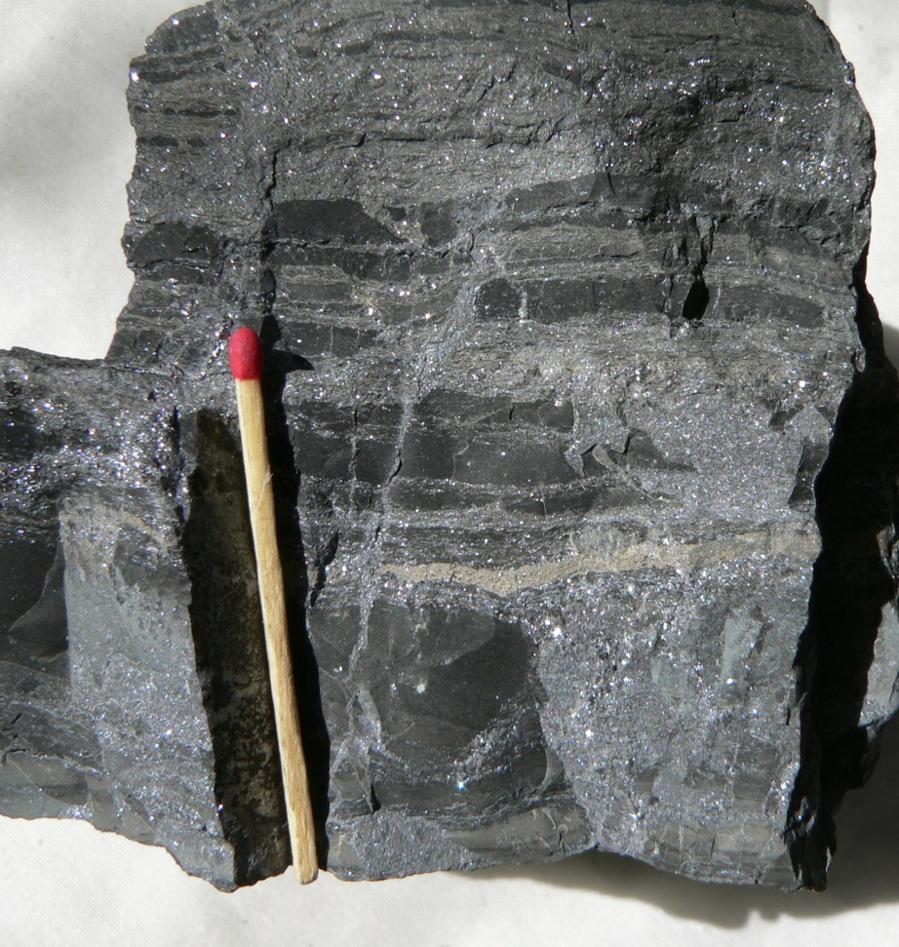
Features of the “Galena Band” - unit 180
Hummocky/wavy bedding in galena-rich black shale, plus massive galena band
Black shale, some pyritic, heavily veined by galena in cross fractures and also stratabound; one pale straw band of c.g. sphalerite evident.
Geoff Derrick: SMEDG meeting, Sydney Thursday 28 September 2023

Slide 32
CENTURY deposit
The following slides feature
some unusual deformation effects (boudinage)
compaction (??dewatering) features
late-stage veins
consumption of matter
Geoff Derrick: SMEDG meeting, Sydney Thursday 28 September 2023

Slide 33
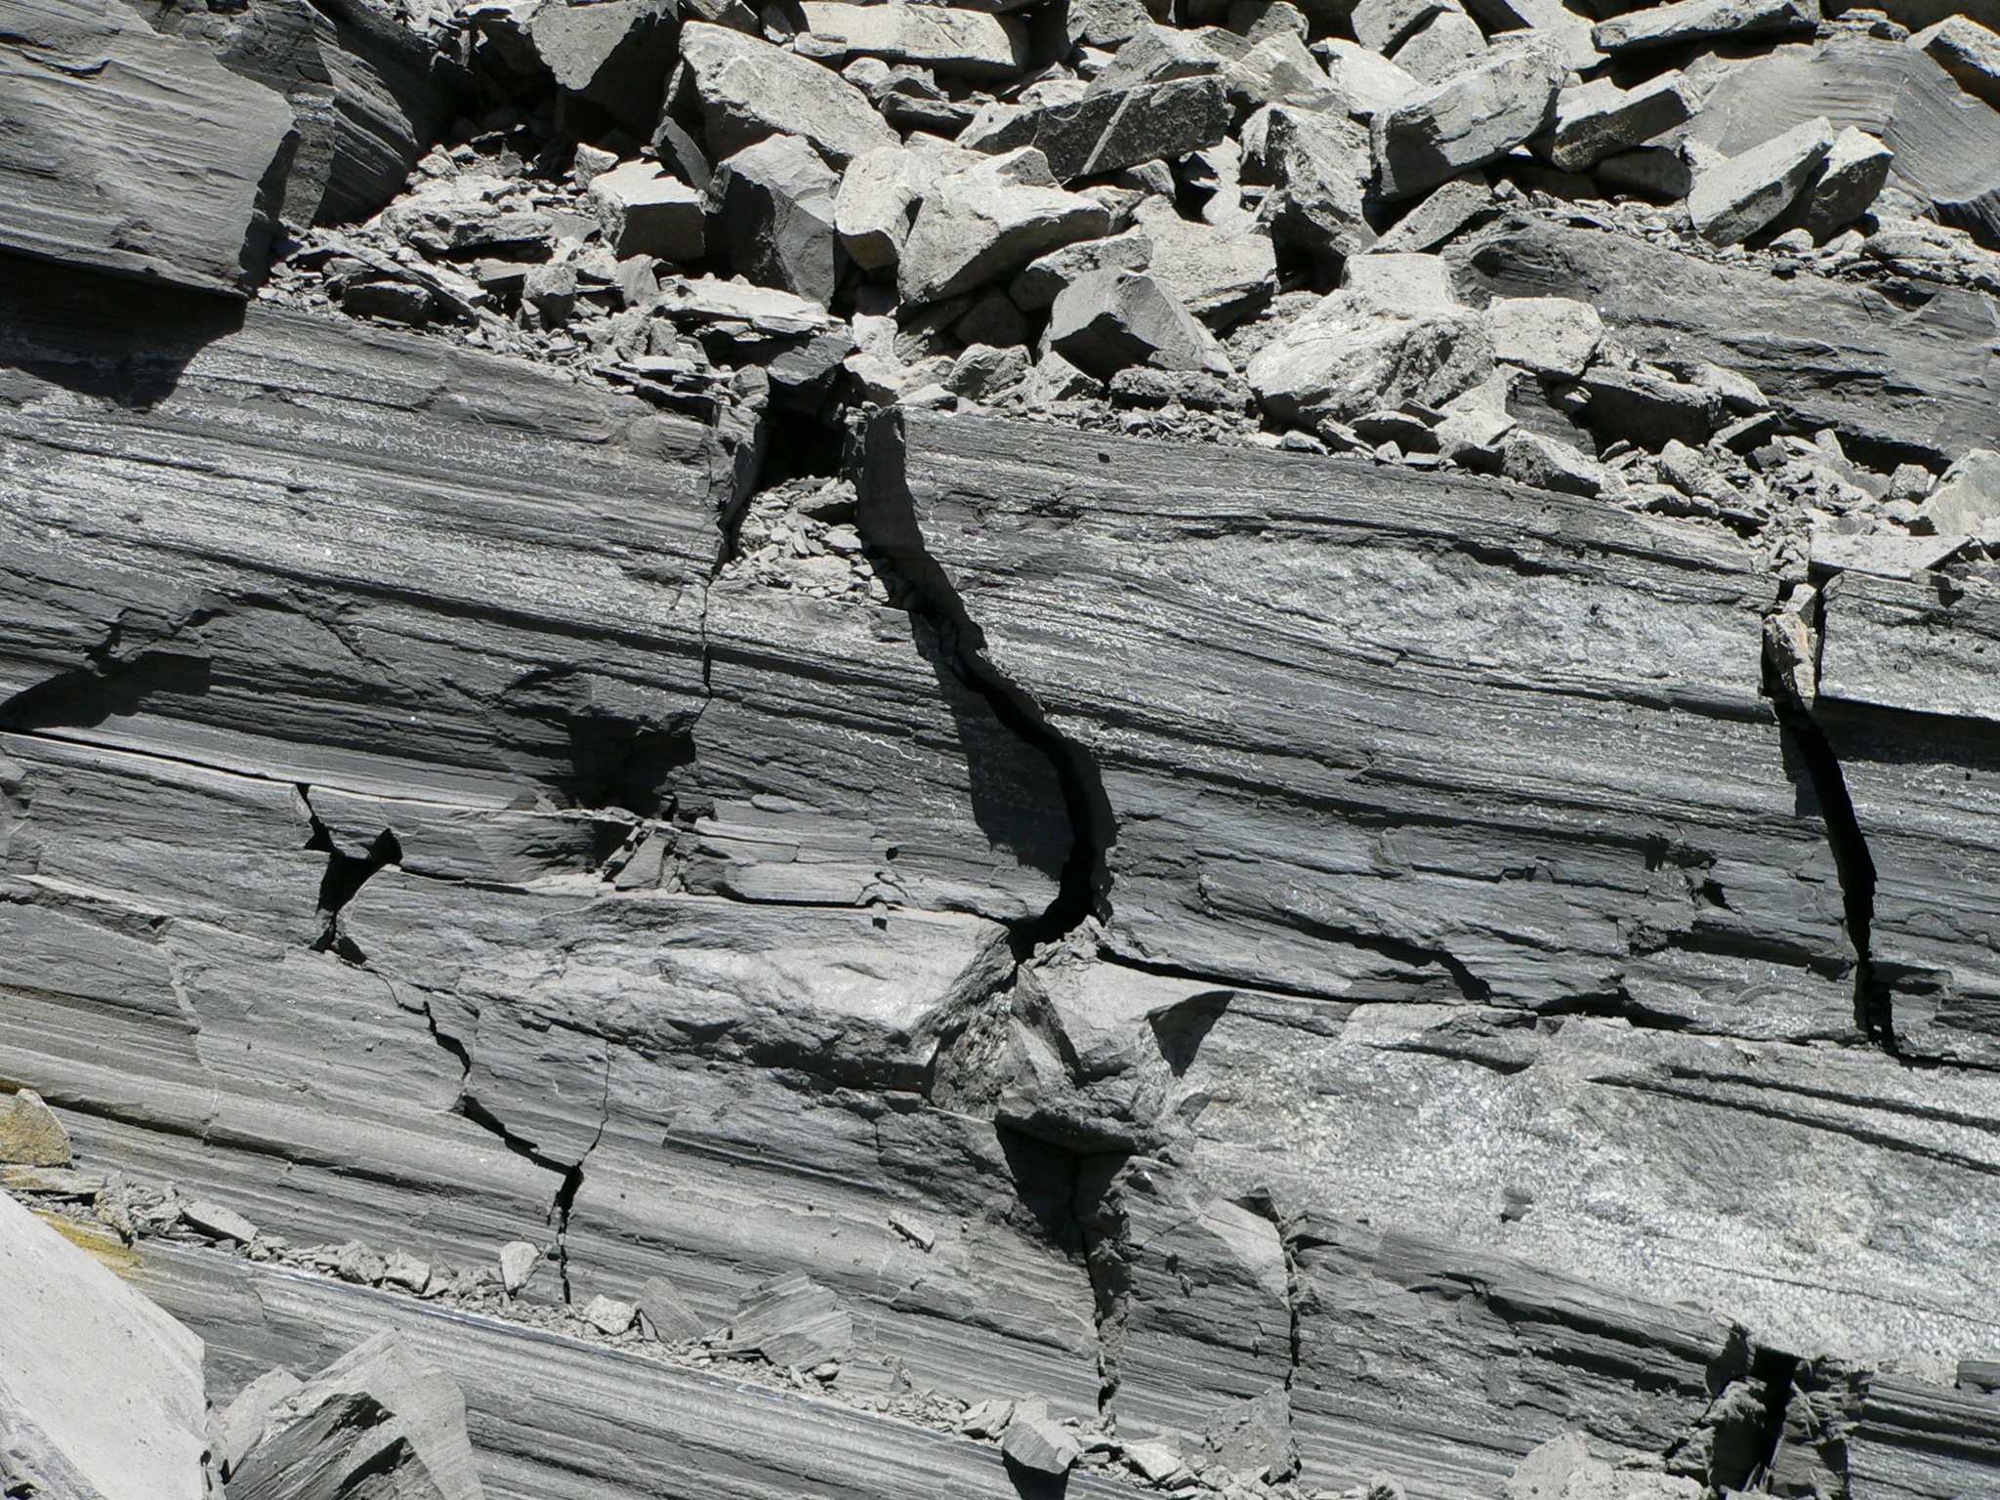
Ore zone 430 with prominent siderite-rich boudins within Zn-rich shales; boudins possibly related to onset of D1 deformation and bedding-parallel movement in early stages of mineralisation
Geoff Derrick: SMEDG meeting, Sydney Thursday 28 September 2023

Slide 34
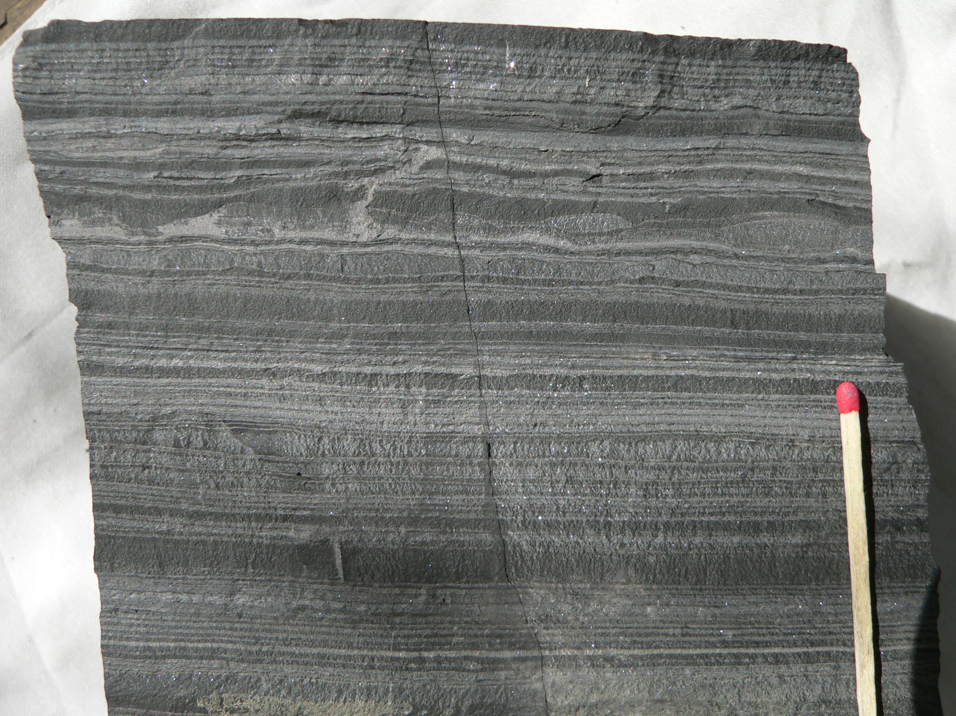
TOP
Zn-rich microbreccia ‘dykes’
Boudins
Zone 430 with zone of nodular boudinage in Zn-rich shale; boudin zone contains a layer of pale sphalerite which grades into cross-layer veins of microbreccia comprising f.g shale fragments in matrix of pale sphalerite; these veins are similar to dewatering, compactional features, and may post-date boudin formation and any major bedding plane slip.
Geoff Derrick: SMEDG meeting, Sydney Thursday 28 September 2023

Slide 35
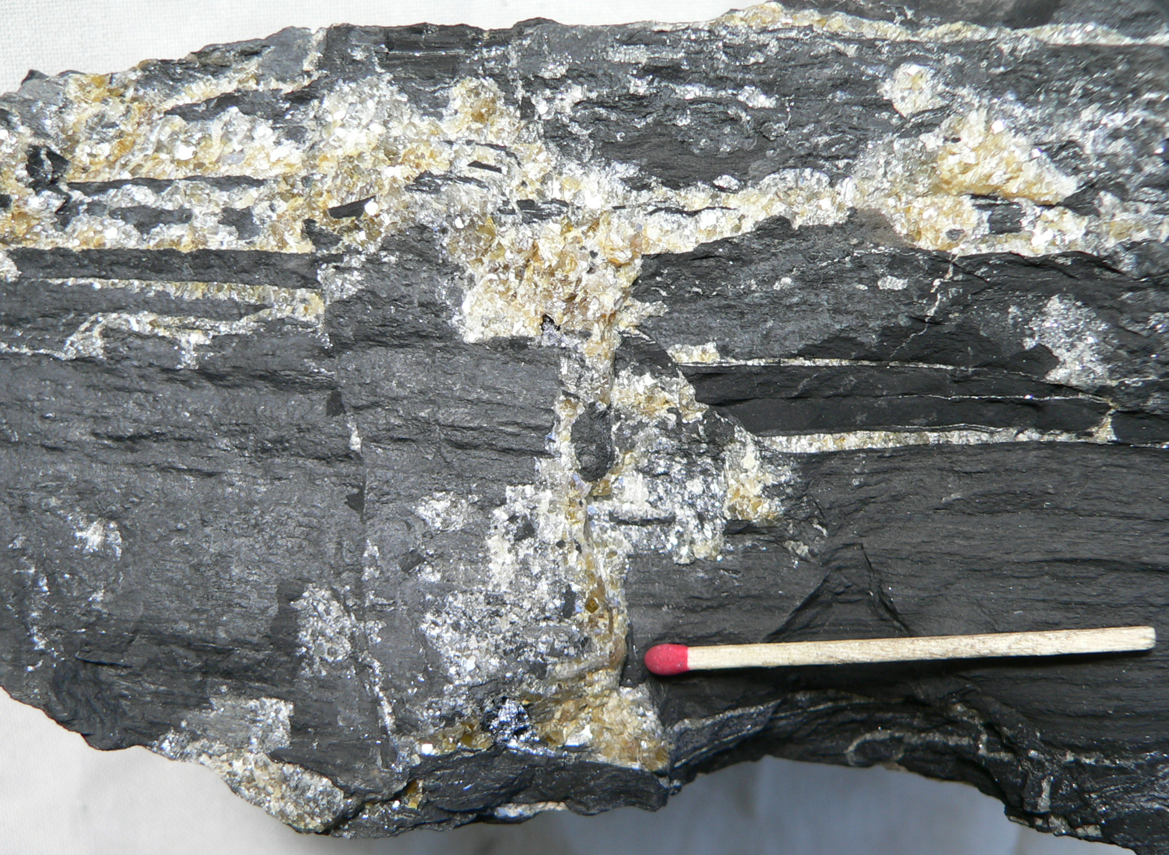
Coarse-grained honey sphalerite with minor galena cutting Zn-rich shale and carbonaceous shale.
Geoff Derrick: SMEDG meeting, Sydney Thursday 28 September 2023

Slide 36
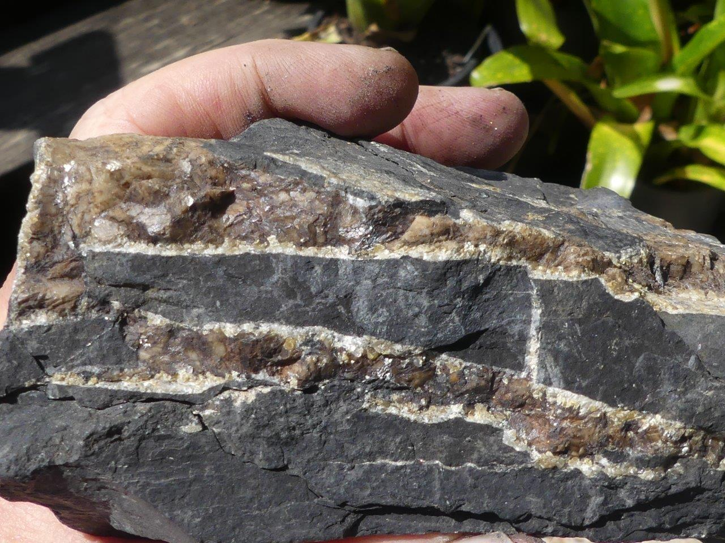
Veins of pale sphalerite with darker brown late siderite infill
Geoff Derrick: SMEDG meeting, Sydney Thursday 28 September 2023

Slide 37

In detail, there is significant consumption of matter at Century
Family Guy
Homer
Geoff Derrick: SMEDG meeting, Sydney Thursday 28 September 2023

Slide 38
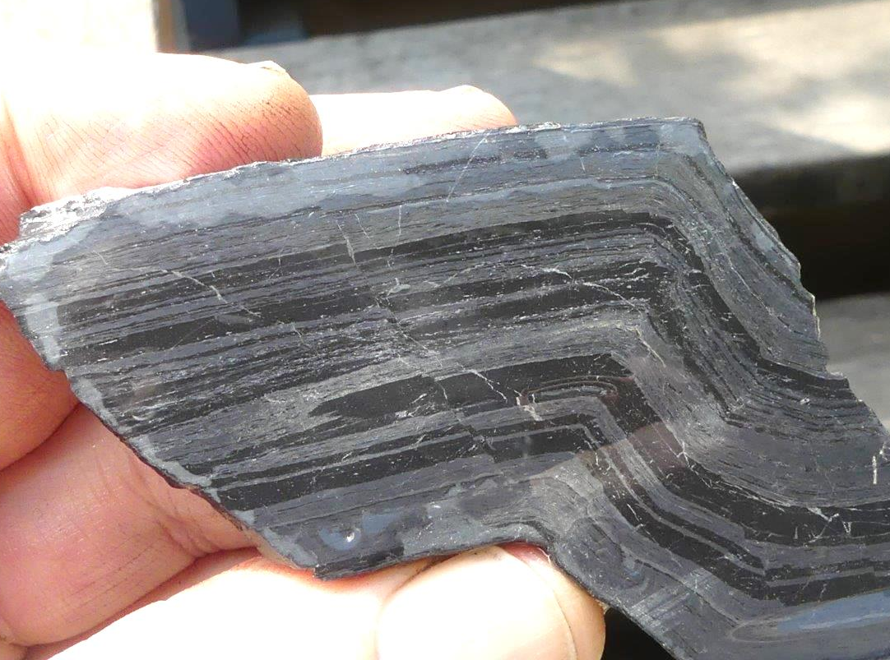
X
X
X
X
Carbonaceous shale replaced by sphalerite
Dr Geoff Derrick , G.M.Derrick Geology
AIG Meeting 9 Oct. 2018
Geoff Derrick: SMEDG meeting, Sydney Thursday 28 September 2023

Slide 39


Which brings us to petrographic and TEM* studies of the (old) Century deposit
* TEM – High Voltage
Transmission Electron Microscopy
Sharper and more focussed beam means resolution down to nanometres
Research by Stafford McNight and Andy Wilde
Geoff Derrick: SMEDG meeting, Sydney Thursday 28 September 2023

Slide 40
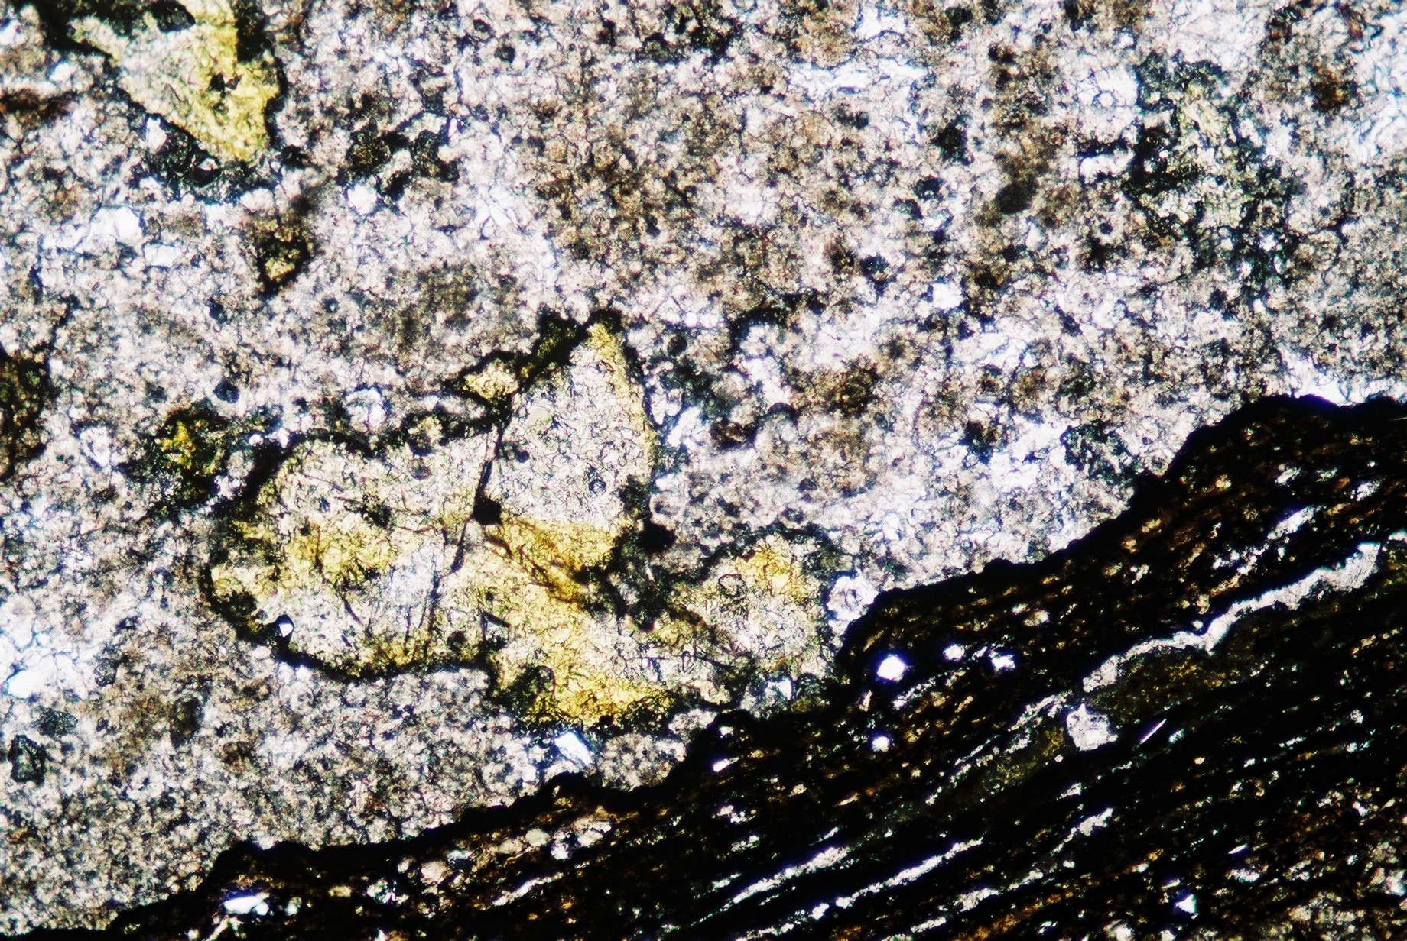
Sideritic layer, unit 100, HW; note coarse-grained and clear yellowish sphalerite (plain light)
carbonate
sphalerite
Carb. shale
0.09mm
Geoff Derrick: SMEDG meeting, Sydney Thursday 28 September 2023

Slide 41
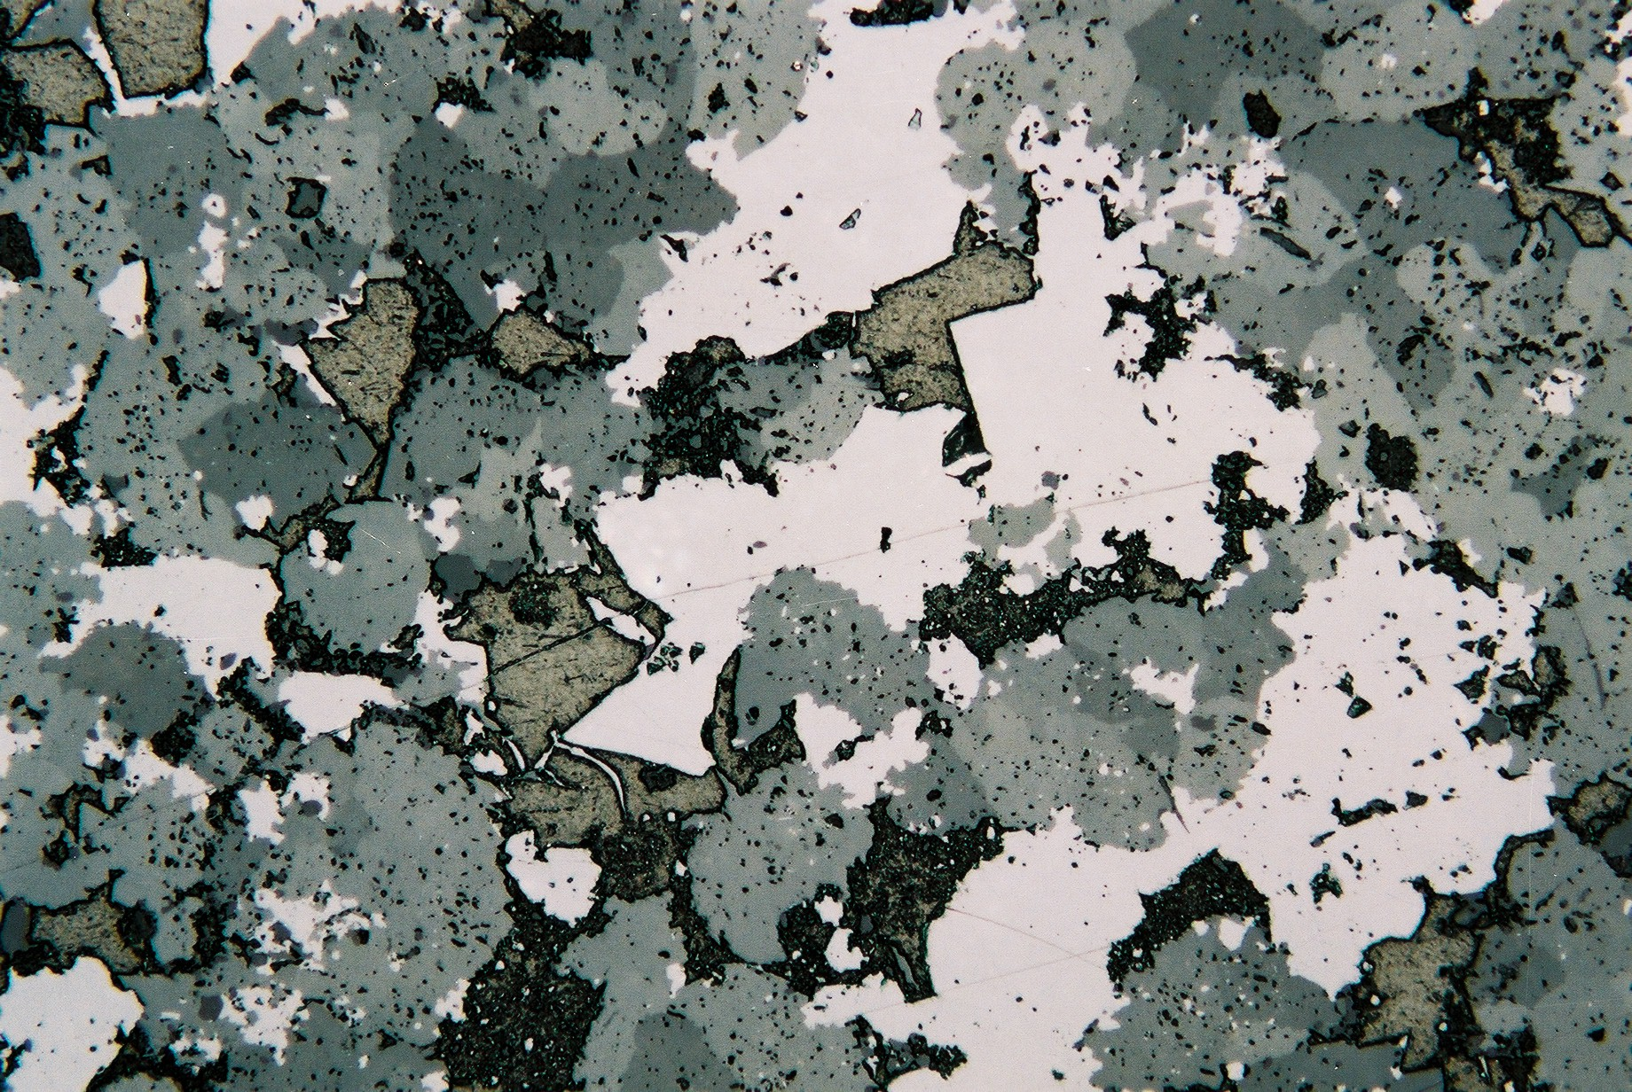
Petrographic features in carbonate rocks
1
2
3
Zn-bearing carbonate from near barren zone 420: Detail of siderite-rich layer, showing massive microcrystalline aggregate of siderite (1) - light to dark grey mottled grains, intergrown with paler grey to white, clear sphalerite (2); olive brown grains are carbonaceous material - c.g. infill of pyrobitumen (3). Sphalerite constitutes about 20 to 30% of this layer.
0.04mm
Geoff Derrick: SMEDG meeting, Sydney Thursday 28 September 2023

Slide 42
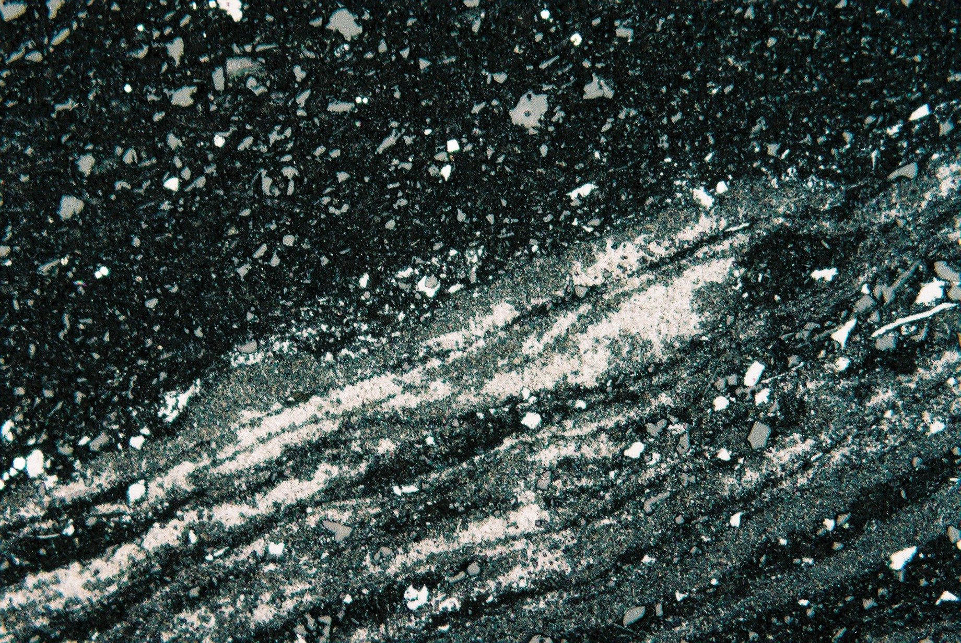
Petrographic features in Zn-rich siltstone
From zone 430 high grade Zn; sample shows two types of sphalerite - the dark, inclusion-rich porous sphalerite mediated by liquid hydrocarbon (??), and clear, white inclusion-free sphaleite mediated by gas (??) in reservoir.
Subtle fining direction??
Which brings us to petrographic and TEM studies of the (old) Century deposit
Carbonaceous siltstone with quartz
White translucent sphalerite
NP
Replacement
front?
P
Geoff Derrick – QUT presentation Century Zn mine, 25 March 2009
0.04mm
Geoff Derrick: SMEDG meeting, Sydney Thursday 28 September 2023
Grey carbonaceous sphalerite

Slide 43
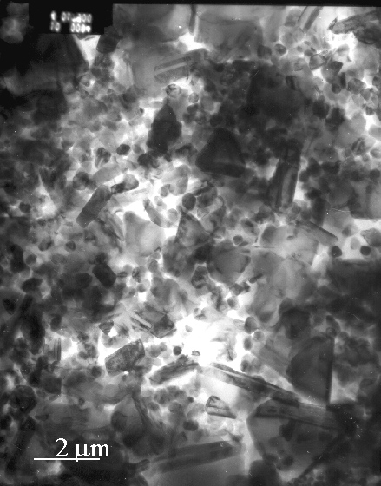
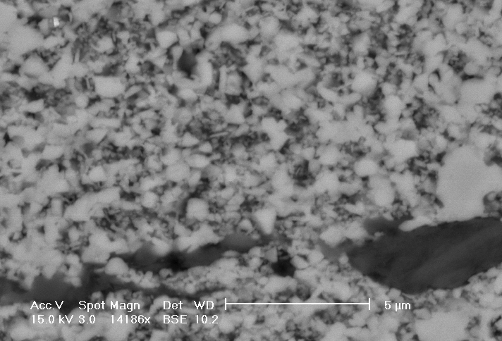
With TEM, the porous sphalerite now looks like this
SEM
TEM
Century “Porous” sphalerite –300kV TEM images
“Porous” is not an appropriate description – really myriads of crystallites of ZnS “floating” in bitumen –

Slide 44
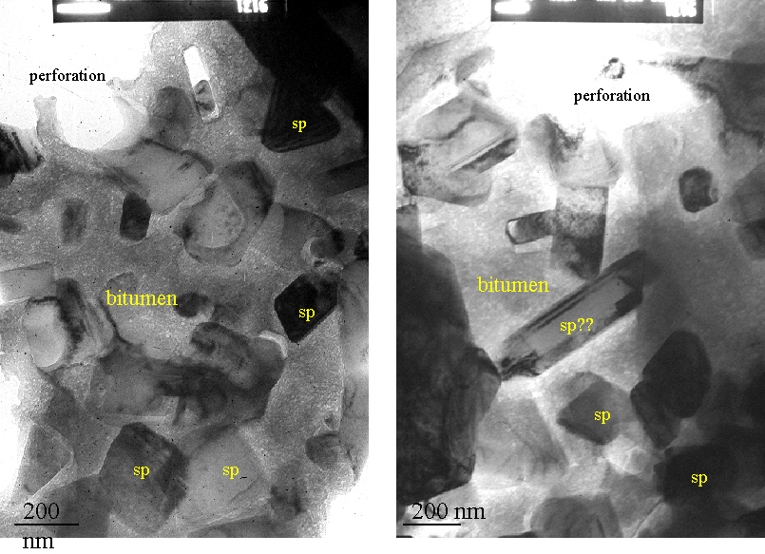
Highly bituminous porous sphalerite x50,000
Postage stamp become 1km square ?
Geoff Derrick: SMEDG meeting, Sydney Thursday 28 September 2023

Slide 45
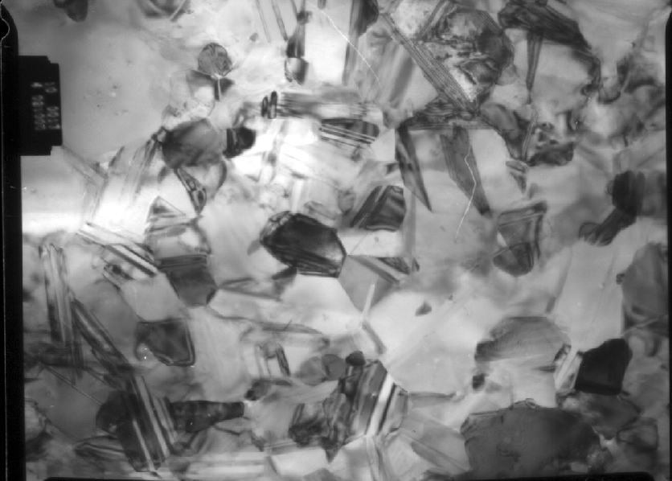
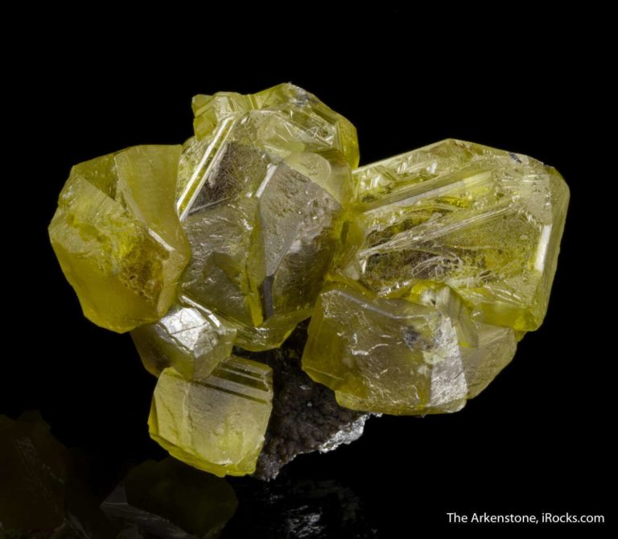
Non-porous sphalerite – NO hydrocarbon: x21,000
4cm x 5 cm specimen
1μm
Geoff Derrick – QUT presentation Century Zn mine, 25 March 2009
Geoff Derrick: SMEDG meeting, Sydney Thursday 28 September 2023

Slide 46

Transition from porous to non-porous sphalerite is a recrystallisation process known as “ostwald ripening”
P
NP
Geoff Derrick: SMEDG meeting, Sydney Thursday 28 September 2023

Slide 47
Back to our original sample – porous predates non-porous, and hydrocarbon generation and sphalerite look like an equilibrium assemblage.
Replacement
front?
Geoff Derrick – QUT presentation Century Zn mine, 25 March 2009
0.04mm
Geoff Derrick: SMEDG meeting, Sydney Thursday 28 September 2023

Slide 48

Timing of siderite clearly post-dates the Century ore-host siltstones
After Broadbent et al 2002

Slide 49

Although CENTURY is late diagenetic and quite unique, it shares many characteristics of sedex Pb-Zn deposits everywhere.
It is associated with growth faults and extension
It occurs in a carbonaceous 2nd or 3rd order basin within platformal environments
It is Pb-Zn-Ag only, deposited from large oxidising fluid systems, with metal sources from coarse volcanoclastics deeper in the section, Fluid temp. 150 to 250ºC.
From Large et al., 1998 V. 93(8)
Geoff Derrick: SMEDG meeting, Sydney Thursday 28 September 2023

Slide 50
Century
A very important roadcut exists between Mt Isa and Mary Kathleen – noted by the author as hosting an excellent tuff bed in the Mary Kathleen Group.
Mt Isa
Mary Kathleen
Geoff Derrick: SMEDG meeting, Sydney Thursday 28 September 2023

Slide 51

Basal eluvial /continental / fluvial facies – basal unconformity – Mary K Gp
1755Ma calcareous arkose
1780 Ma
felsic volcanics
ARGYLLA FMN
Geoff Derrick: SMEDG meeting, Sydney Thursday 28 September 2023

Slide 52

1755 Ma
1780 Ma
25 Ma time gap on this line
Geoff Derrick: SMEDG meeting, Sydney Thursday 28 September 2023

Slide 53

Basal Mary K Gp
Arkosic grits above the u/c
Geoff Derrick: SMEDG meeting, Sydney Thursday 28 September 2023

Slide 54

1755 Ma
Unmapped tuff bed in lower Mary K Gp – no outcrop outside of roadcut
Geoff Derrick: SMEDG meeting, Sydney Thursday 28 September 2023

Slide 55

Reworking of tuff in overlying sands
sandstone
tuff
Geoff Derrick: SMEDG meeting, Sydney Thursday 28 September 2023

Slide 56

Diagrammatic section – Mary Kathleen Group and equivalents: correlation achieved across the basement block
W
E
Shoreface and strand line facies
Shelf carbonate facies
Quilalar
Time lines (isochrones)
Corella Fmn
1755 Ma
Myally Subgroup
Basal lenticular continental and eluvial/fluvial facies
Leichhardt River Fault Trough
Basement granite and volcanics
General direction of sag-induced onlap and transgression, over 100km E-W
Geoff Derrick: SMEDG meeting, Sydney Thursday 28 September 2023

